Slide 1

MAKE GOOD THINGS HAPPEN
Day 2 ANIMALS
Materials free for classroom use

Slide 2



stretch 1
Make your body loose and free
Swing your arms open and hug yourself 5 times

Slide 3


stretch 2
Make your body loose and free
Flap your arms like a bird 5 times

Slide 4





stretch 3
Make your body loose and free
Roll your shoulders in a circle 5 times

Slide 5


cloud meditation
Press
cloud
to
play

Slide 6
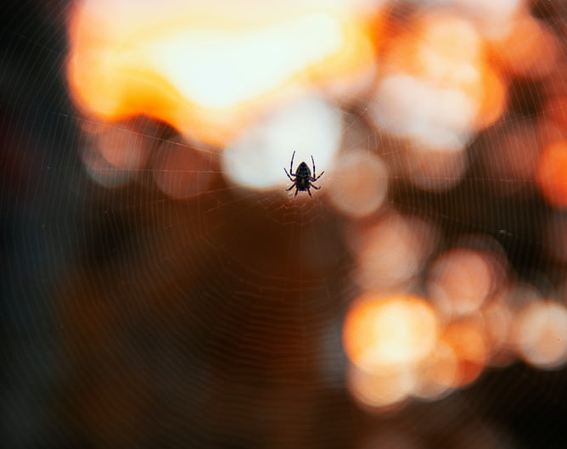
MESSAGES from NATURE
Go outside and notice a small creature that people can miss.
WATCH IT FOR 1 MINUTE.
Listen to it and see if it wants to tell you something.
Write down its message.

Slide 7
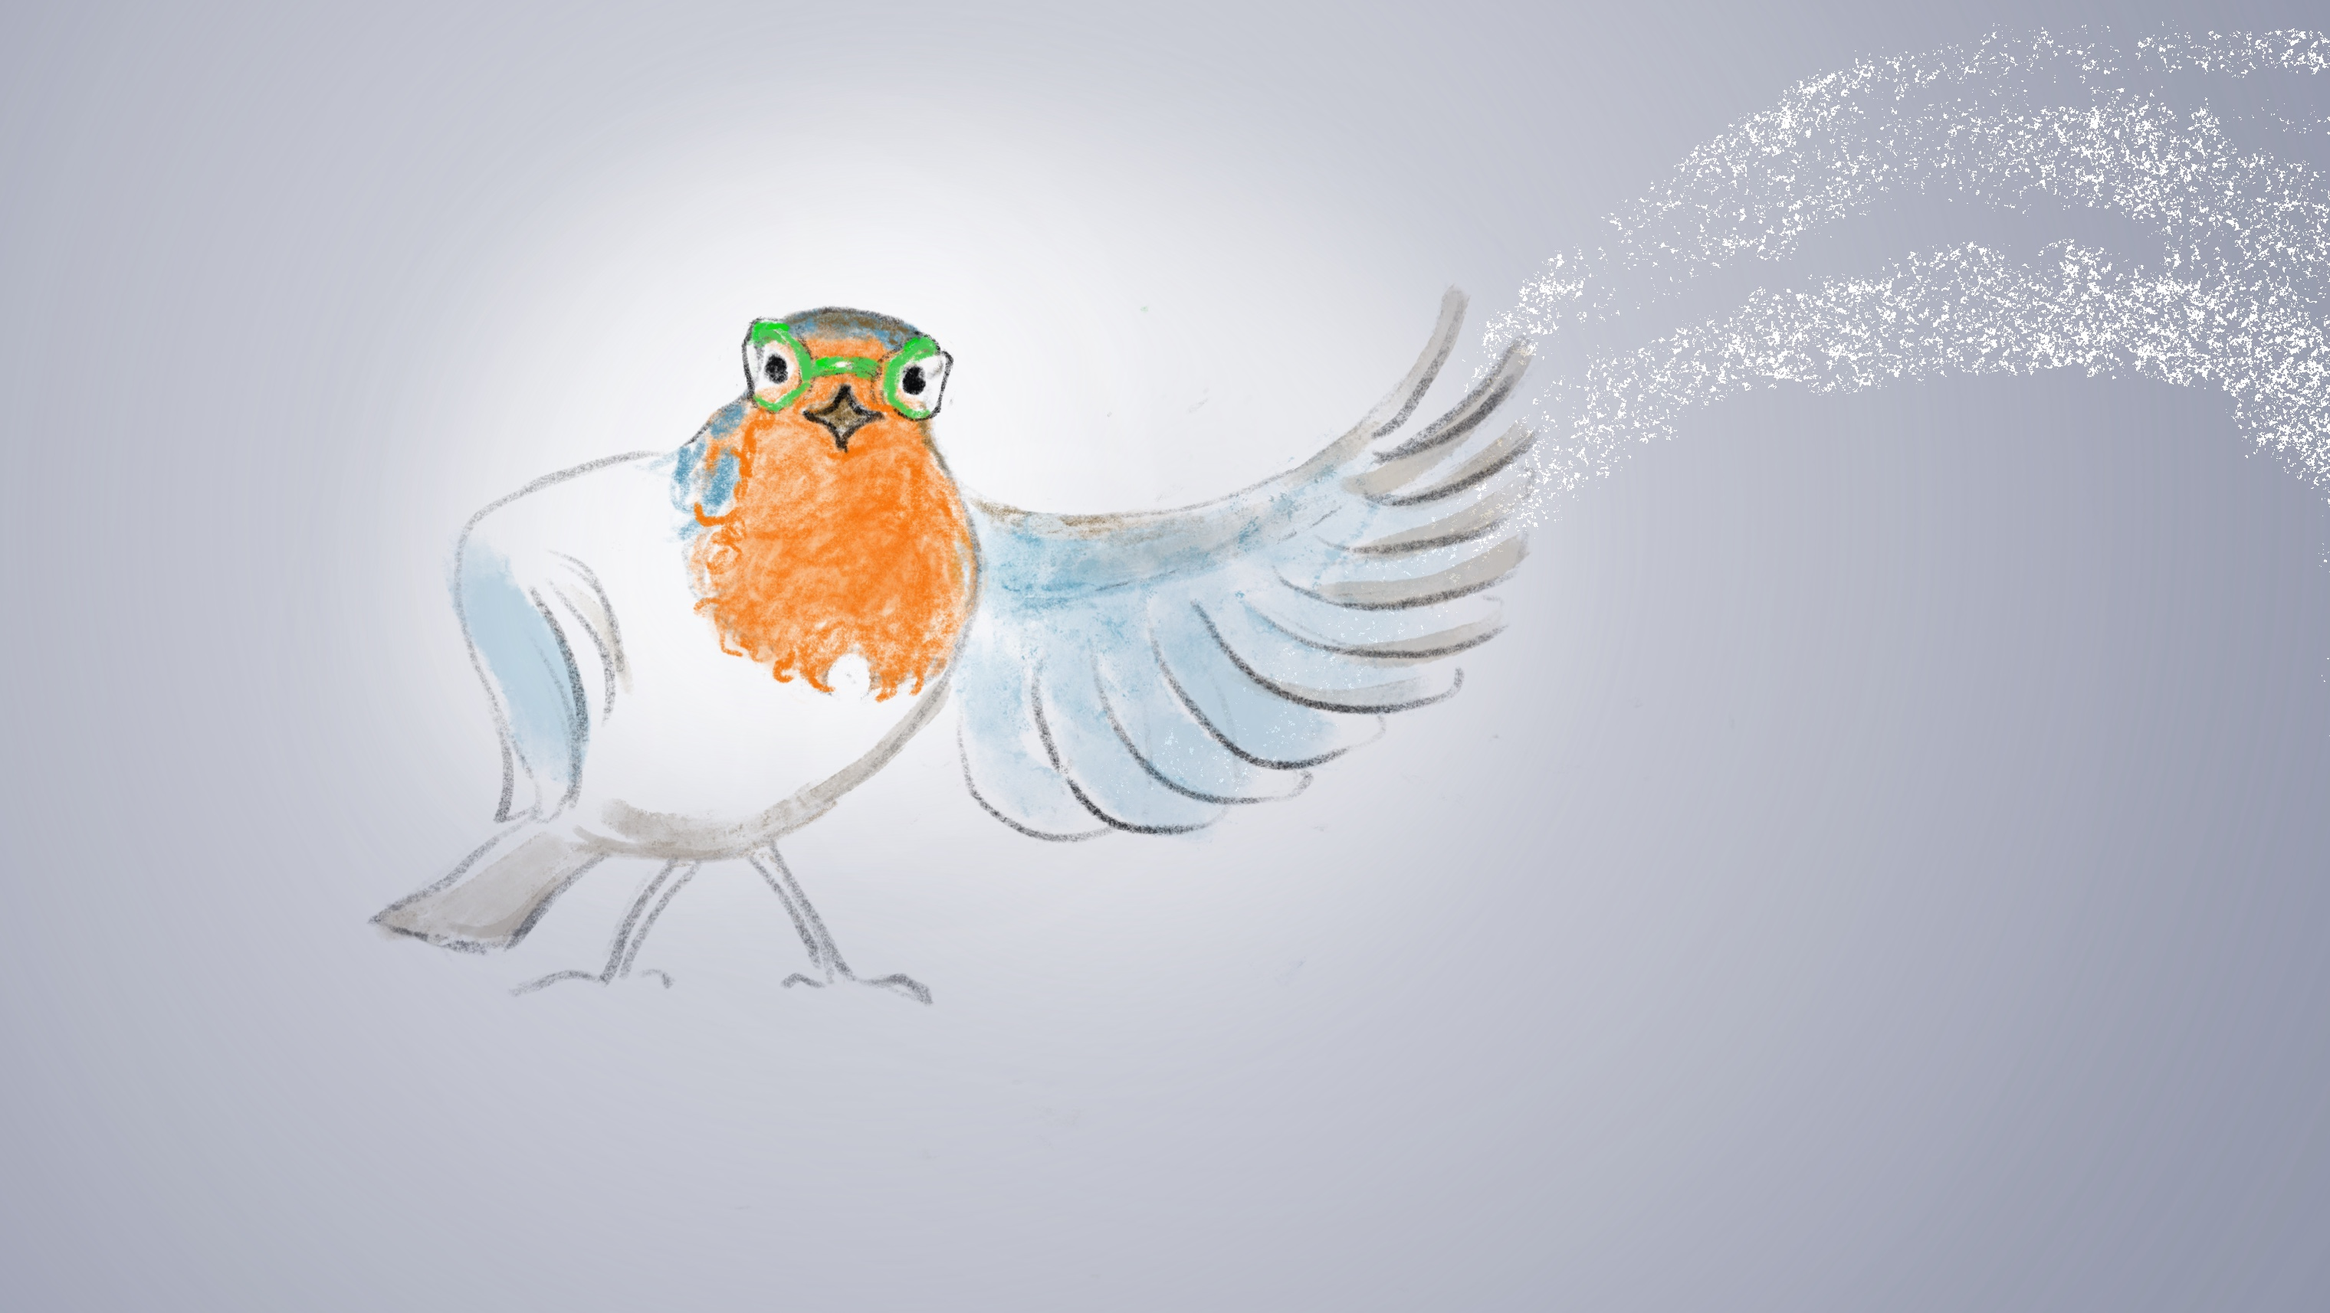
Robyn and the
Three Secrets
Chapter 2

Slide 8
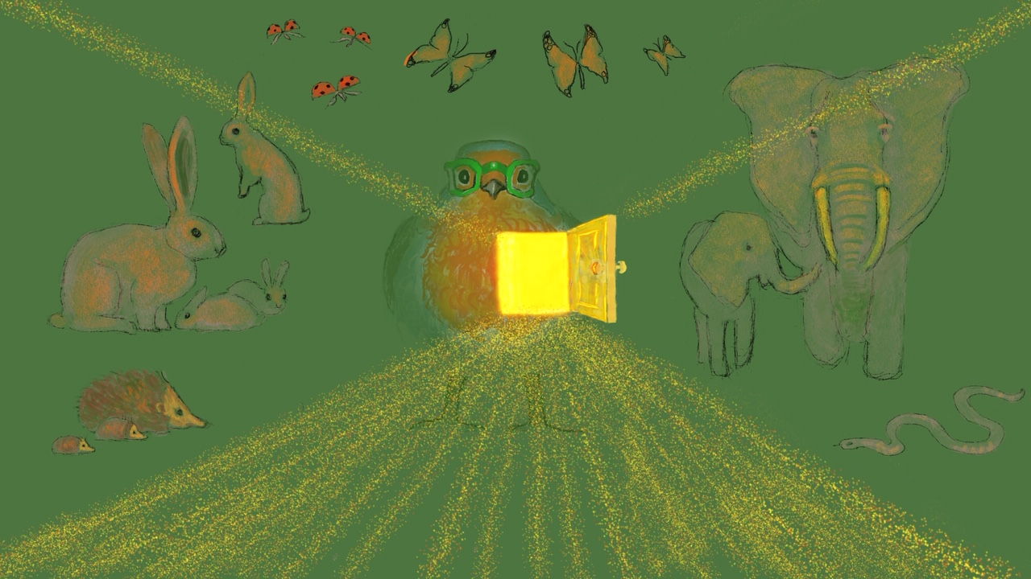
Send Rays
of Heartle
to animals
Press to play
Press to play

Slide 9
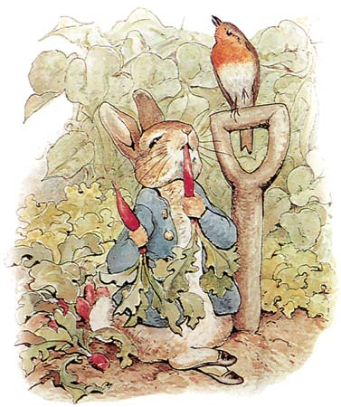
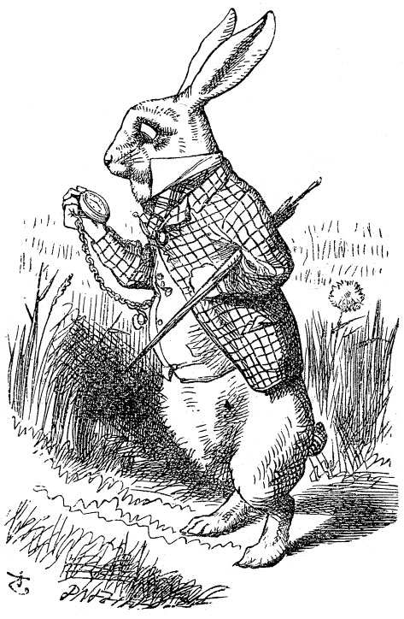
Design a RABBIT TOY
DRAW a rabbit from your imagination
CUT it out
MAKE a cut out outfit with tabs
Design clothes for the rabbit that are fun or beautiful
The aim is to design a new toy to make people happy

Slide 10
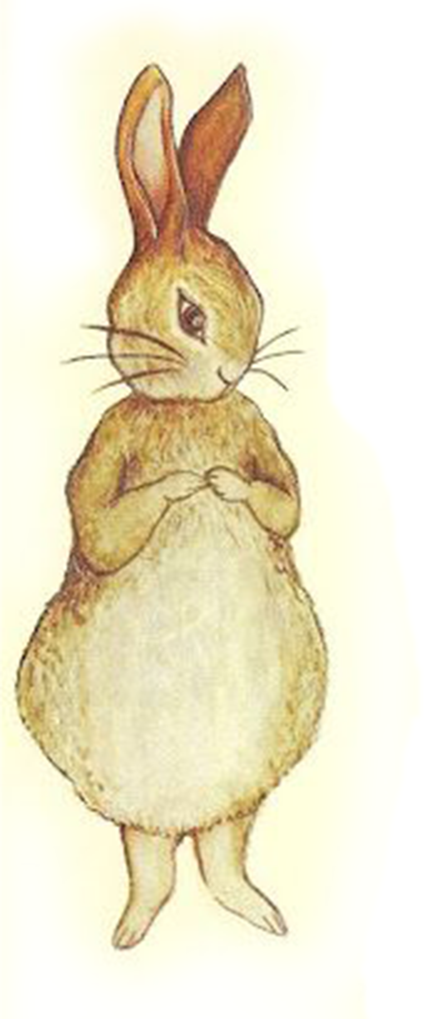
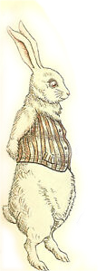
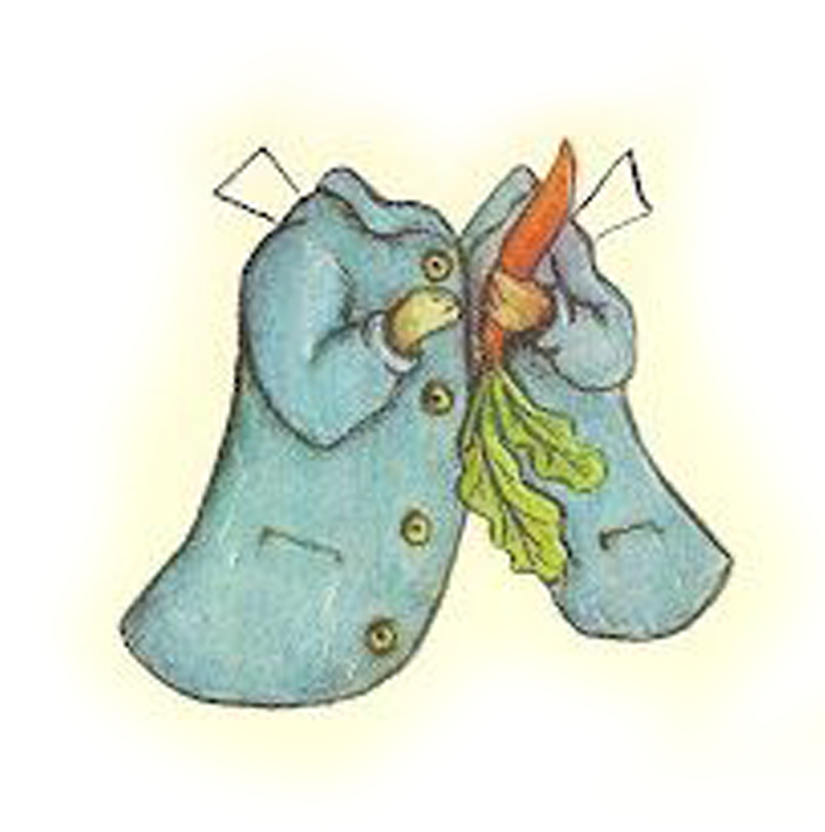
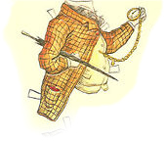
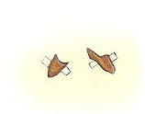
With cut out clothes you can try different outfits
These characters are from over 100 years ago
Make tabs
On the clothes to fold over the rabbit
The character you create could be dressed in wild and wonderful outfits, from today’s styles or any time in history
Peter Rabbit
The White Rabbit from
Alice in Wonderland

Slide 11
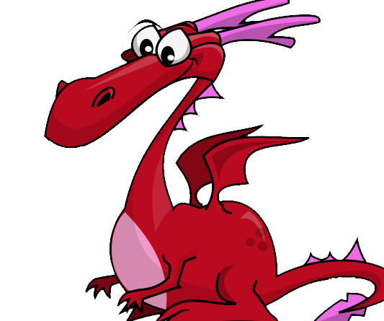
FEED THE DRAGON
Do you have any worries for the Dragon today?
Post them in the box.
He will enjoy a tasty meal of them.

Slide 12

Click for Folk Dancing website

Slide 13
End of the day stretches
Make your body loose and free

