Slide 1

MAKE GOOD THINGS HAPPEN
Day 8 OUR COMMUNITY
Materials free for classroom use

Slide 2



stretch 1
Make your body loose and free
Swing your arms open and hug yourself 5 times

Slide 3


stretch 2
Make your body loose and free
Flap your arms like a bird 5 times

Slide 4





stretch 3
Make your body loose and free
Roll your shoulders in a circle 5 times

Slide 5
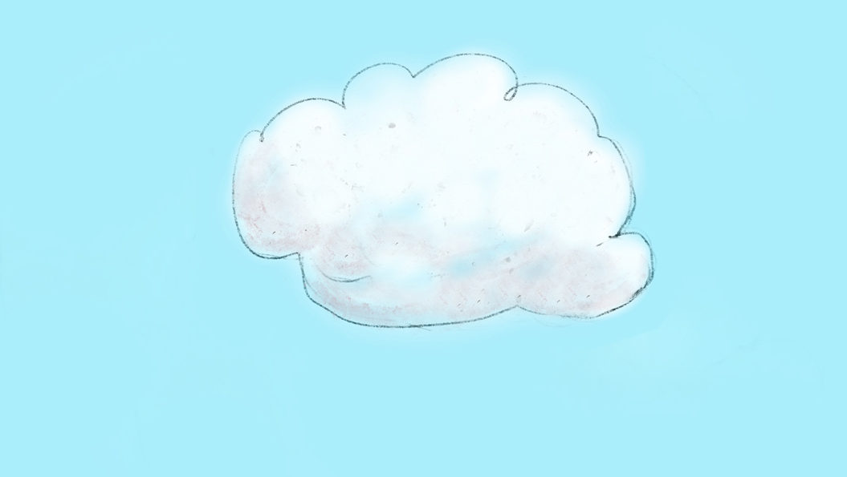

cloud meditation
Press
cloud
to
play

Slide 6
Secret lives
.

Slide 7
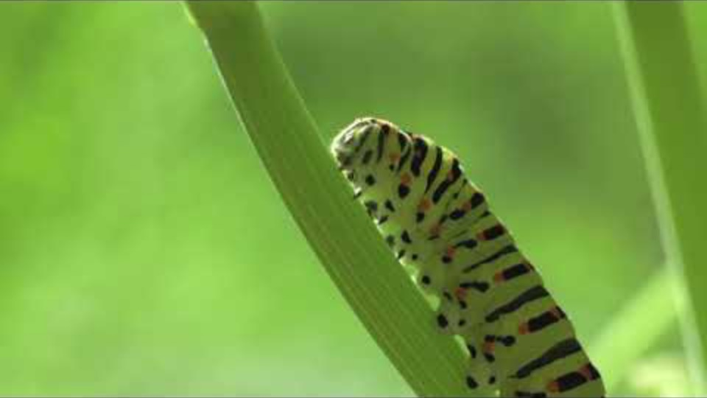
.
Film clip - click and wait to load.
Make sure you have enabled live content below menu bar.

Slide 8
What creatures
did you spot?
.

Slide 9
Secret lives
You would be surprised at all the animals that have secret lives around the school.
Some come out at night.
Some live under stones.
Or hide underneath leaves.
Go outside and see if you can find any secret creatures
imagine which creatures come out at night here
investigate where their secret homes might be….
Choose a secret creature and write a story about their secret life

Slide 10
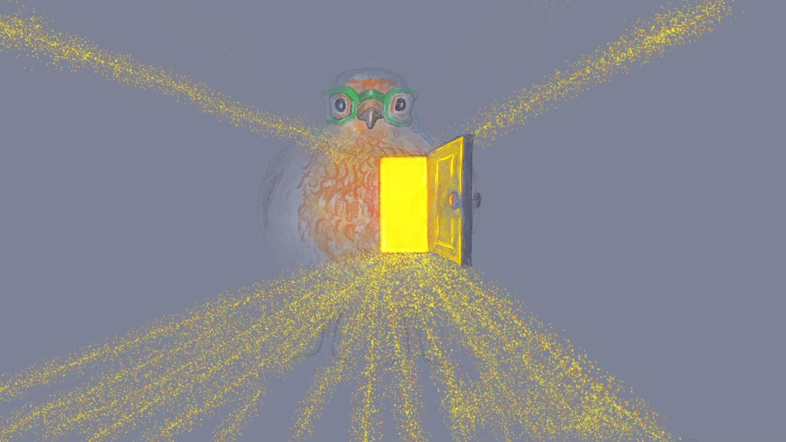
Send Rays
of Heartle
to our
community
Press to play

Slide 11
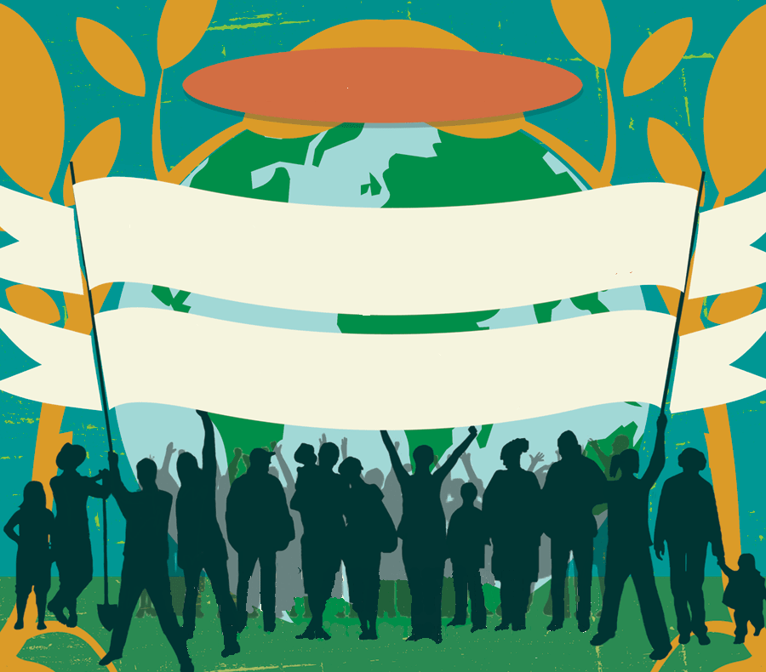
My Community Poster
Make a poster
To say why we love the place we live
and why we are proud of all the people that care for each other here.
You could display it on the school railings
or in a local shop
or local cafe
or a health centre
Where else could you put
a My Community Poster?
WE LOVE
Our Town
because…

Slide 12

Click for kids folk dancing website
http://resources.hwb.wales.gov.uk/VTC/2017/dawnsio-gwerin-english/index.html

Slide 13
End of the day stretches
Make your body loose and free

