Slide 1

MAKE GOOD THINGS HAPPEN
Day 7 MY SCHOOL
Materials free for classroom use

Slide 2



stretch 1
Make your body loose and free
Swing your arms open and hug yourself 5 times

Slide 3


stretch 2
Make your body loose and free
Flap your arms like a bird 5 times

Slide 4





stretch 3
Make your body loose and free
Roll your shoulders in a circle 5 times

Slide 5


cloud meditation
Press
cloud
to
play

Slide 6
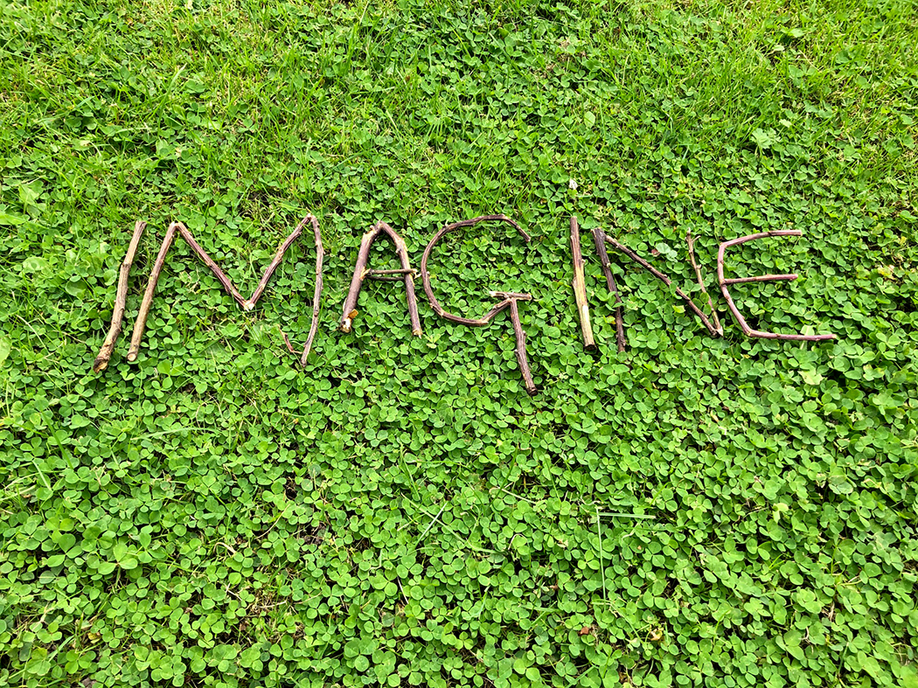
The sky is my friend
Nature Word Art
collect twigs
Think of one word to describe the best thing about school.
It could be … kind or amazing or fun … or something else from your imagination.
Make that word out of twigs and place in a interesting spot around the school grounds.
Lie on your back or gaze out of a window
and look up at the sky for a few minutes
Watch the clouds drifting by

Slide 7
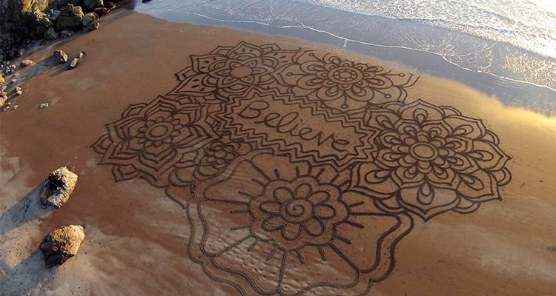
Word Art made on sand
.

Slide 8
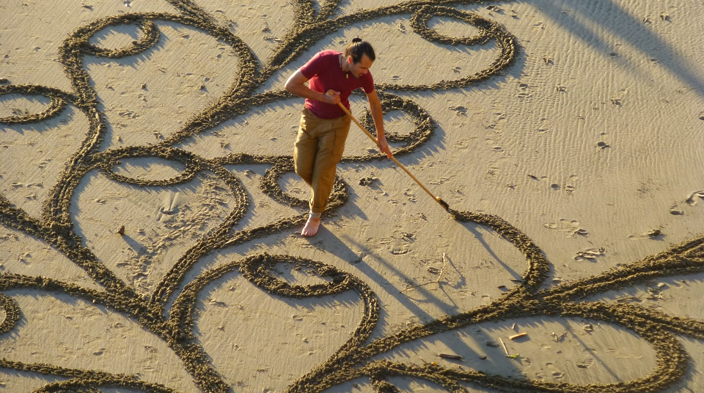
.
This is Andre Amador making giant art on a beach
with just a rake. He can only see what he has done from above.

Slide 9
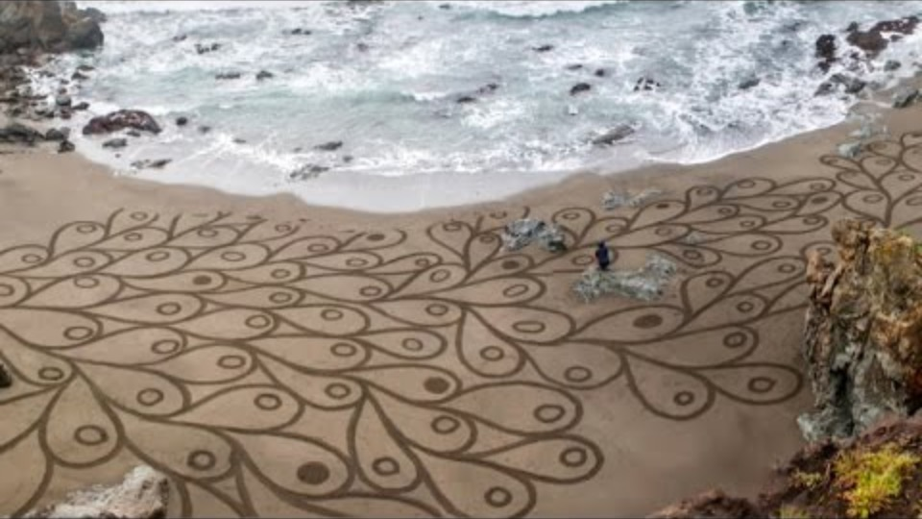
.
Film clip - click and wait to load.
Make sure you have enabled live content below menu bar.

Slide 10

Send Rays
of Heartle
to our
school
Press to play

Slide 11
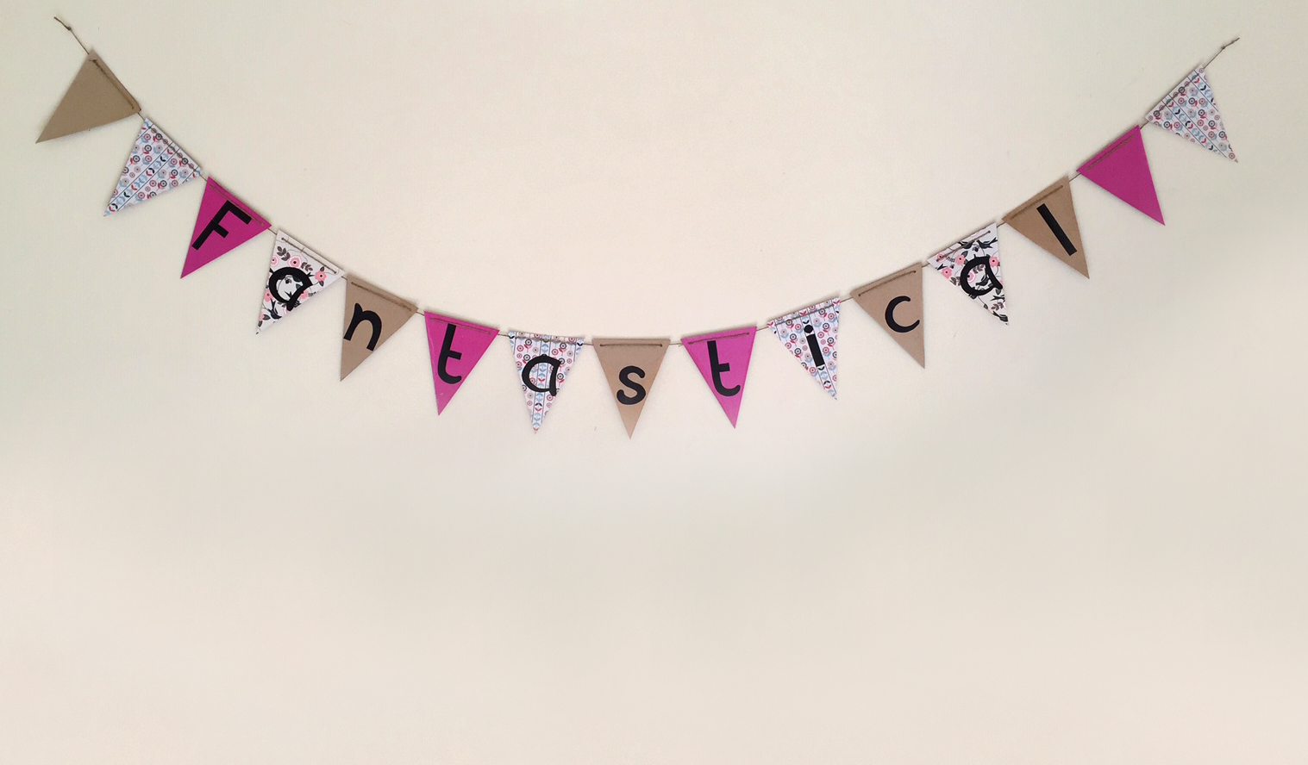
Make Bunting
Make bunting out of paper or fabric and string
To hang round the school to make people smile when they see it
Decorate it with patterns, words, colours

Slide 12

Click for kids folk dancing website
http://resources.hwb.wales.gov.uk/VTC/2017/dawnsio-gwerin-english/index.html

Slide 13
End of the day stretches
Make your body loose and free

