Slide 1

MAKE GOOD THINGS HAPPEN
Day 6 FAMILY
Materials free for classroom use

Slide 2



stretch 1
Make your body loose and free
Swing your arms open and hug yourself 5 times

Slide 3


stretch 2
Make your body loose and free
Flap your arms like a bird 5 times

Slide 4





stretch 3
Make your body loose and free
Roll your shoulders in a circle 5 times

Slide 5


cloud meditation
Press
cloud
to
play

Slide 6
The sky is my friend
Secrets underground
Secret world underground
Lie on your back or gaze out of a window
and look up at the sky for a few minutes
Watch the clouds drifting by

Slide 7
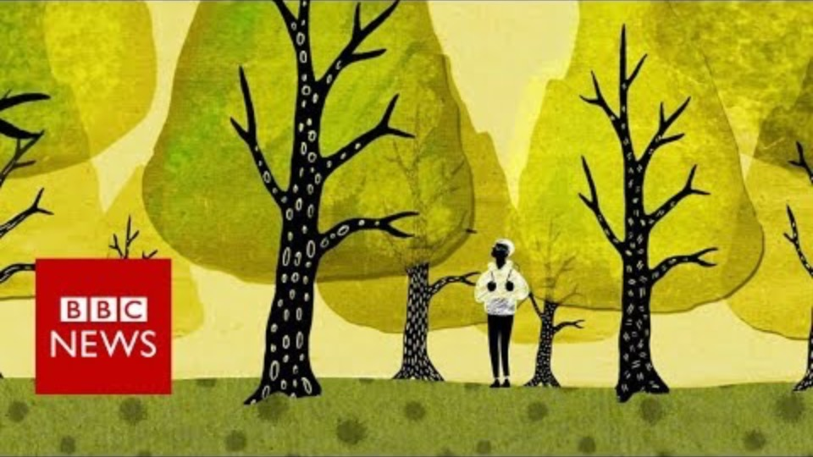
.
Film clip - click and wait to load.
Make sure you have enabled live content below menu bar.

Slide 8
Secrets underground
Feel the world beneath your feet
Go outside. Plant your feet firmly on the ground and close your eyes
For 1 minute…
imagine all the roots beneath your feet joined up with each other
Joining up every plant in every garden
Joining up all the trees in every forest
Feel all this happening beneath your feet
The sky is my friend
wherever I am
feels like home

Slide 9
TREE FAMILY
Draw a family of trees
with all the roots joined up underground.
Put beautiful colours on your drawing
to show all the things people can’t see.
All the amazing things happening in the roots beneath our feet.

Slide 10
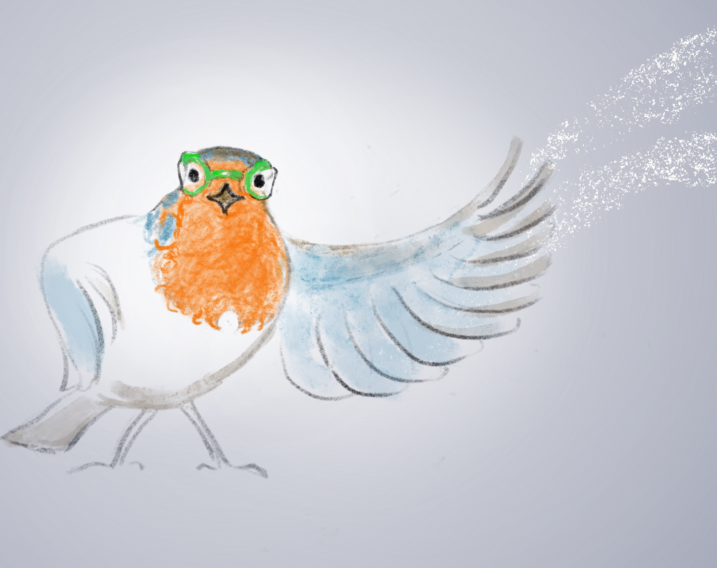
Robyn and the
Three Secrets
Chapter 3

Slide 11
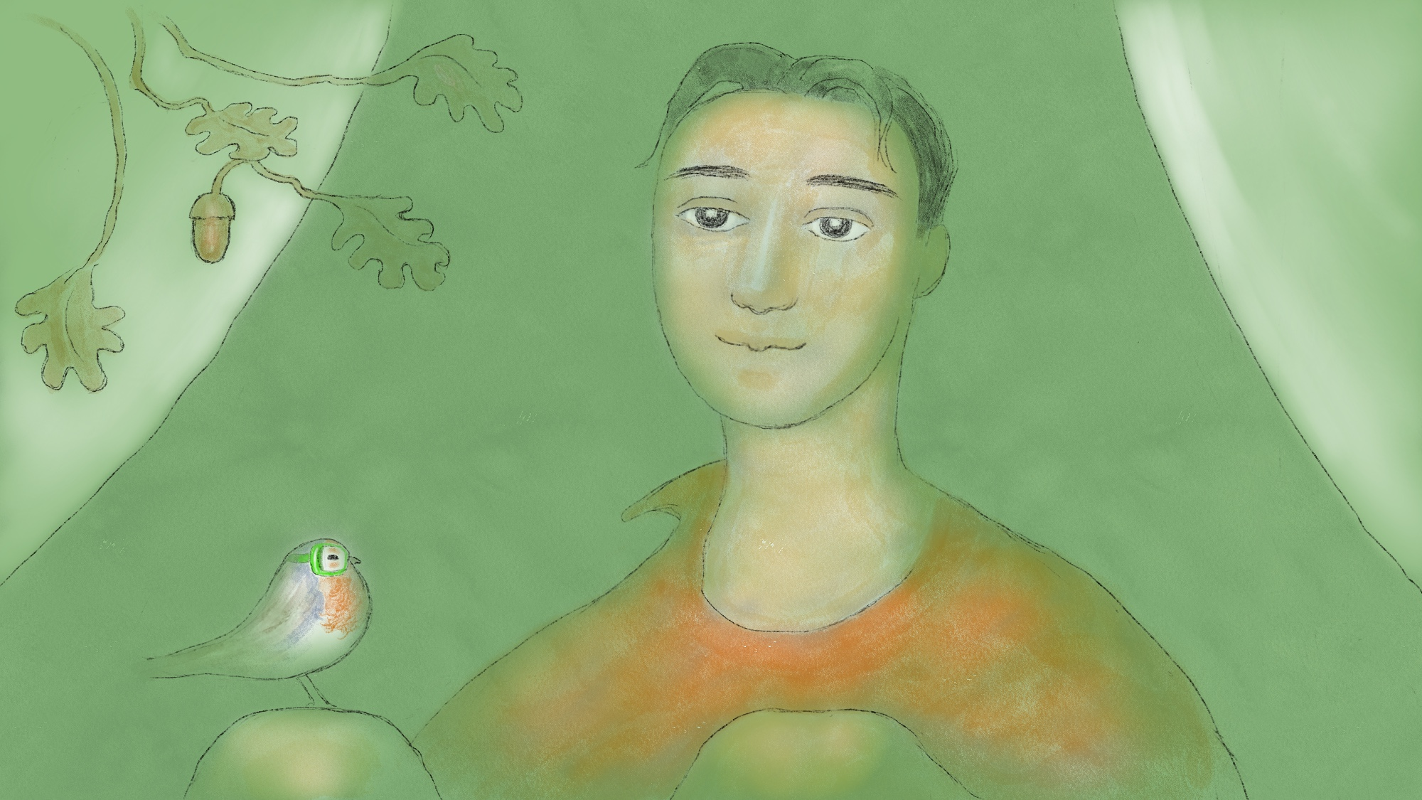

Slide 12
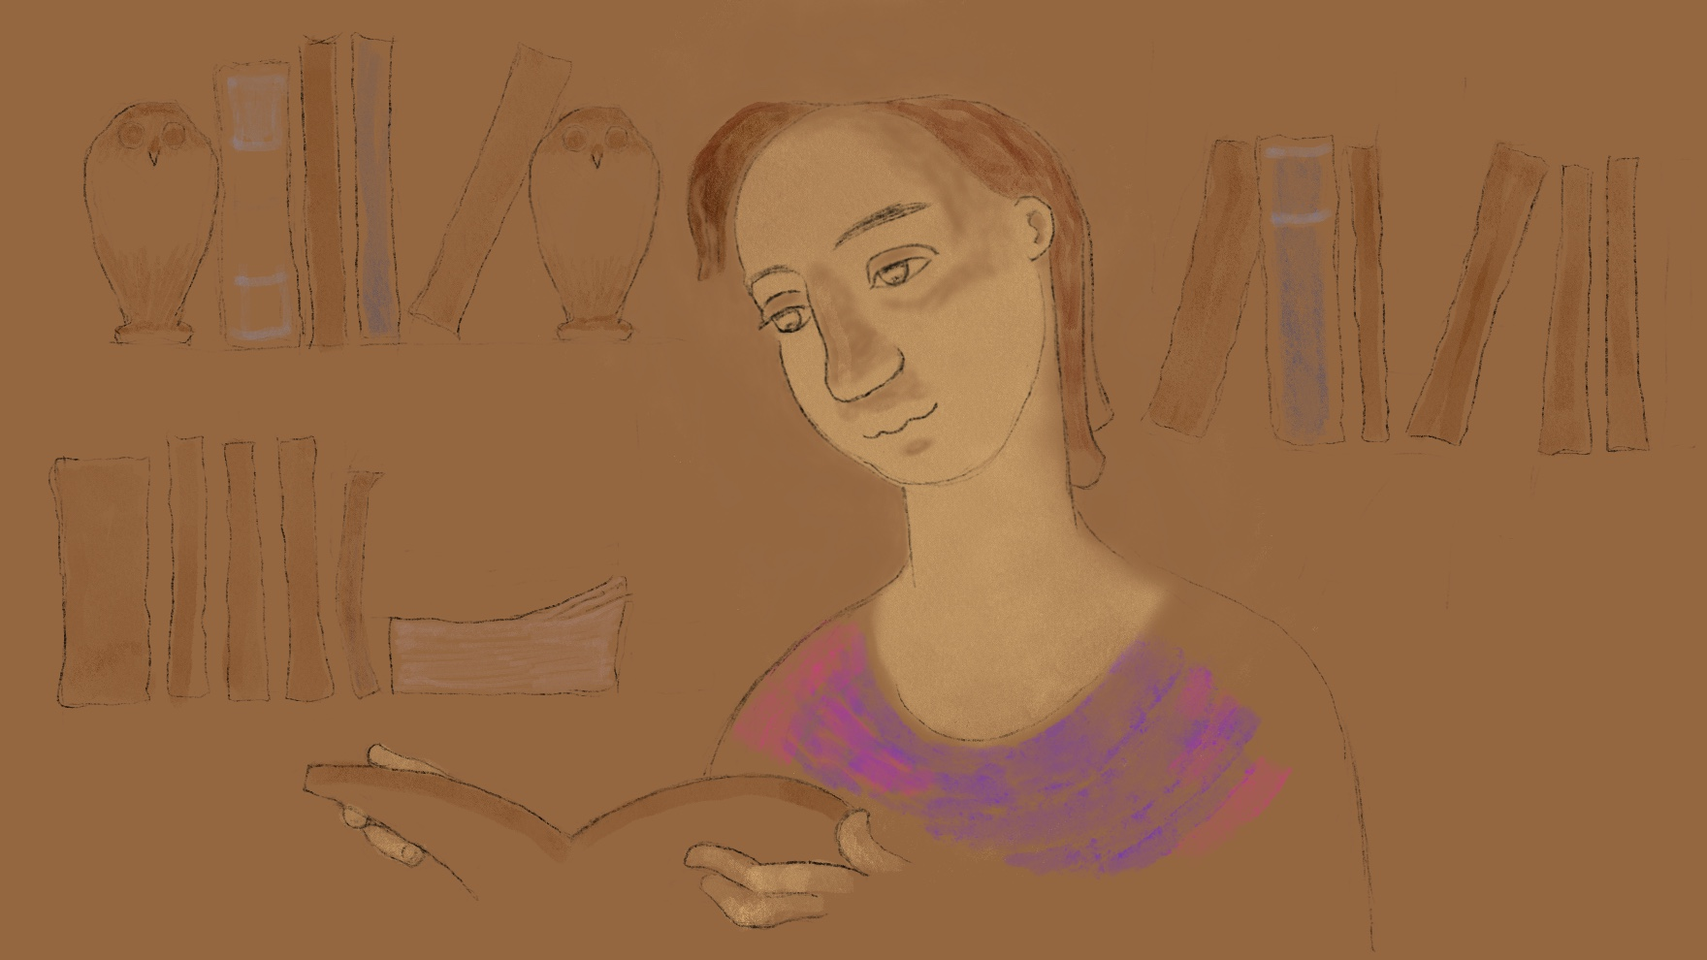

Slide 13
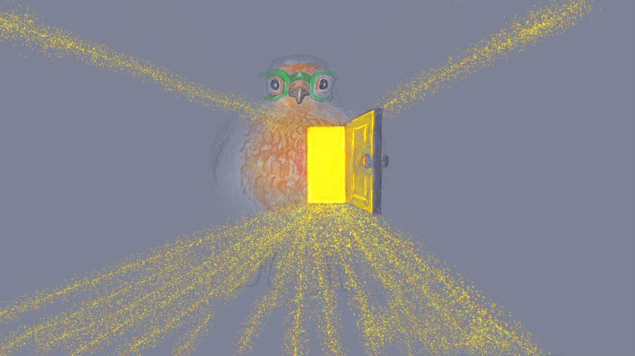
Send Rays
of Heartle
to our
family
Press to play

Slide 14
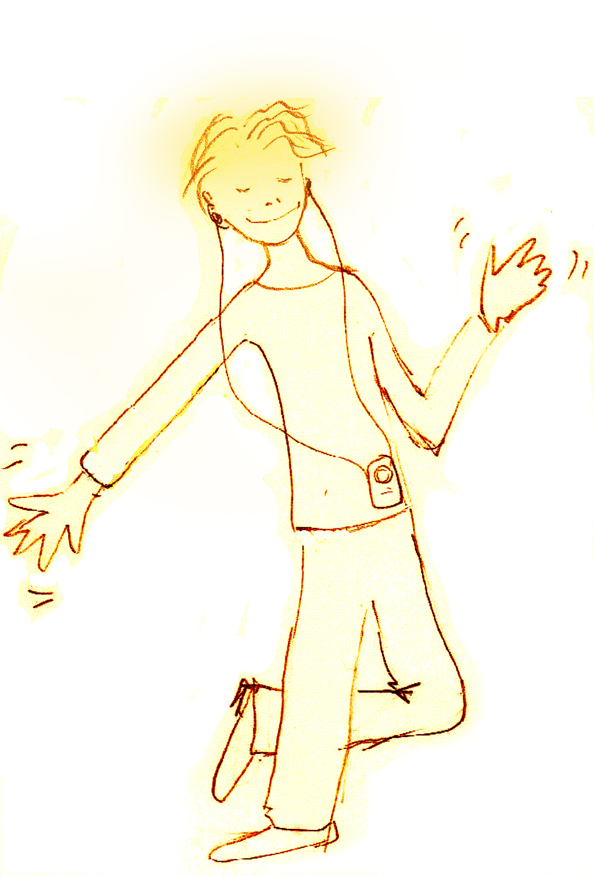
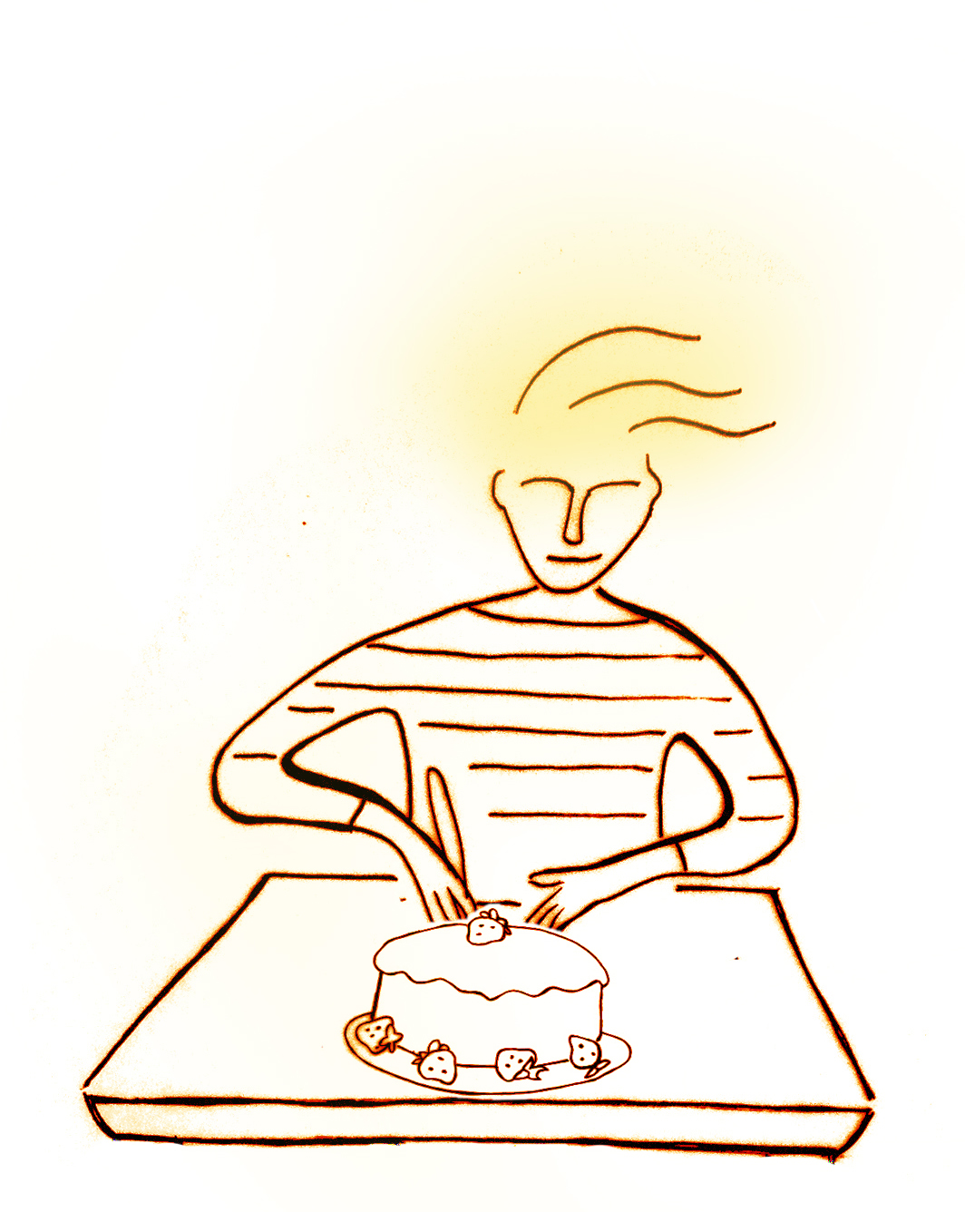
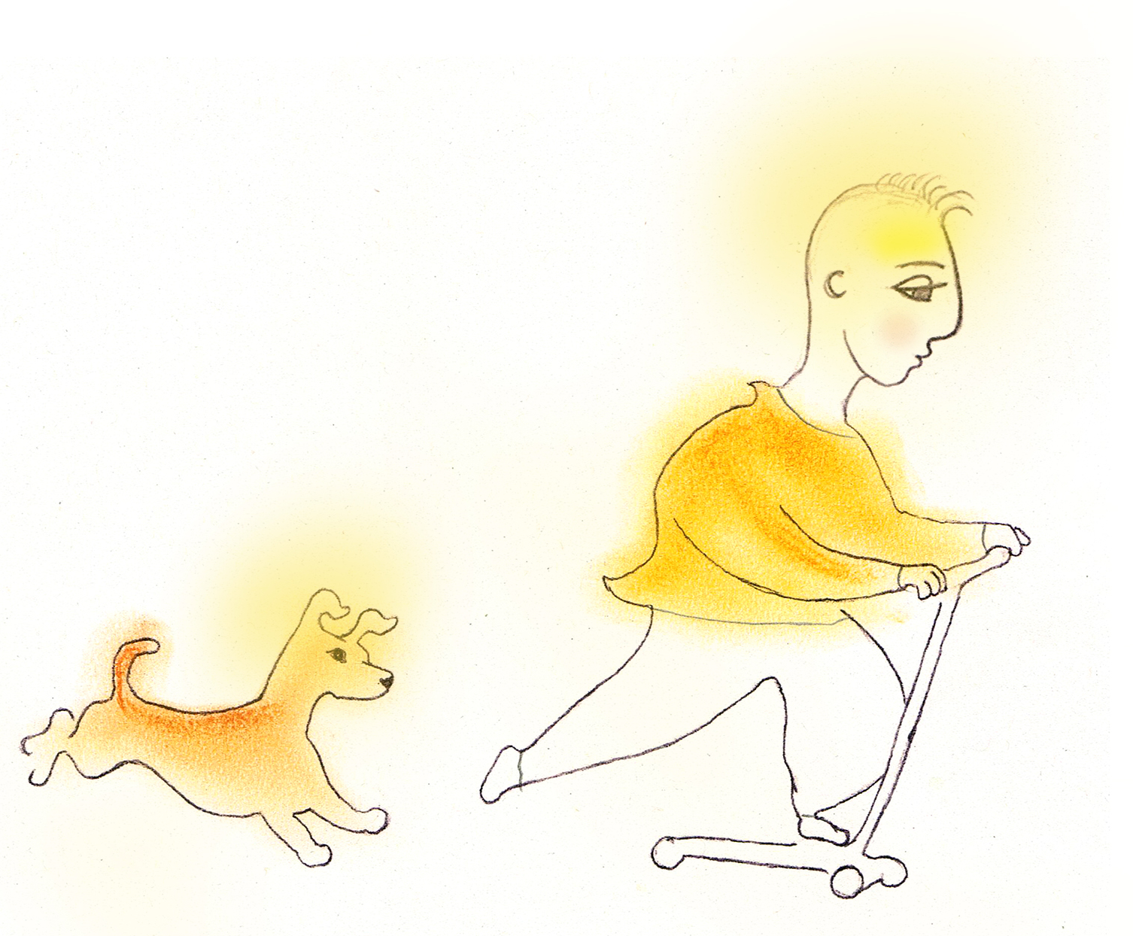
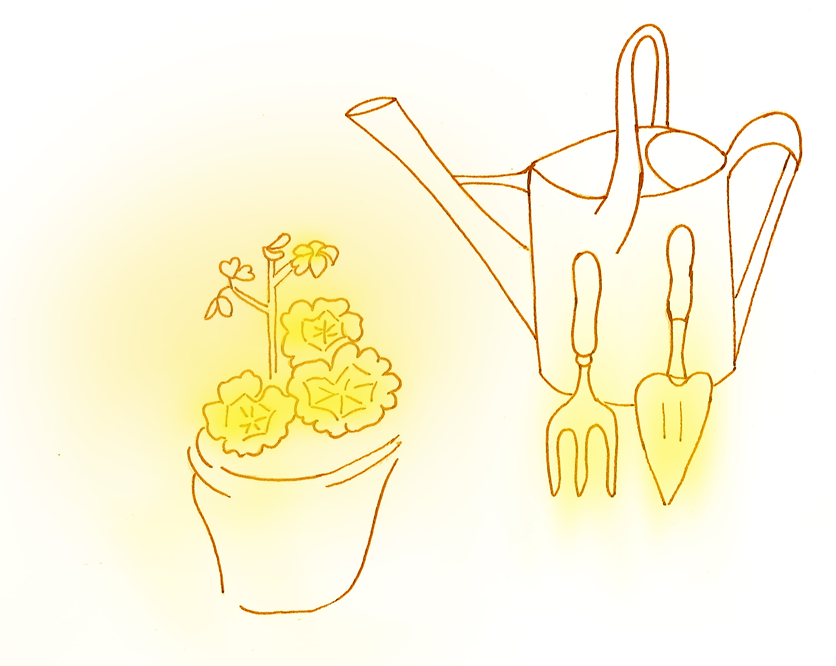
Draw your family UPLIT
Draw a picture of your family – guess what each one loves doing – the thing that lights them up
See if you guessed right. Ask each person at home what their UPLIT is so you can add it to your picture.

Slide 15

Click for kids folk dancing website
http://resources.hwb.wales.gov.uk/VTC/2017/dawnsio-gwerin-english/index.html

Slide 16
End of the day stretches
Make your body loose and free

