Slide 1

MAKE GOOD THINGS HAPPEN
Day 5 FRIENDS
Materials free for classroom use

Slide 2



stretch 1
Make your body loose and free
Swing your arms open and hug yourself 5 times

Slide 3


stretch 2
Make your body loose and free
Flap your arms like a bird 5 times

Slide 4





stretch 3
Make your body loose and free
Roll your shoulders in a circle 5 times

Slide 5


cloud meditation
Press
cloud
to
play

Slide 6
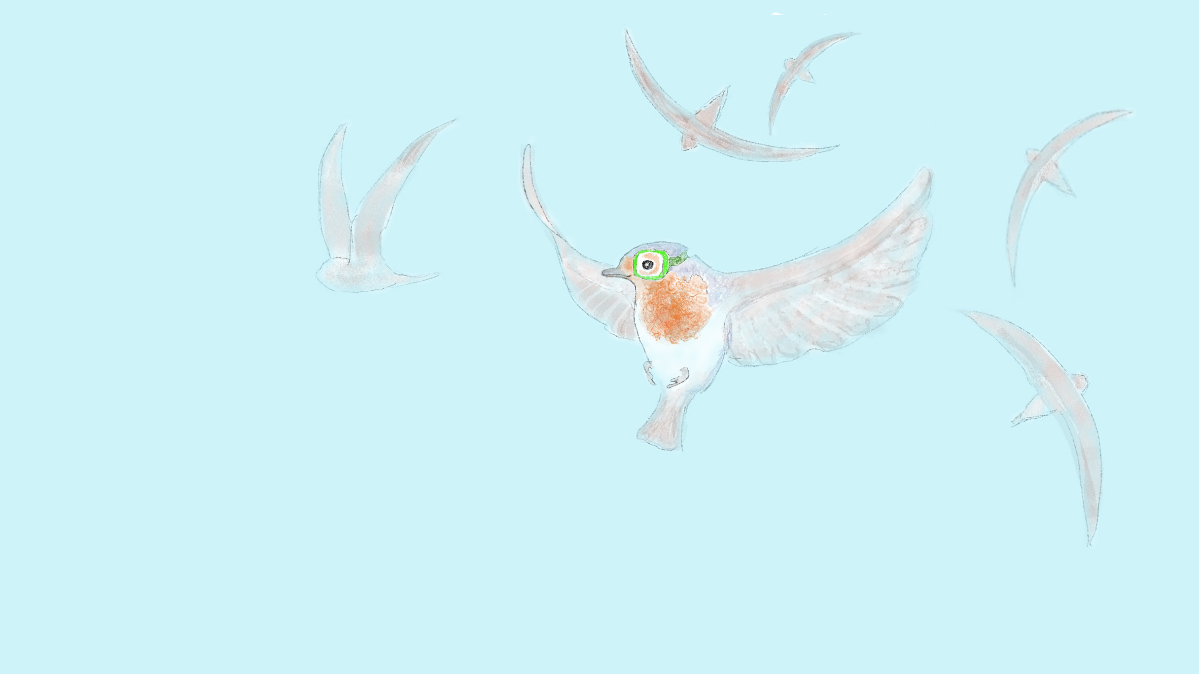
The sky is my friend
wherever I am
feels like home

Slide 7

The sky is my friend
Cloud watching
Make the sky your friend
Watch the sky for a few minutes
Lie on your back or gaze out of a window
Watch the clouds drift by
notice their shapes
Lie on your back or gaze out of a window
and look up at the sky for a few minutes
Watch the clouds drifting by

Slide 8
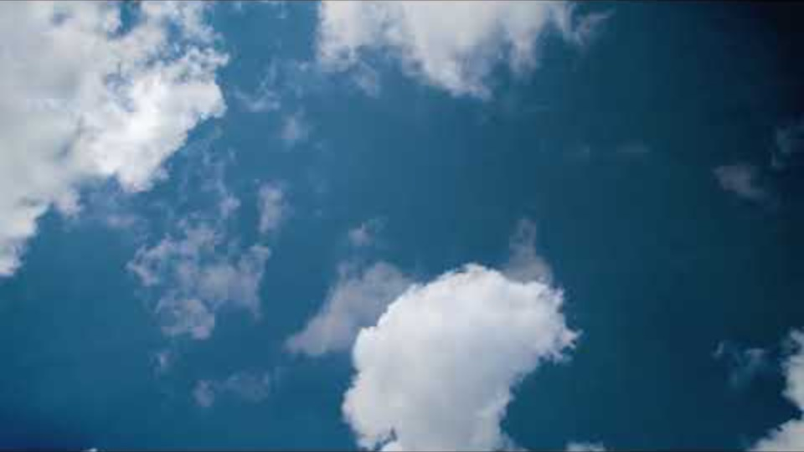
Watching clouds
Film clip - click and wait to load.
Make sure you have enabled live content below menu bar
notice the beauty of a changing cloud

Slide 9
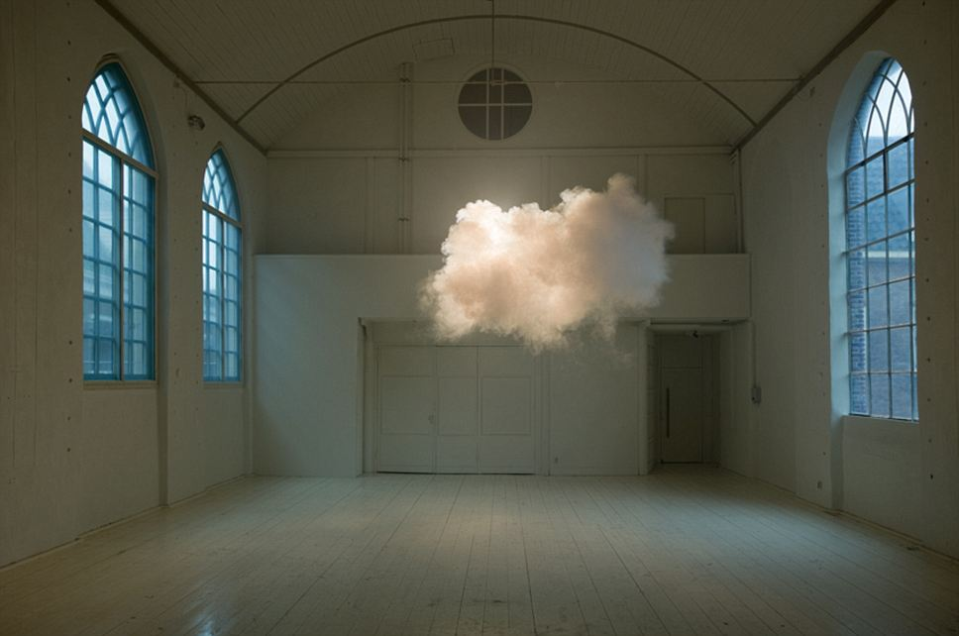
Making clouds

Slide 10
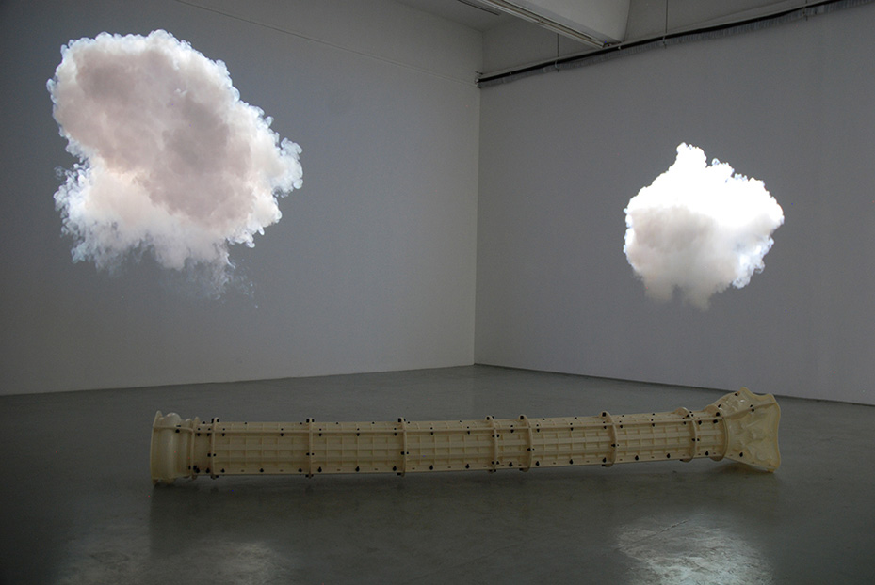
Indoor clouds made by artist Berndnaut Smilde.

Slide 11

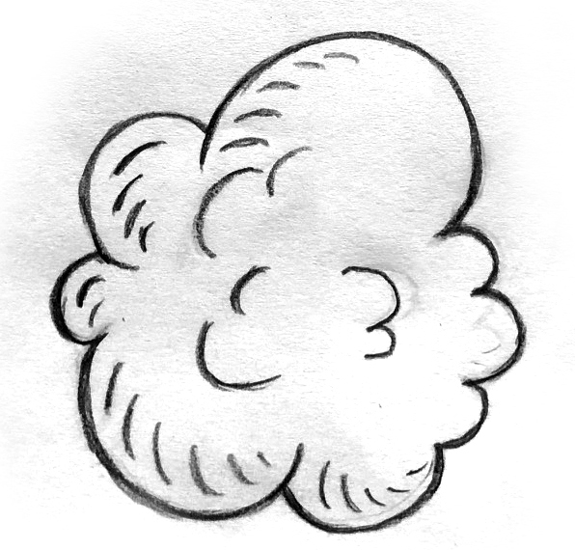
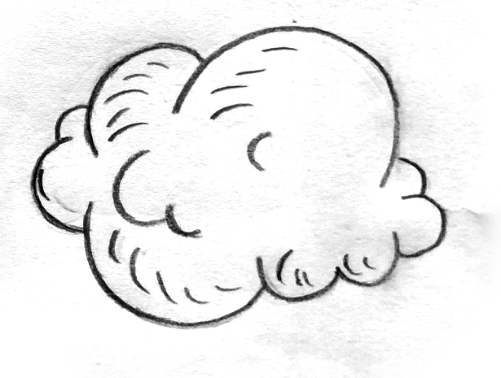

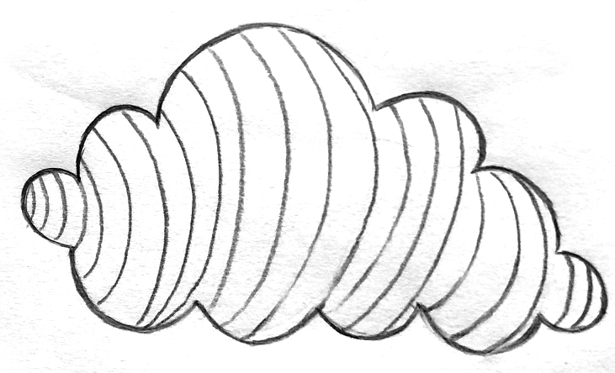
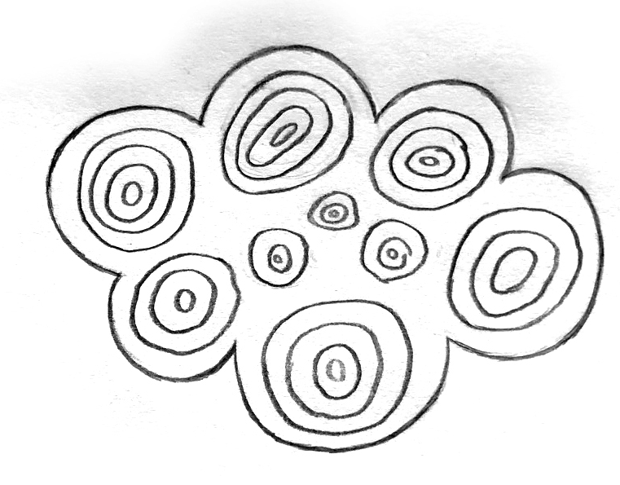
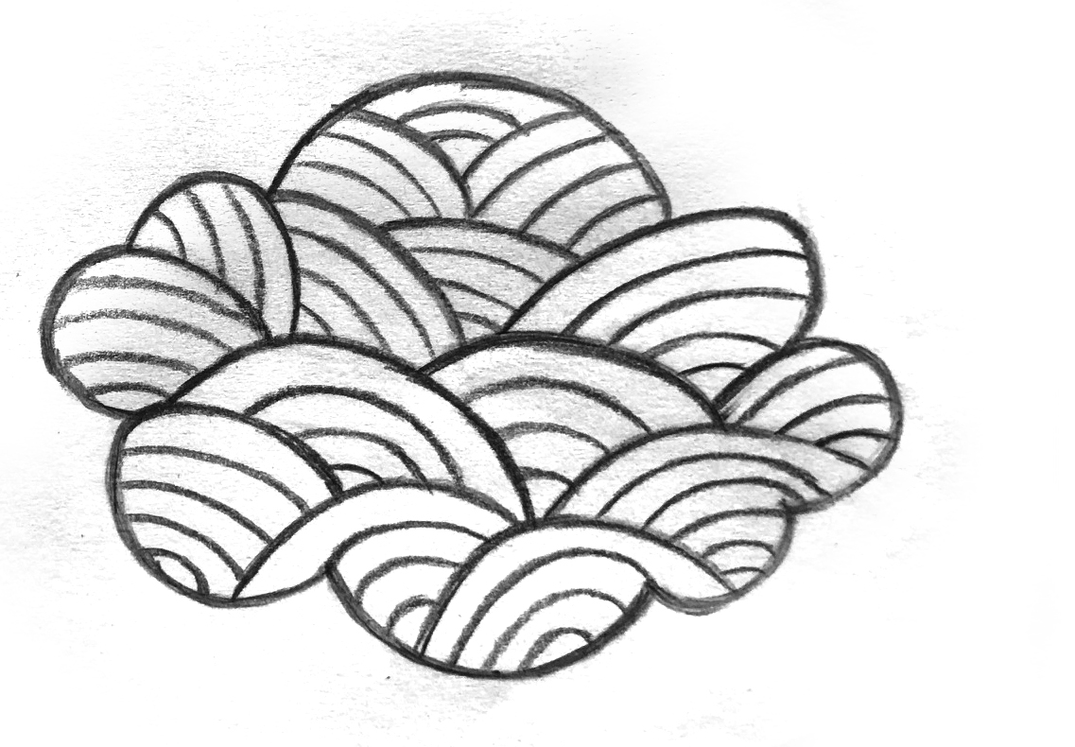
drawing clouds
draw the fluffiness of a cloud draw the swirliness of a cloud
draw your own style of cloud
draw patterns in clouds

Slide 12

Like a good friend
the sky
is always there for us

Slide 13

Send Rays
of Heartle
to all
my friends
Press to play

Slide 14
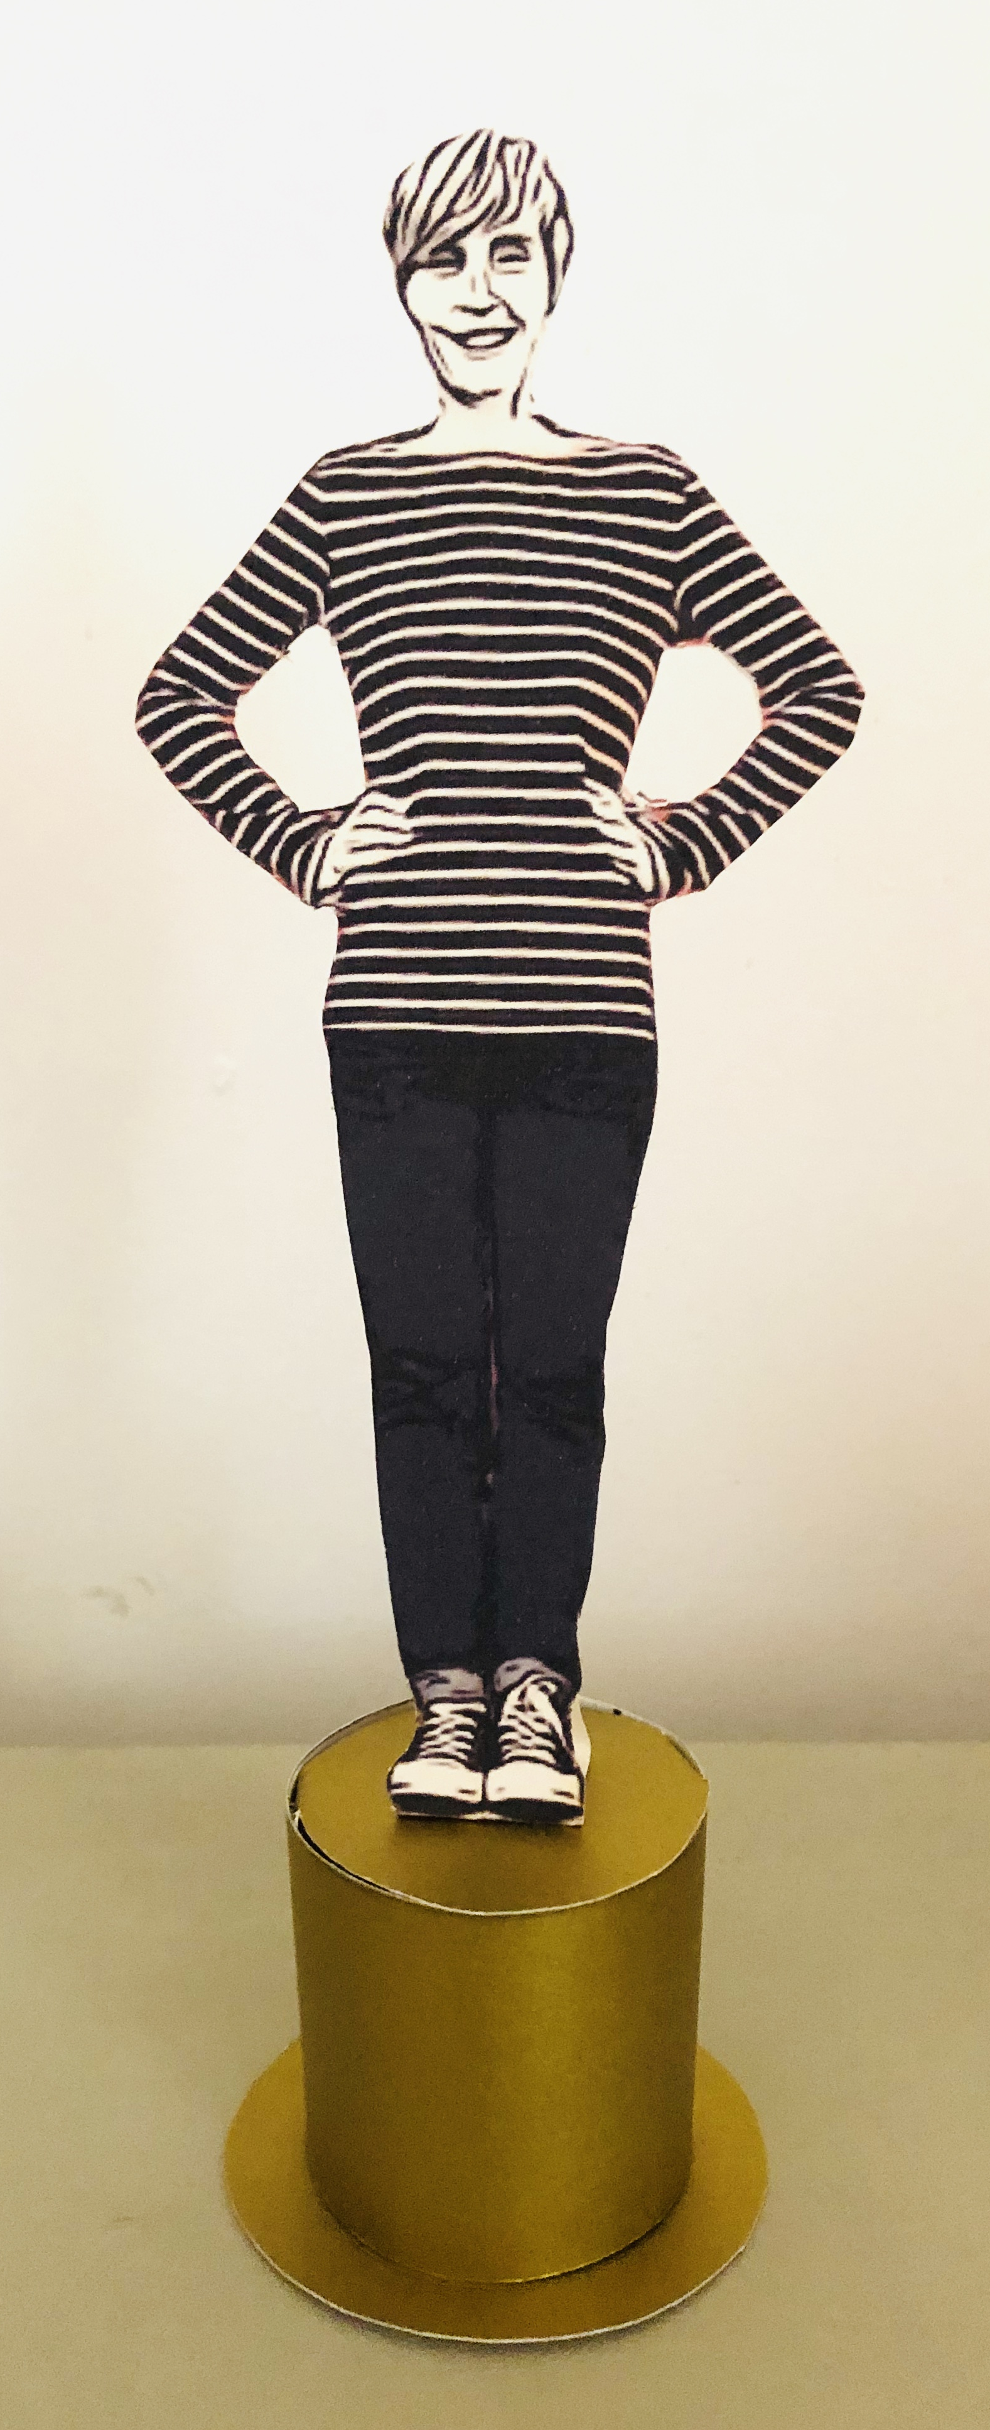
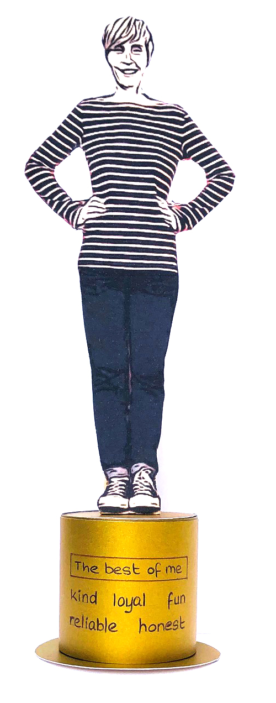
THE BEST OF ME
Make an OSCAR of you looking really happy
.
Write on the front how to be a really good friend
This is the best of you.
Being a good friend is the best part of everyone.

Slide 15

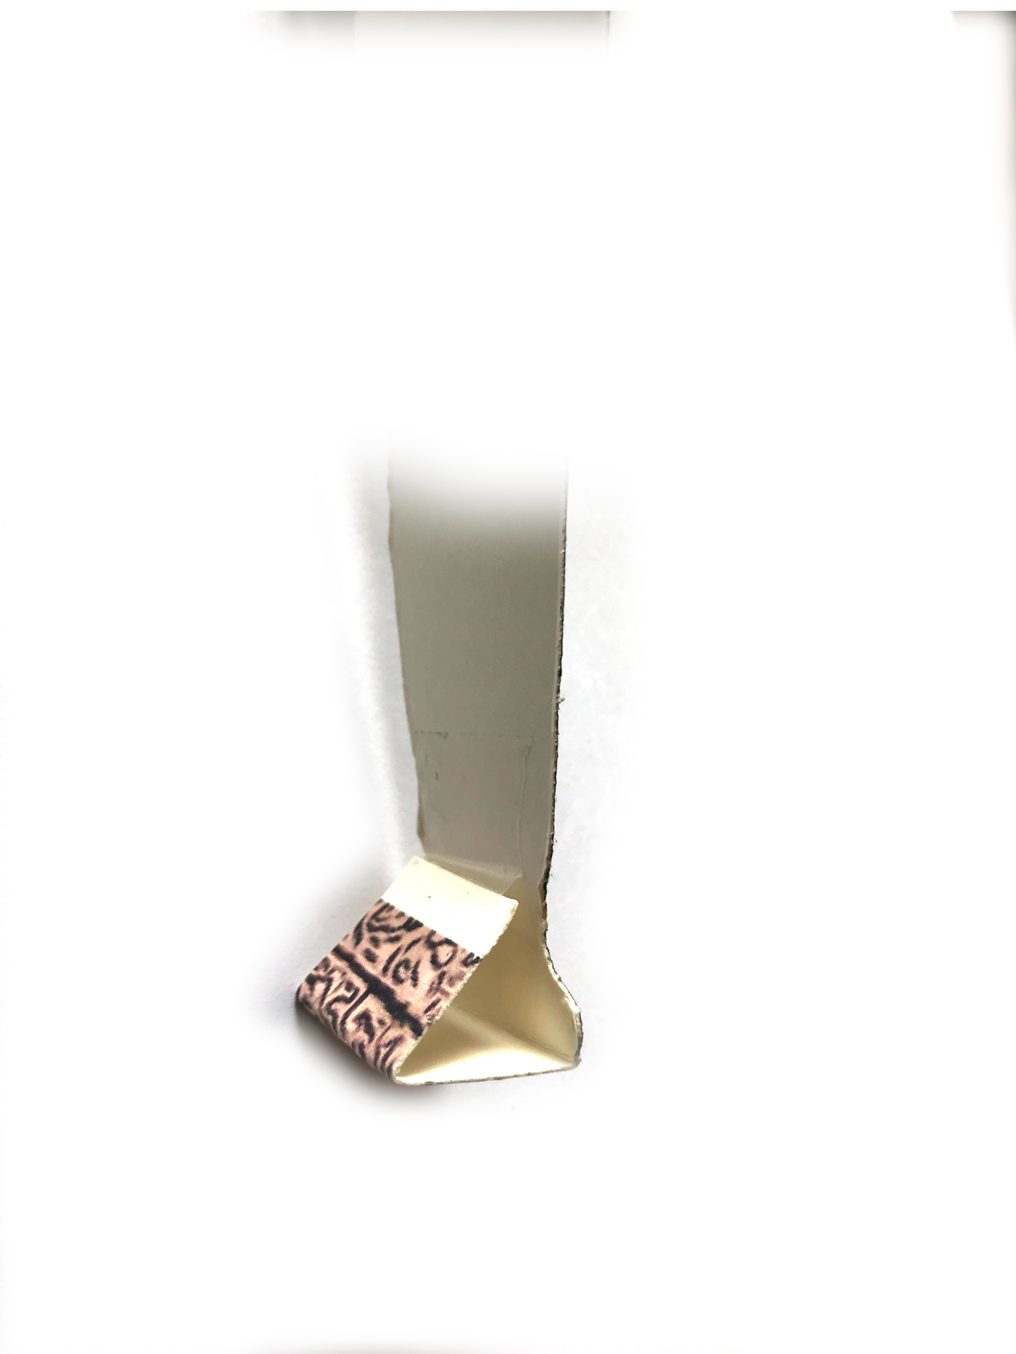
HOW TO MAKE YOUR OWN OSCAR
Draw a picture of yourself looking really happy on card
or cardboard and cut it out
Make a base out of card or toilet roll tube or a yogurt pot
Decorate the base with tin foil, gold paper or anything you fancy
Write on the front of the base how to be a really good friend
.
Oscars can be
25- 30cm high
Leave some extra card at the bottom of your drawing to fold back and sellotape into a triangle.
Glue your statue to the base.

Slide 16

Click for kids folk dancing website
http://resources.hwb.wales.gov.uk/VTC/2017/dawnsio-gwerin-english/index.html

Slide 17
End of the day stretches
Make your body loose and free

