Slide 1

MAKE GOOD THINGS HAPPEN
Day 4 OCEANS
Materials free for classroom use

Slide 2



stretch 1
Make your body loose and free
Swing your arms open and hug yourself 5 times

Slide 3


stretch 2
Make your body loose and free
Flap your arms like a bird 5 times

Slide 4





stretch 3
Make your body loose and free
Roll your shoulders in a circle 5 times

Slide 5


cloud meditation
Press
cloud
to
play

Slide 6
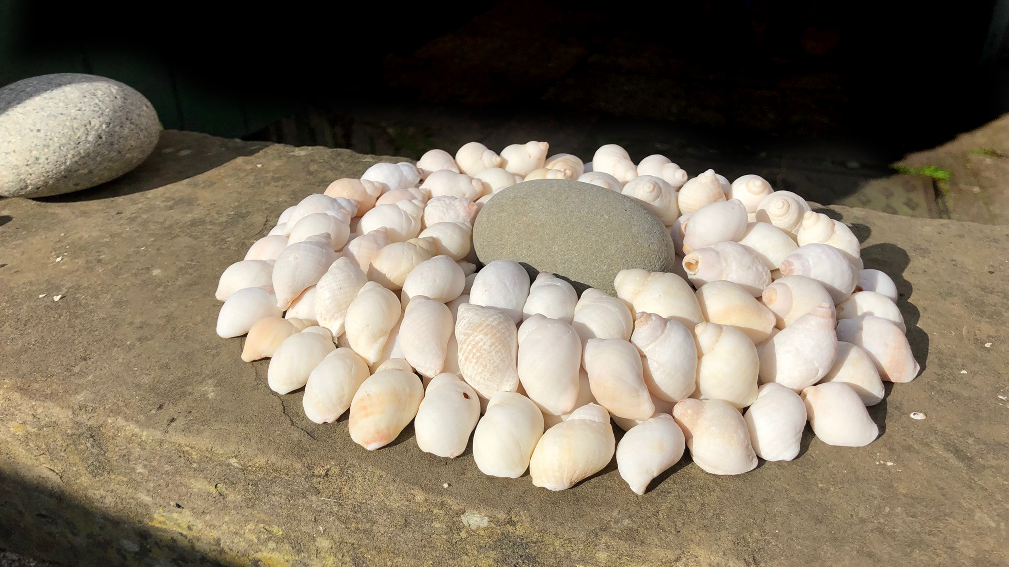
NATURE ART
Arrange shells and pebbles

Slide 7
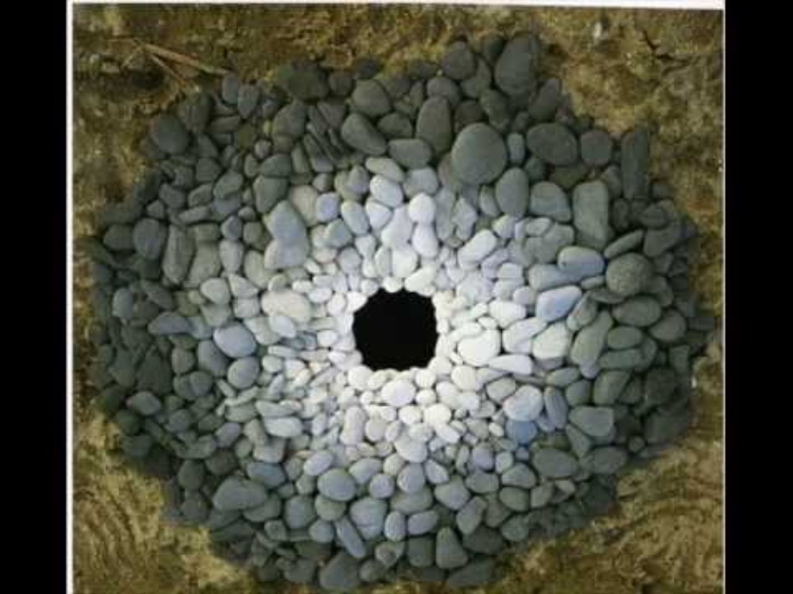
Film clip - click and wait to load.
Make sure you have enabled live content below menu bar

Slide 8
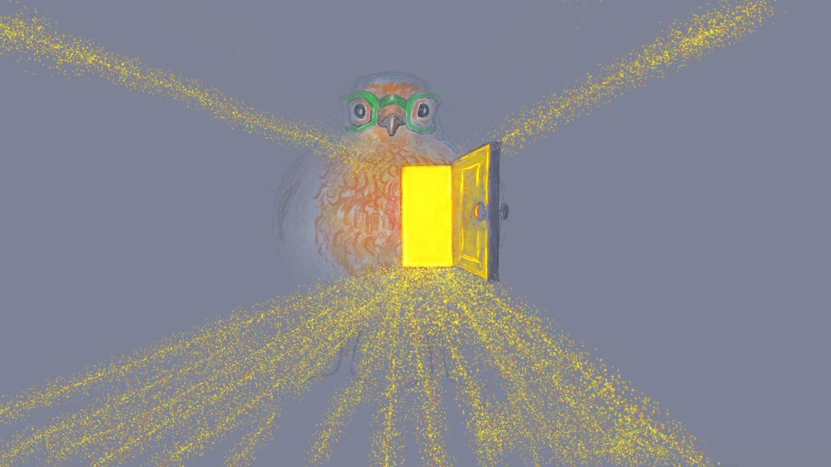
Send Rays
of Heartle
to the oceans
Press to play
Press to play

Slide 9
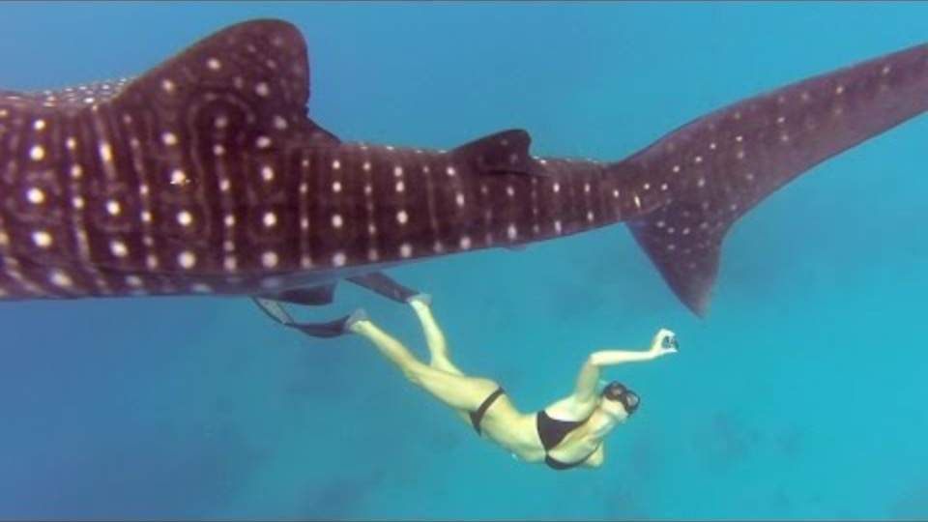
Film clip - click and wait to load.
Make sure you have enabled live content below menu bar.
Ocean Ramsey is an ocean biologist, helping to protect sea creatures, seen here swimming with a whale shark

Slide 10
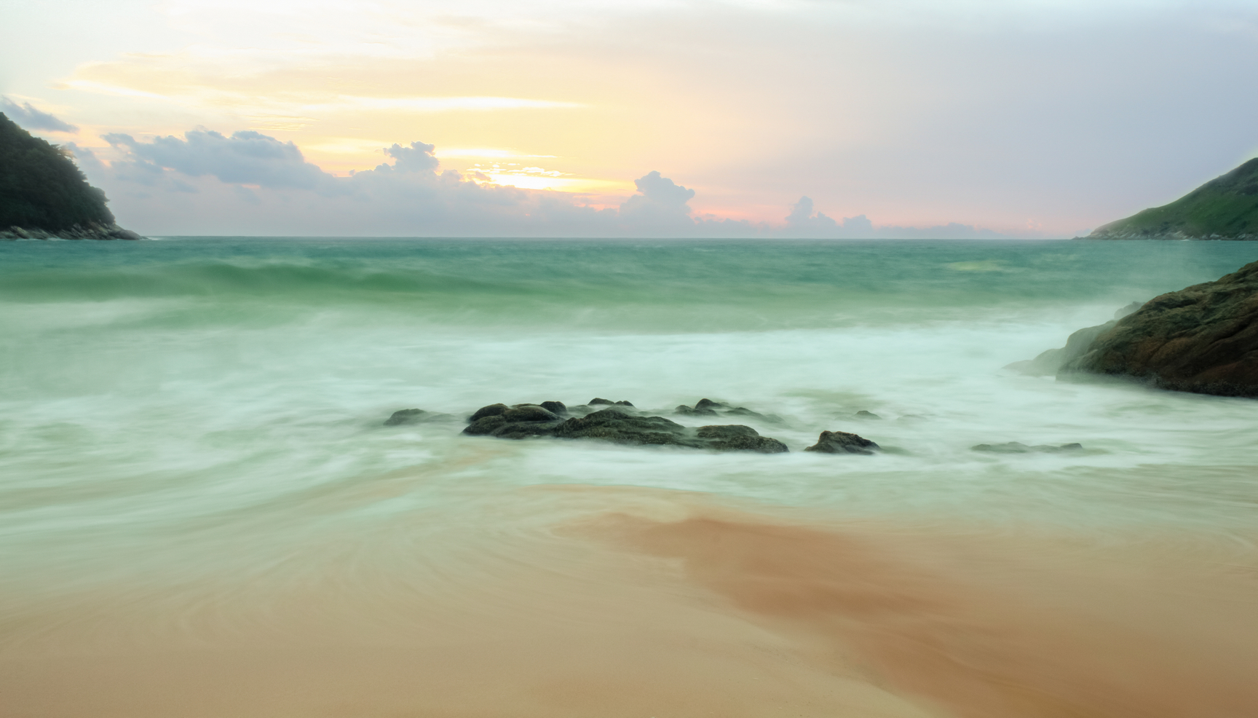
if the oceans could speak
create a song or poem to imagine what the oceans would like to say to all humans

Slide 11

Click for Folk dancing website
http://resources.hwb.wales.gov.uk/VTC/2017/dawnsio-gwerin-english/index.html

Slide 12
End of the day stretches
Make your body loose and free

