Slide 1

MAKE GOOD THINGS HAPPEN
Day 3 FORESTS
Materials free for classroom use

Slide 2



stretch 1
Make your body loose and free
Swing your arms open and hug yourself 5 times

Slide 3


stretch 2
Make your body loose and free
Flap your arms like a bird 5 times

Slide 4





stretch 3
Make your body loose and free
Roll your shoulders in a circle 5 times

Slide 5


cloud meditation
Press
cloud
to
play

Slide 6
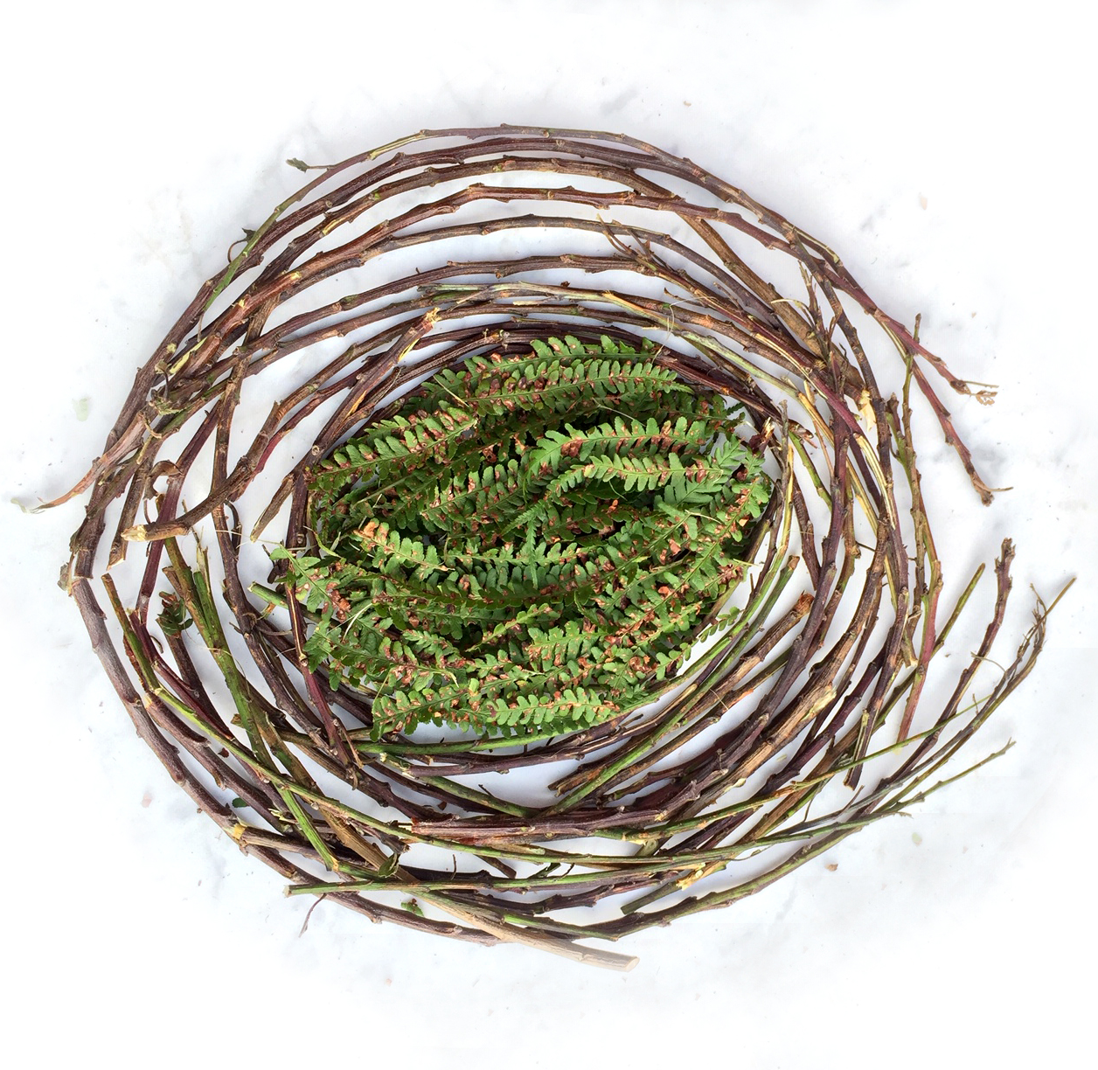
NATURE ART
COLLECT TWIGS
OR ANY OTHER NATURAL THINGS
Have a go at arranging them
in curves or lines
circles or squares
or any shape or pattern that looks beautiful to you.

Slide 7

Send Rays
of Heartle
to the forests
and trees
Press to play
Press to play

Slide 8
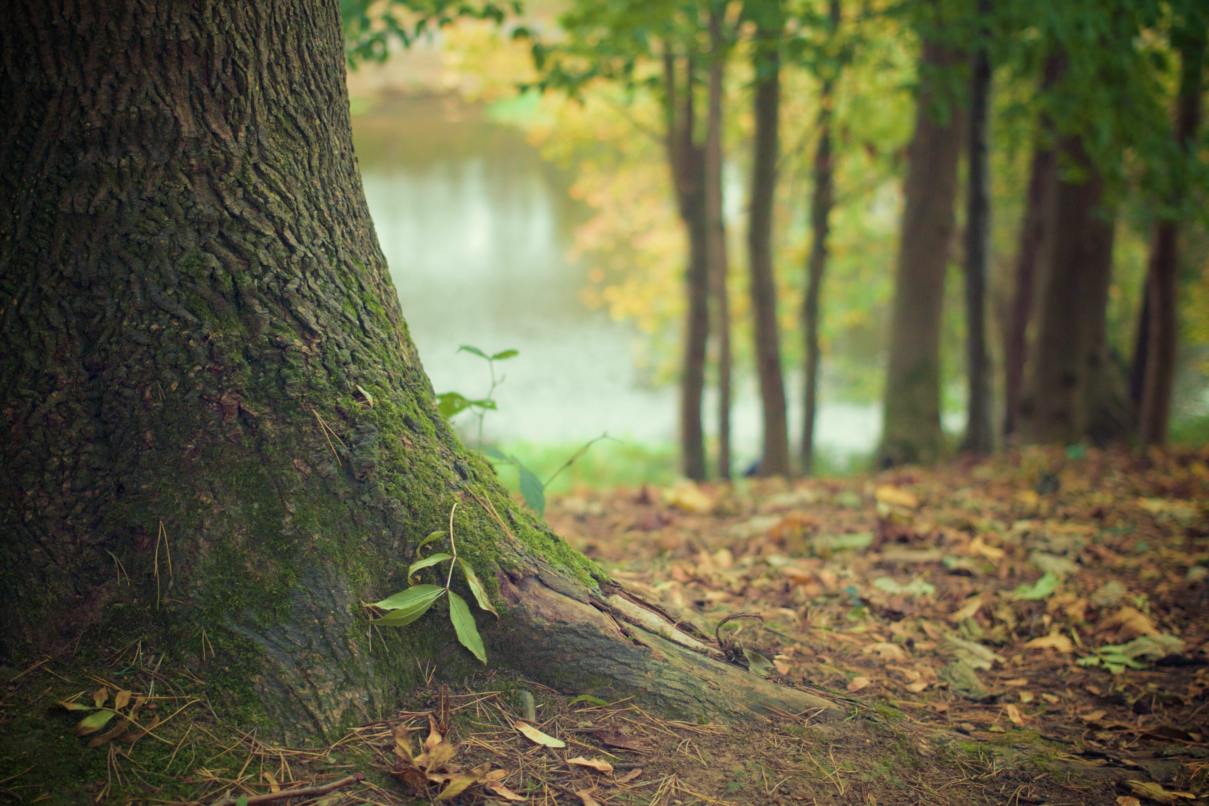
MESSAGES from NATURE
Go outside and touch a tree.
Look for something on the tree that people might not spot. Spend at least 1 minute just looking at it - and then draw it.
Listen to the tree and see what it wants to tell you. Write the message next to your drawing

Slide 9
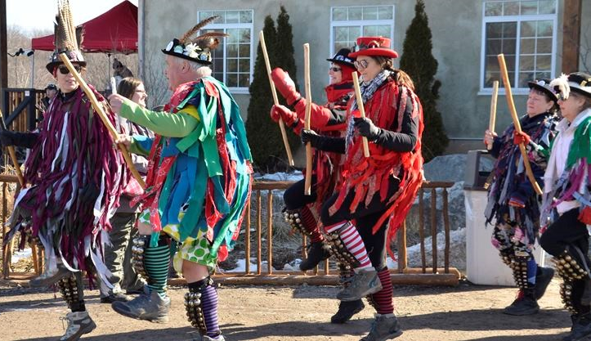
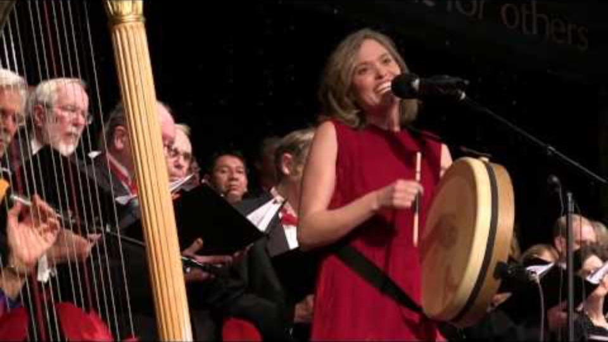
apple tree dance
APPRECIATIING TREES
In Britain
Songs for the trees
Wassailing
Film clip - click and wait to load.
Make sure you have enabled live content below menu bar
The ancient tradition of locals gathering in mid Jan to wake up the apple trees by singing and dancing to them in colourful costumes. To help the trees grow strong and produce good apples.
Toast soaked in cider is hung in the branches to lure robins – thought to be the guardian of the trees.

Slide 10
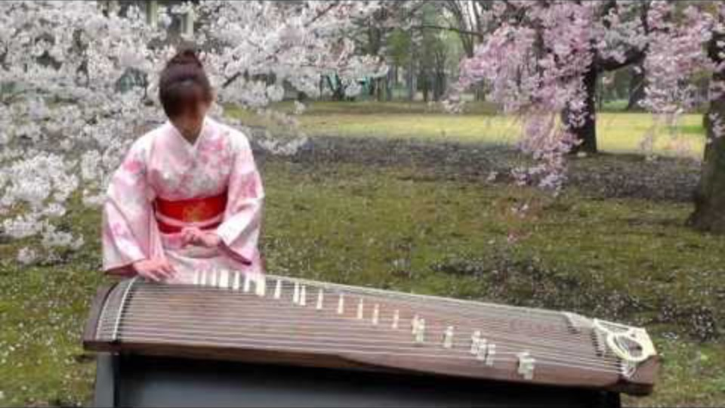
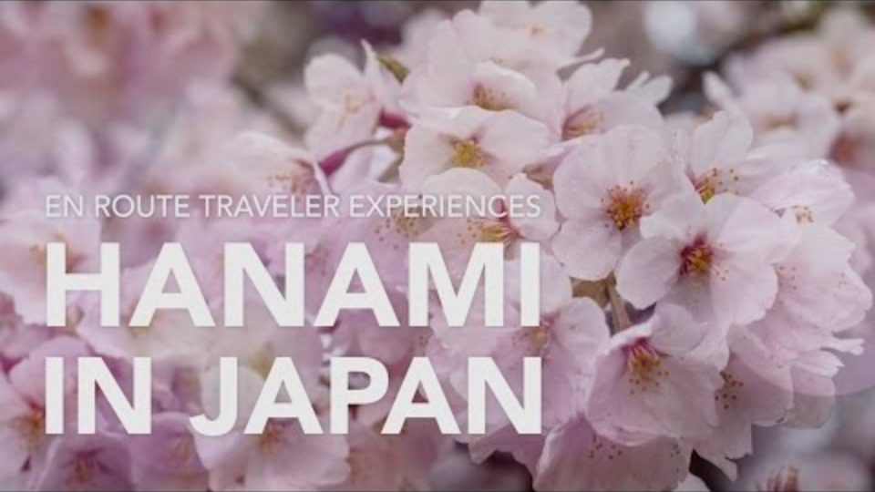
APPRECIATING
TREES
in Japan
Hanami Festival
Film clip - click and wait to load.
Film clip - click and wait to load.
Make sure you have enabled live content below menu bar
Playing music to the trees in blossom
The whole of Japan
eagerly waits the Cherry trees to blossom
and gaze at them in awe and wonder

Slide 11

Click for Folk dancing website
http://resources.hwb.wales.gov.uk/VTC/2017/dawnsio-gwerin-english/index.html

Slide 12
End of the day stretches
Make your body loose and free

