Slide 1

MAKE GOOD THINGS HAPPEN
Day 13 Your Ocean Adventure with Robyn
Materials free for classroom use

Slide 2



stretch 1
Make your body loose and free
Swing your arms open and hug yourself 5 times

Slide 3


stretch 2
Make your body loose and free
Flap your arms like a bird 5 times

Slide 4





stretch 3
Make your body loose and free
Roll your shoulders in a circle 5 times

Slide 5


cloud meditation
Press
cloud
to
play

Slide 6
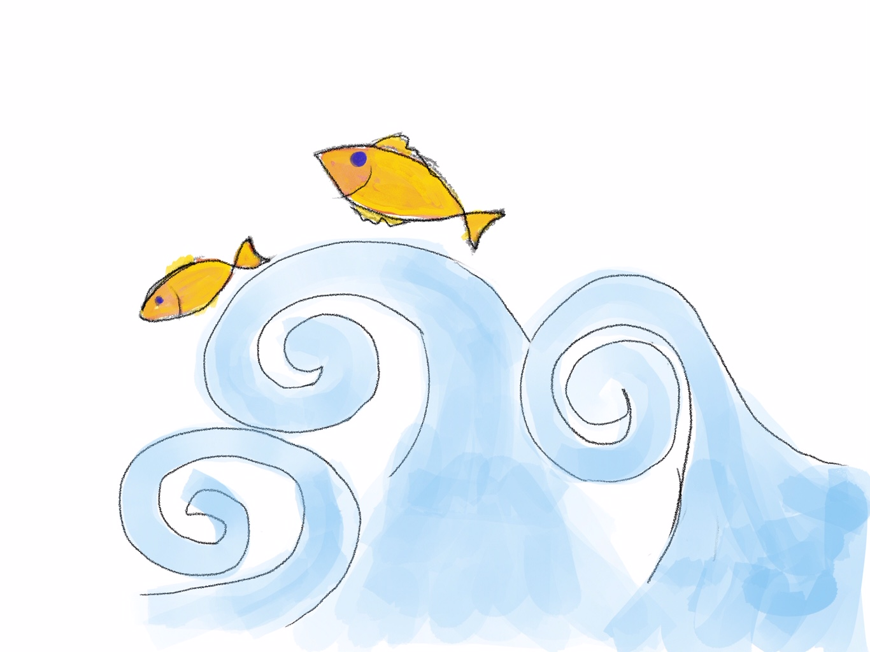
“You may say that I am a dreamer, but I am not the only one”
Robyn’s next adventure
with you

Slide 7
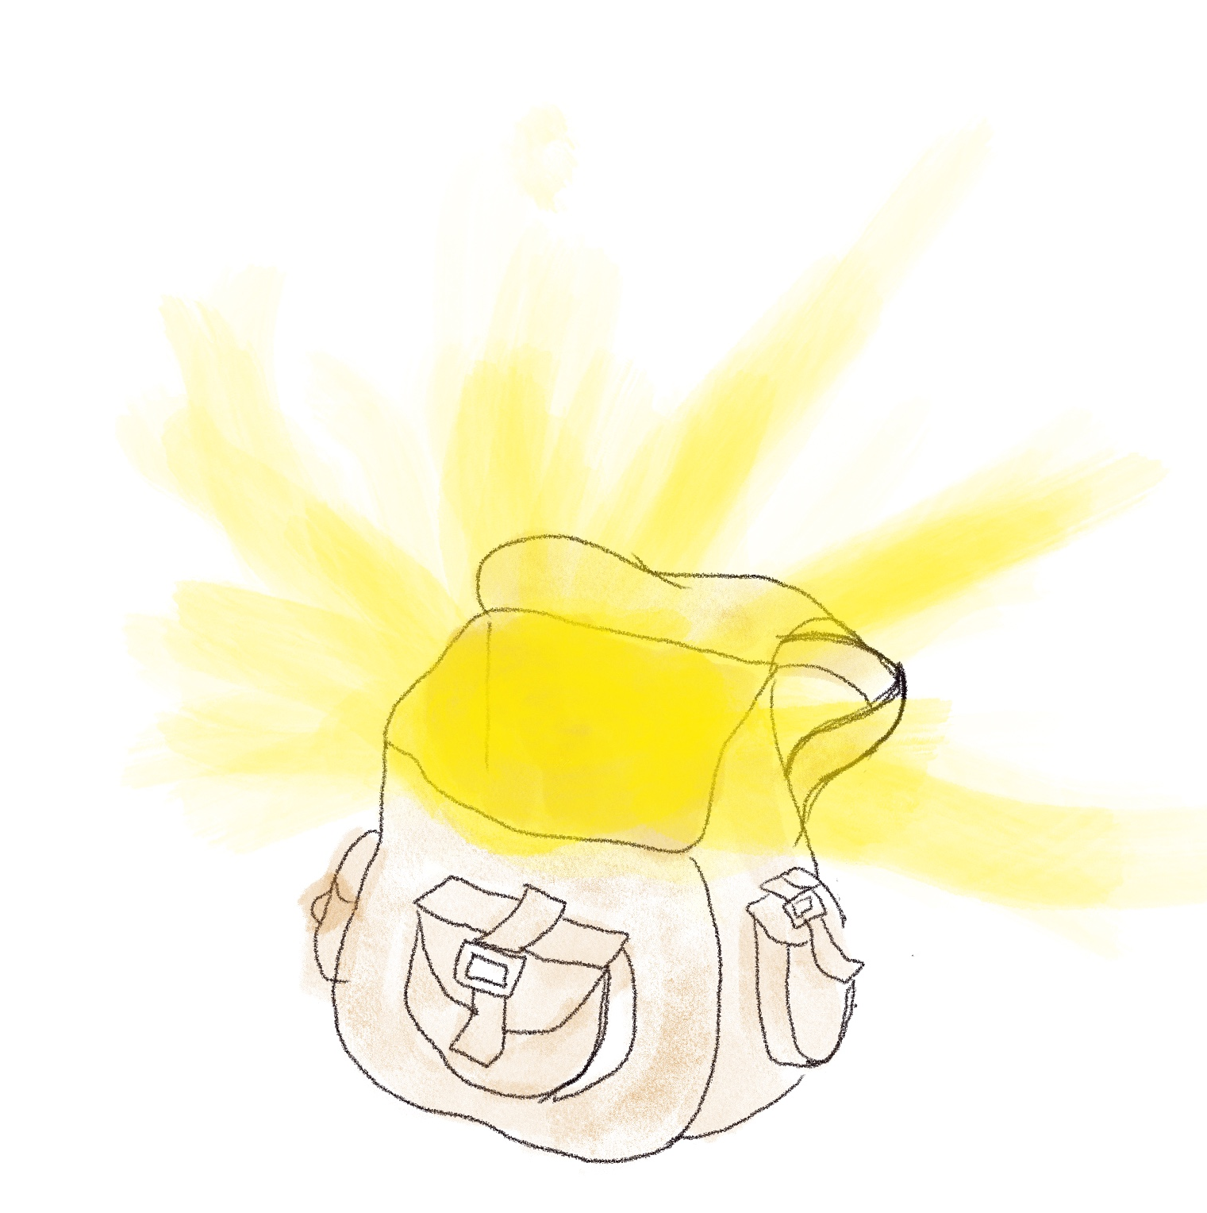
Kinddom
Today you are heading back to Kinddom, the kindest place in the universe.
Robyn has more superpowers in her adventure bag for you to use.
Remember - because they are natural superpowers,
they only work when used with kindness.

Slide 8
Your Ocean adventure with Robyn
Another thing needs sorting out in Kinddom. The oceans aren’t as clean as they should be yet, so Robyn has called round to ask you to go on an adventure with her.
The creatures of the sea have asked for your help.
You can use any of the superpowers from Robyn’s bag to help you that run on kindness
swim underwater for as long and as fast as a dolphin
talk to any animal in the ocean
a big ocean vac to suck up any rubbish
hear other animals from 1 mile away
take the form of any sea creature

Slide 9
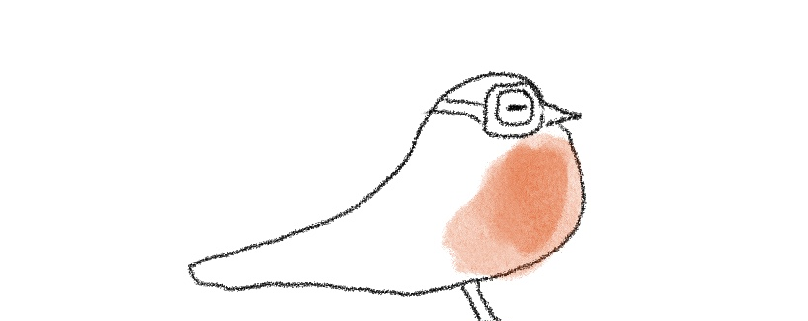
Your cartoon story
Make a story using pictures and words about how you and Robyn are going to help the ocean and all the creatures that live there.
Your new animal friends have been really looking forward to you coming.
They really want to help you make the ocean clean and beautiful again.
Don’t forget to ask Robyn for the superpowers in her bag.
They will be a big help.

Slide 10

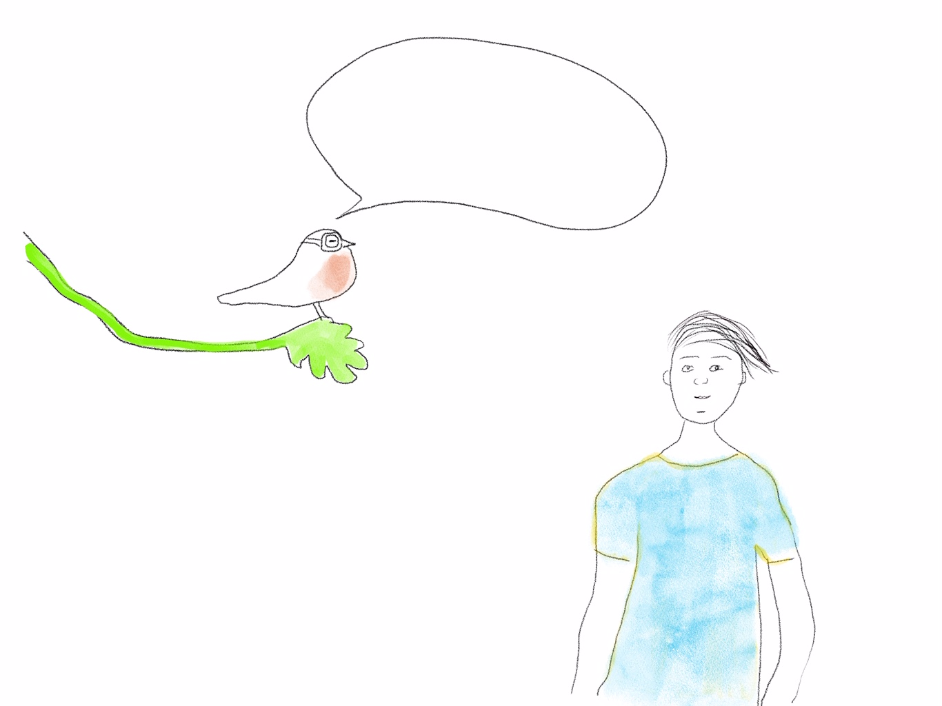
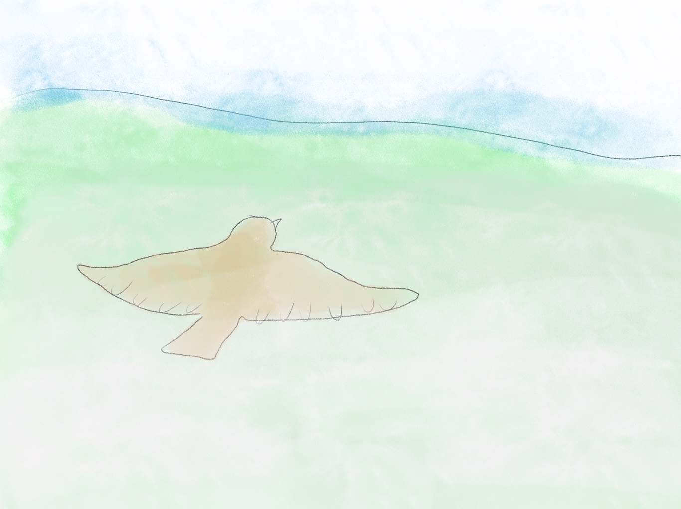
Are you ready for
an adventure to help
all the sea creatures?
Draw a line in the middle of your page so you have two cartoon boxes to draw your cartoon story.
You will need a few cartoon boxes to tell all the story.
Right, we are off…

Slide 11

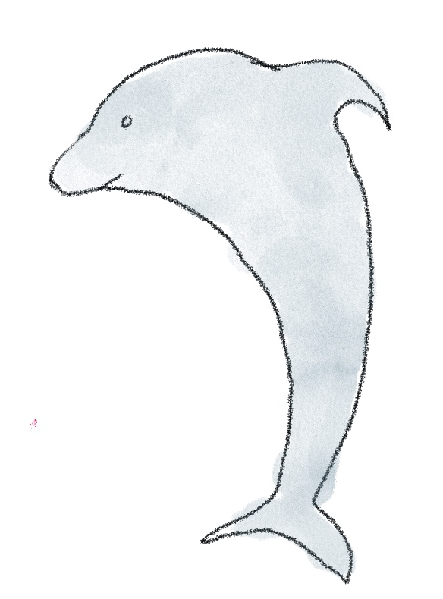
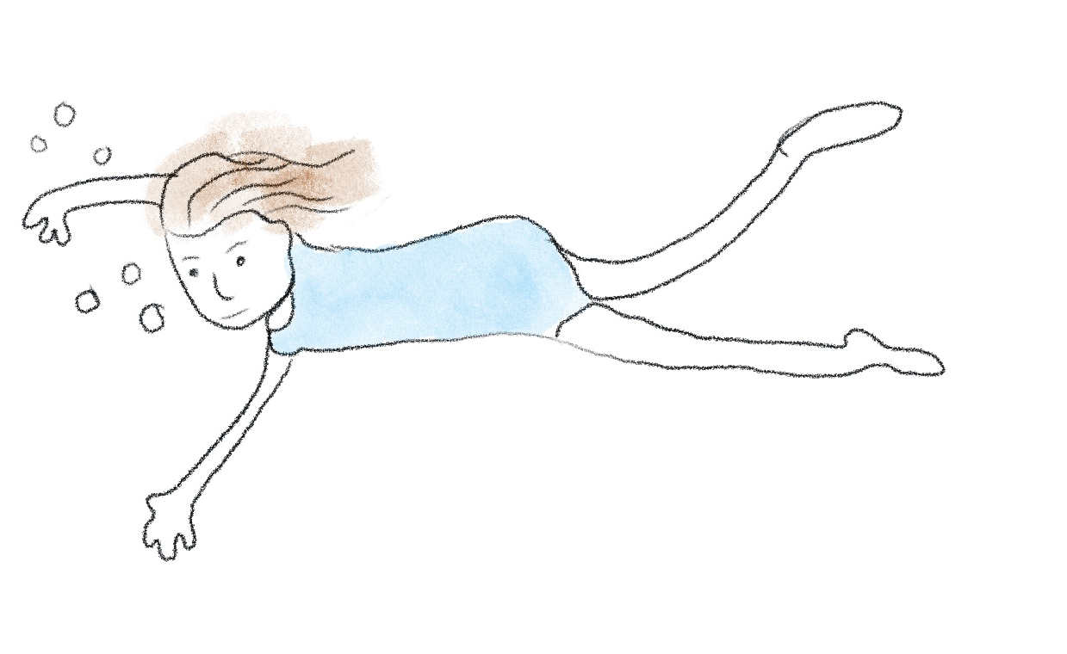

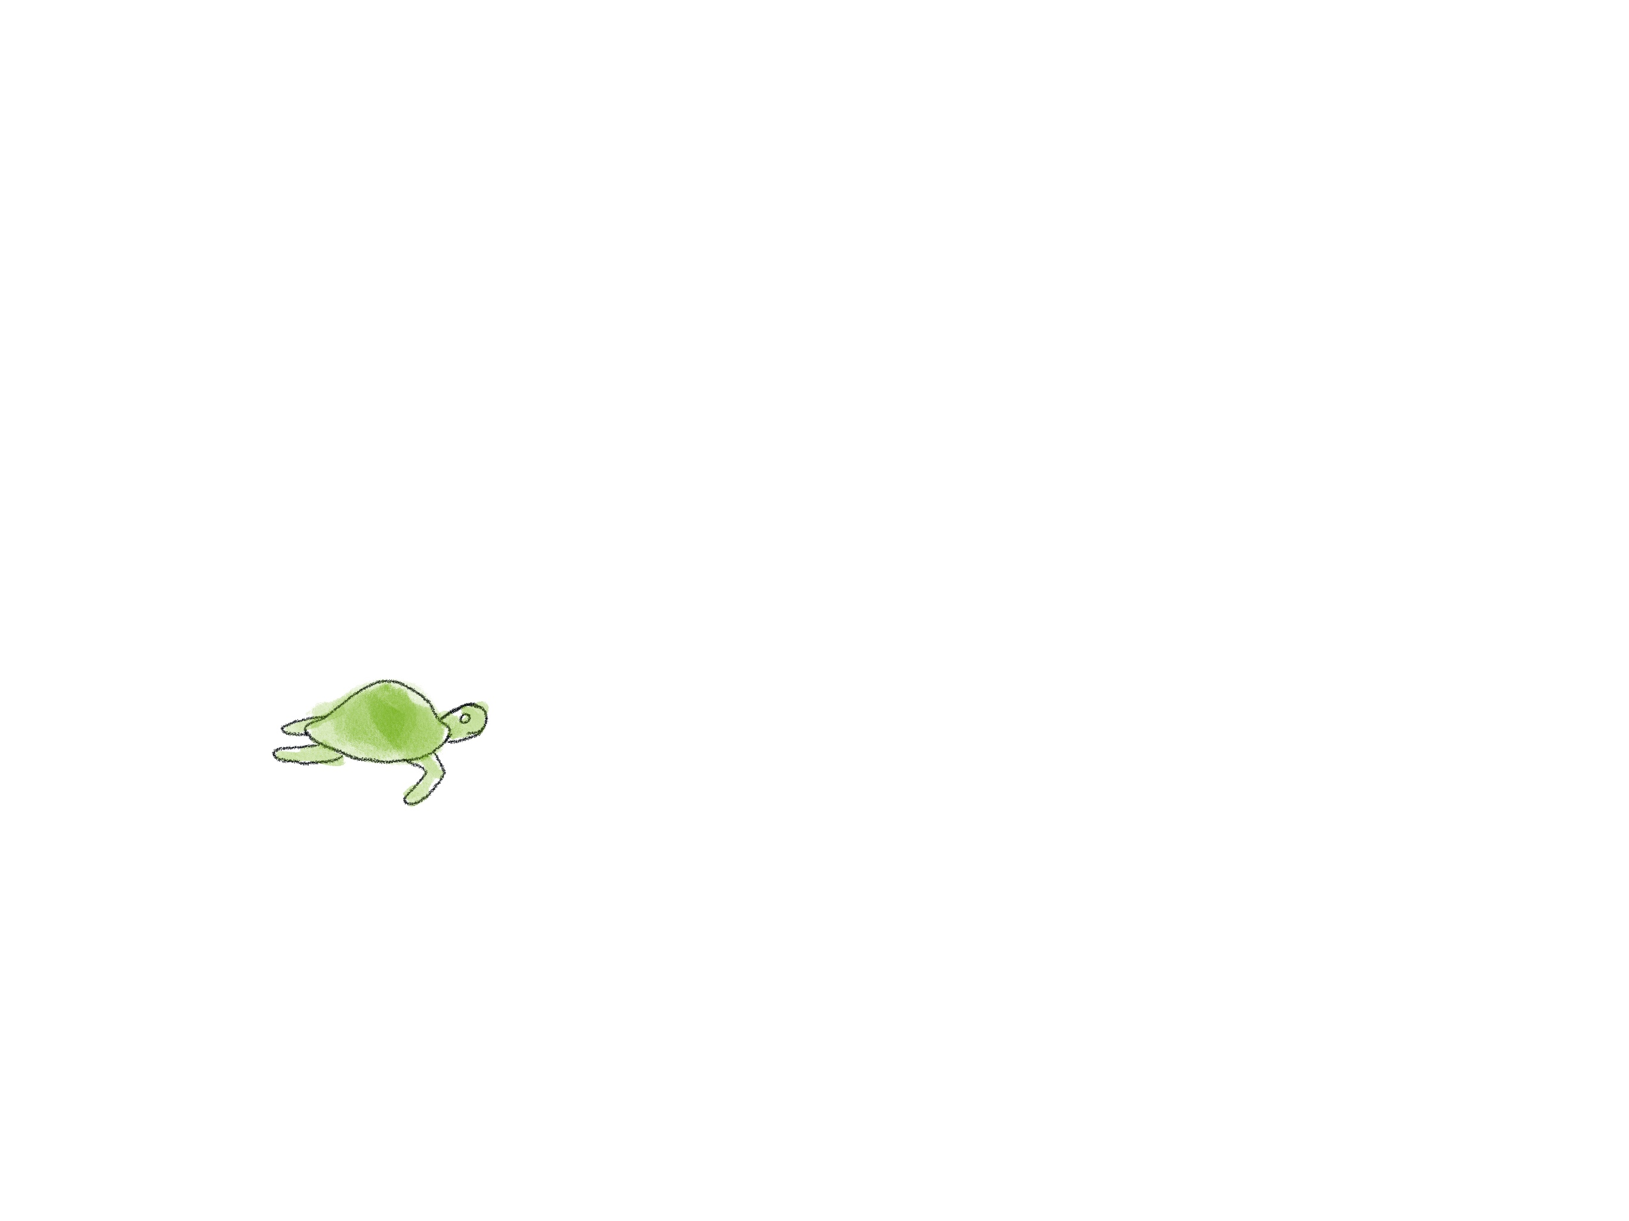
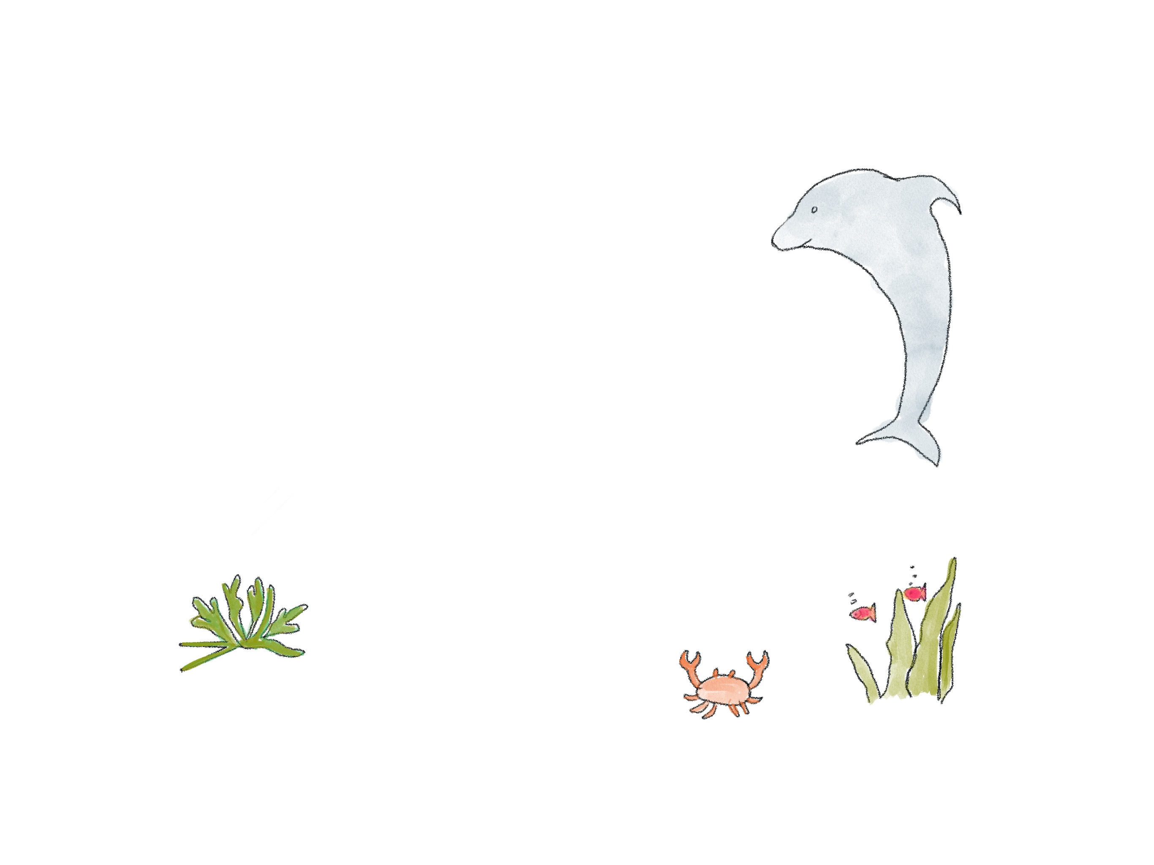

These are some of the characters you might meet along the way

Slide 12

Click for kids folk dancing website
http://resources.hwb.wales.gov.uk/VTC/2017/dawnsio-gwerin-english/index.html

Slide 13
End of the day stretches
Make your body loose and free

