Slide 1

MAKE GOOD THINGS HAPPEN
Day 12 Your Forest Adventure with Robyn
Materials free for classroom use

Slide 2



stretch 1
Make your body loose and free
Swing your arms open and hug yourself 5 times

Slide 3


stretch 2
Make your body loose and free
Flap your arms like a bird 5 times

Slide 4





stretch 3
Make your body loose and free
Roll your shoulders in a circle 5 times

Slide 5
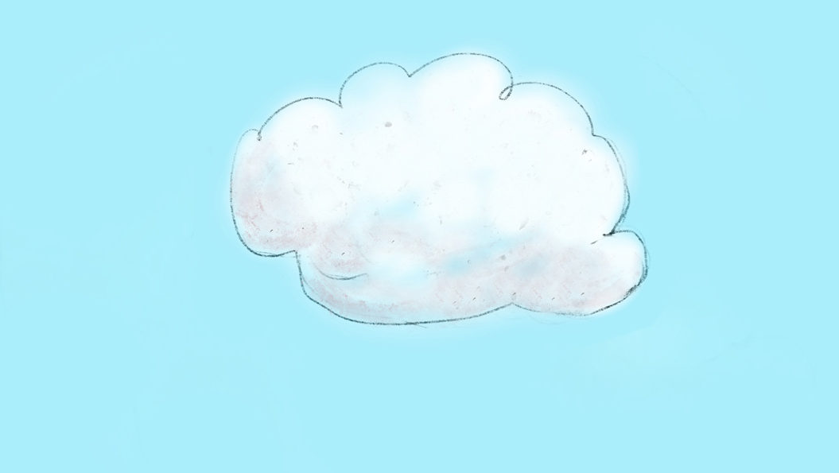

cloud meditation
Press
cloud
to
play

Slide 6
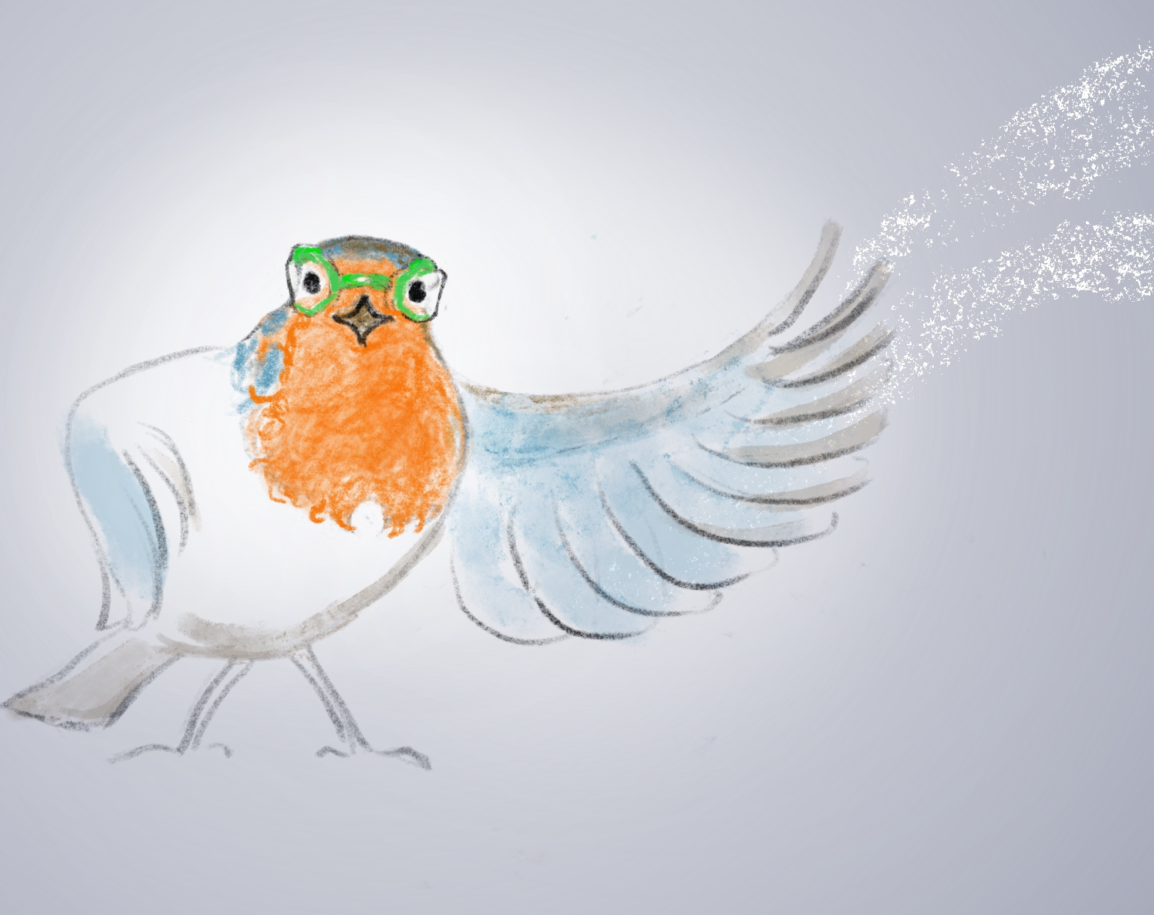
Robyn and the
Three Secrets
Chapter 4

Slide 7
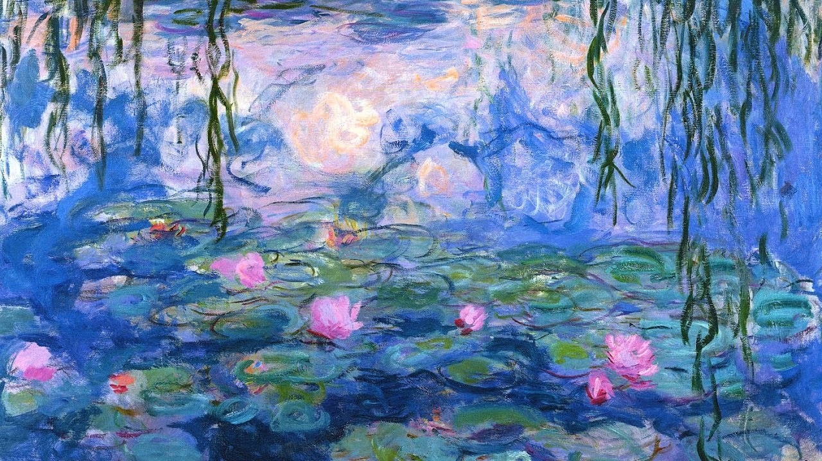
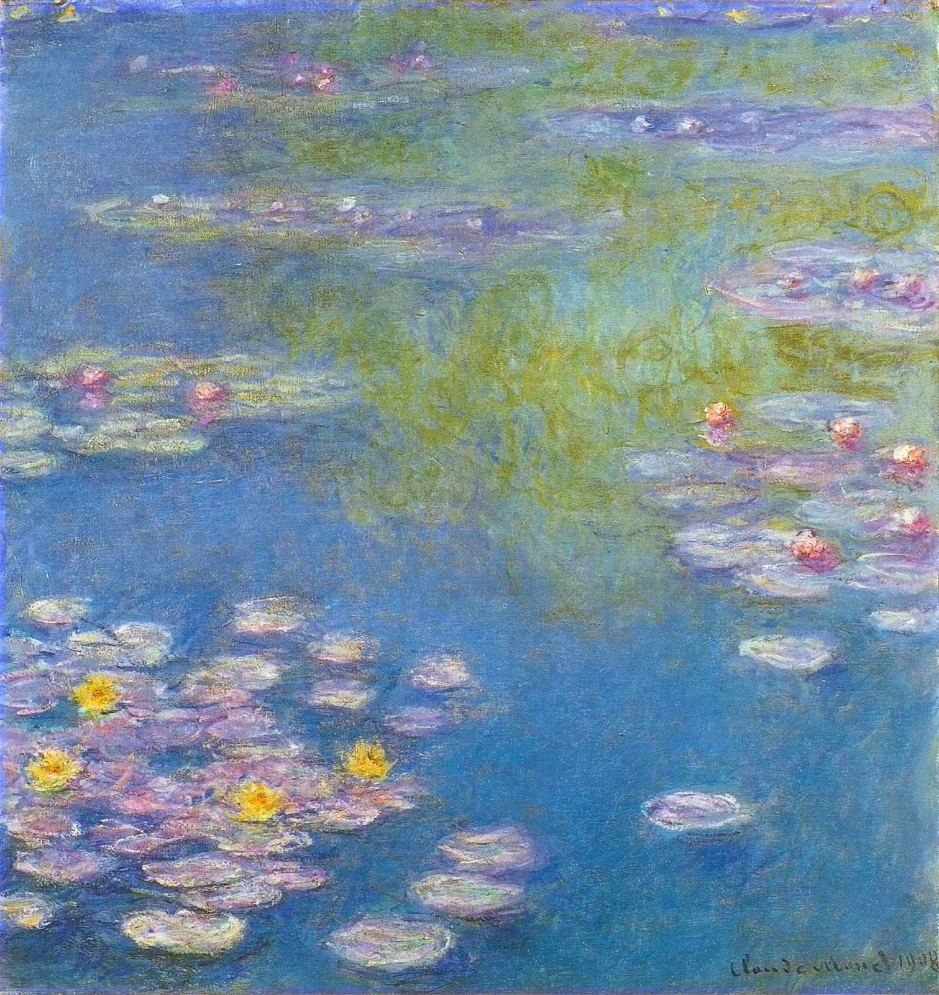

Slide 8
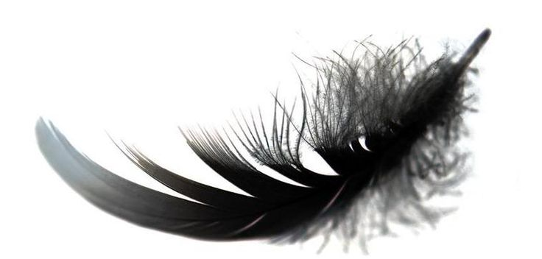
Nature activity
Go outside and find something
small from nature.
A stone, a feather, a leaf, a pebble, a shell.
Anything you think is beautiful or reminds you of how beautiful our world is.
Put your object in the world bowl.

Slide 9
“You may say that I am a dreamer, but I am not the only one”
Robyn’s adventure with you
in the forests

Slide 10
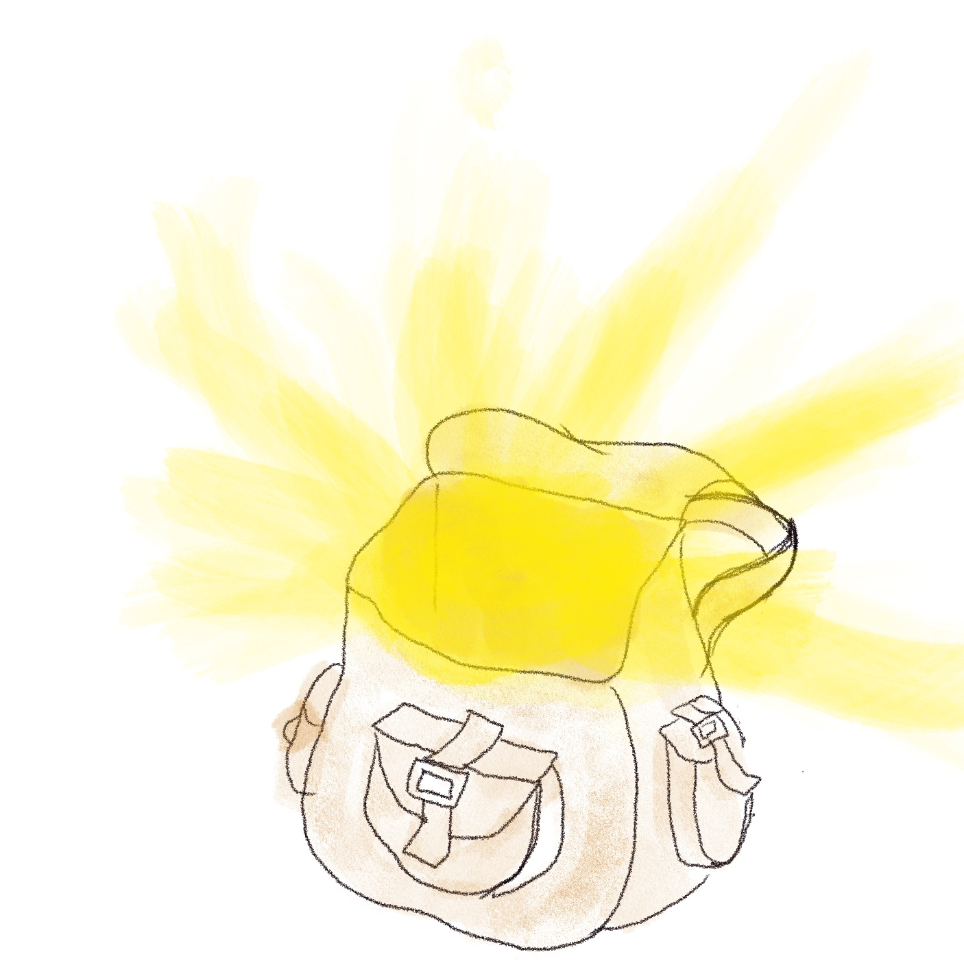
“You may say that I am a dreamer, but I am not the only one”
Kinddom
Imagine the world becomes the kindest place possible because many people like you have been sending rays of Heartle to all the people, animals and places that need it.
The world has become so kind it becomes known as Kinddom.
Robyn has some superpowers in her adventure bag for you to use. But they only work when surrounded with all the kindness in Kinddom…

Slide 11
Your forest adventure with Robyn
The thing is, Kinddom does need some help cleaning up the mess left over from before, so Robyn has called round to ask you to go on an adventure with her.
There needs to be more woodland for all the animals to live in, so the trees and creatures of the woods have asked for your help.
You can use any of the superpowers from Robyn’s bag to help you. Remember these superpowers only work when you do kind things.
see as far as an eagle
run as fast as a cheetah
fly as fast as a swift
Run up trees like a squirrel
talk to any animal
talk to trees
help trees grow faster
make rain clouds
get into very small spaces like a spider
glow in the dark like a firefly

Slide 12
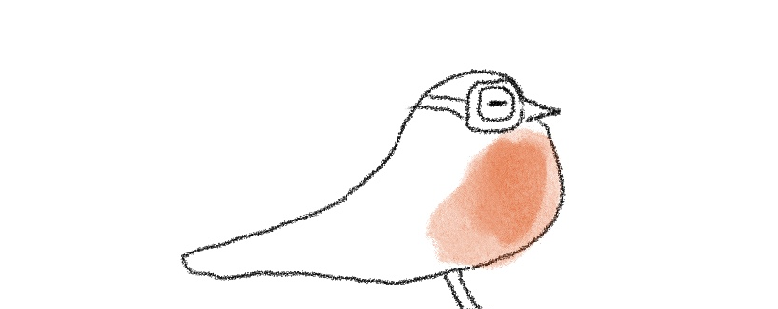
Your cartoon story
Make a story using pictures and words about how you and Robyn are going to help the forests and all the creatures that live there.
Your new animal friends have been really looking forward to you coming.
They need help growing back the woodland with more trees, wildflowers, ponds and rivers.
Ask them what else they need.
Don’t forget to ask Robyn for the superpowers in her bag.
They will be a big help on your adventure.

Slide 13

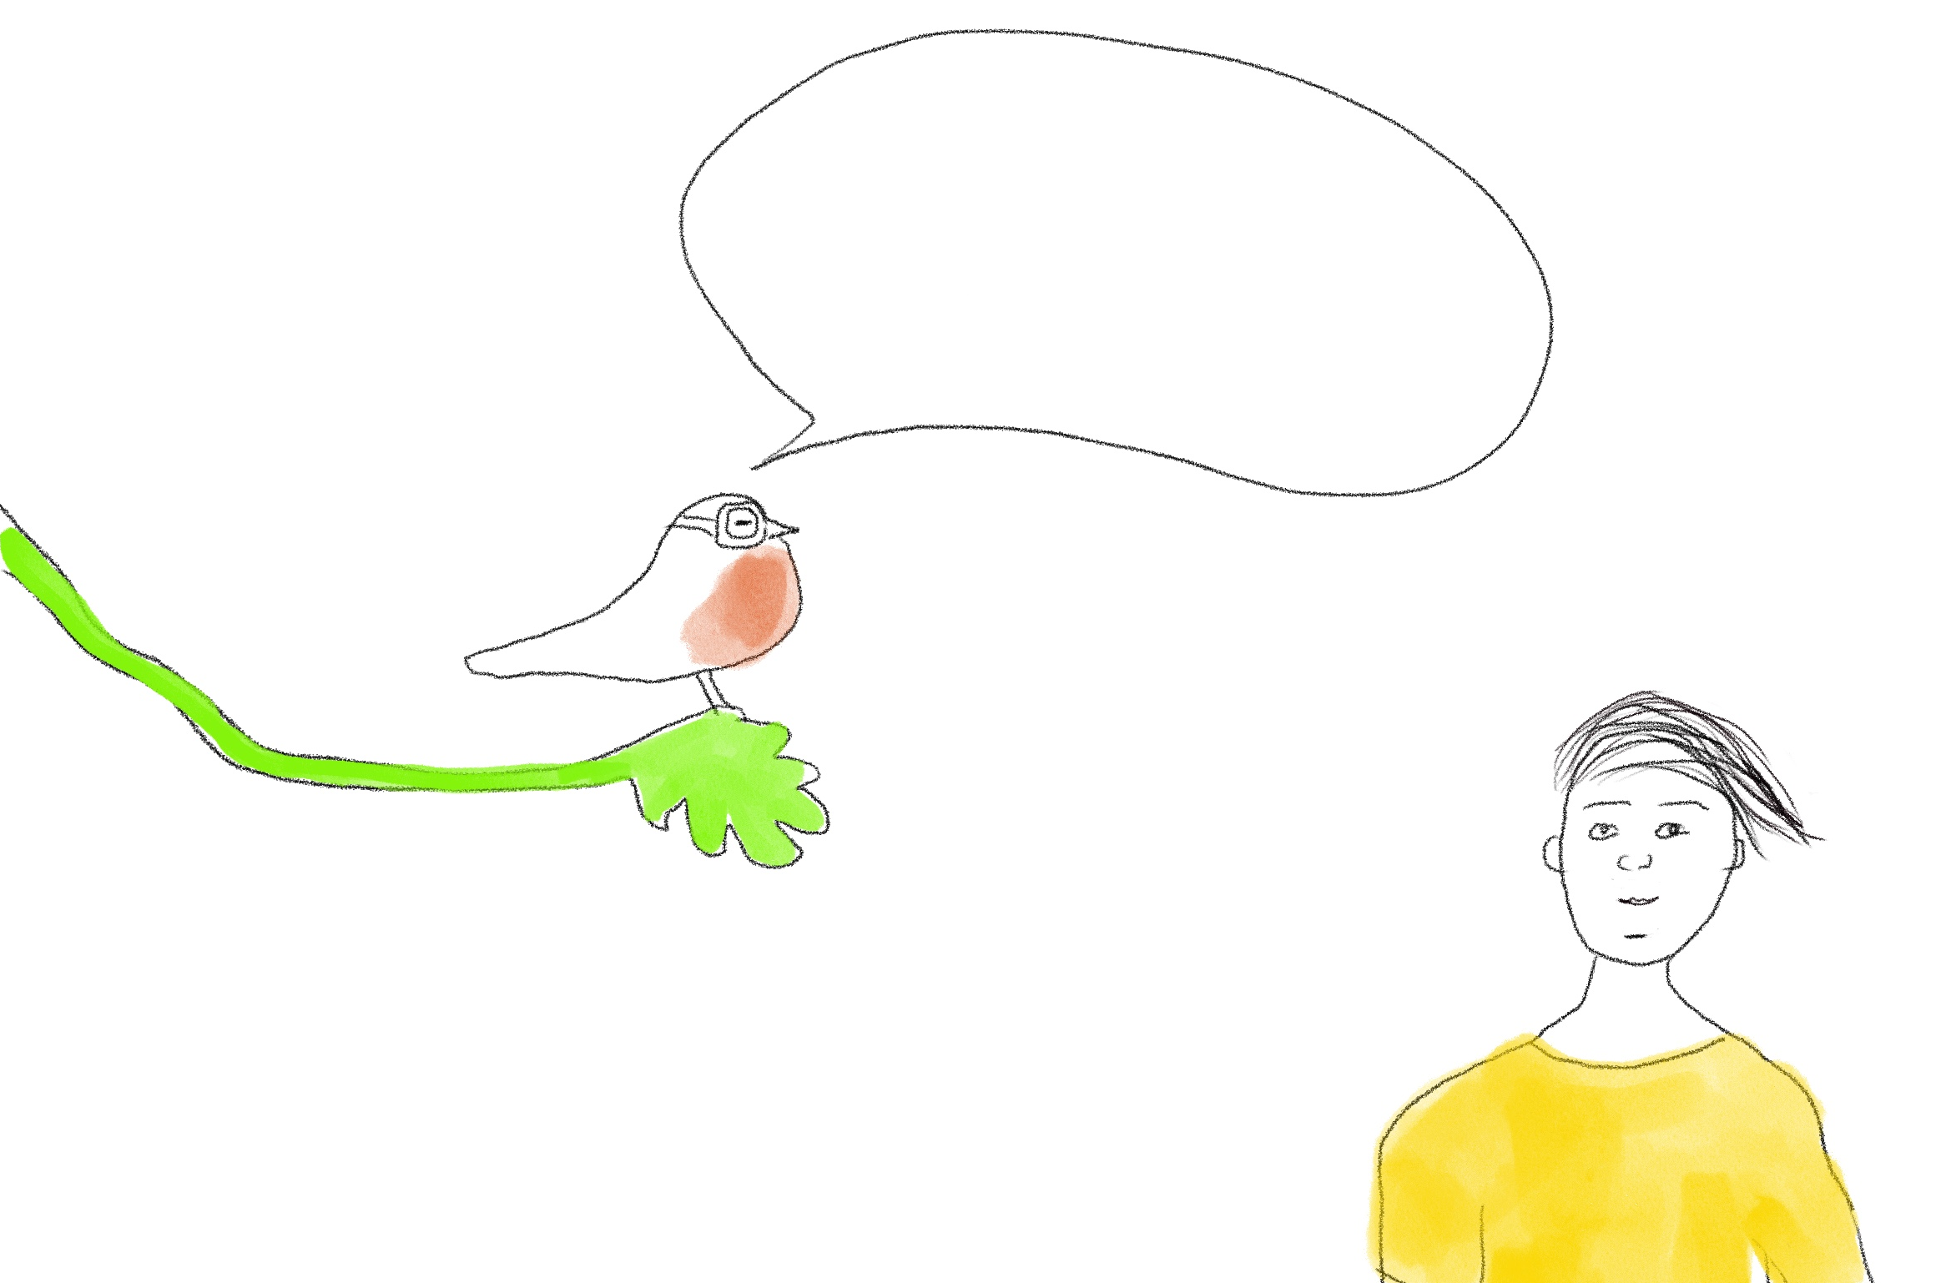
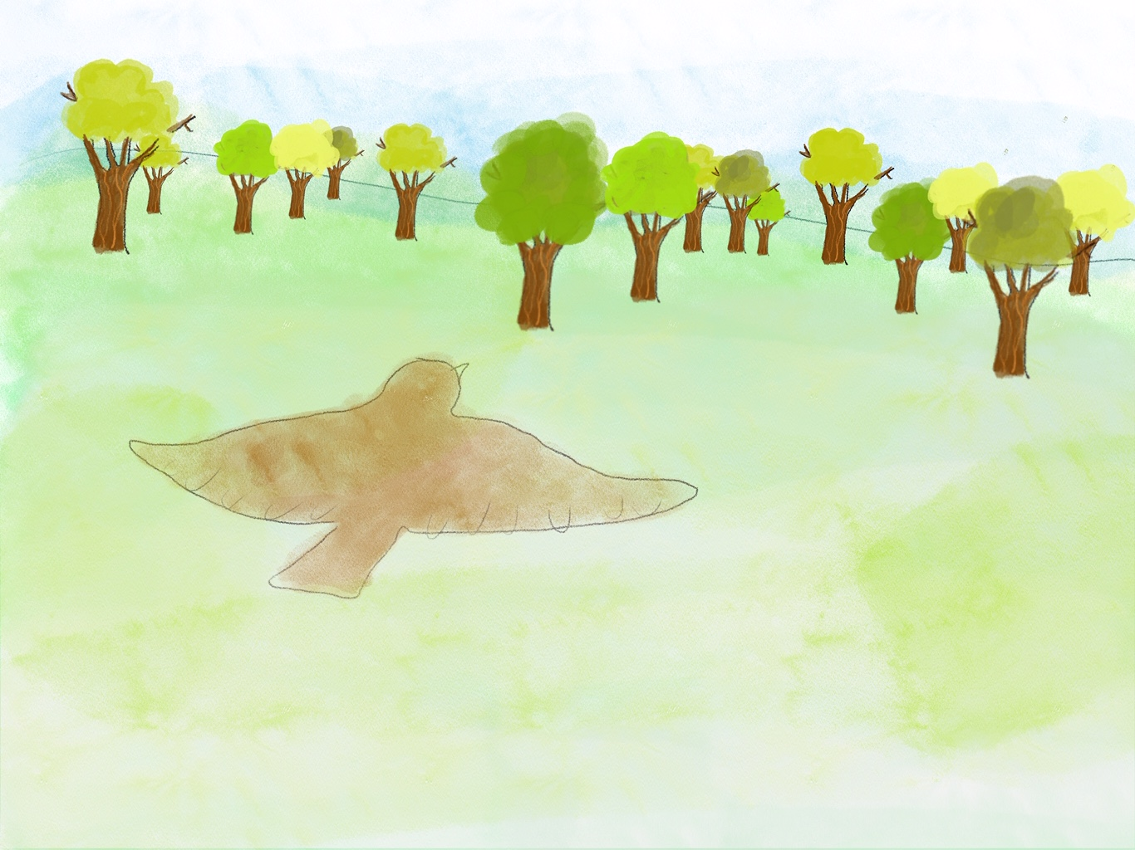
Are you ready for
an adventure to help
the forests?
Draw a line in the middle of your page so you have two cartoon boxes to draw your cartoon story.
You will need a few cartoon boxes to tell all the story.
Let’s go…

Slide 14
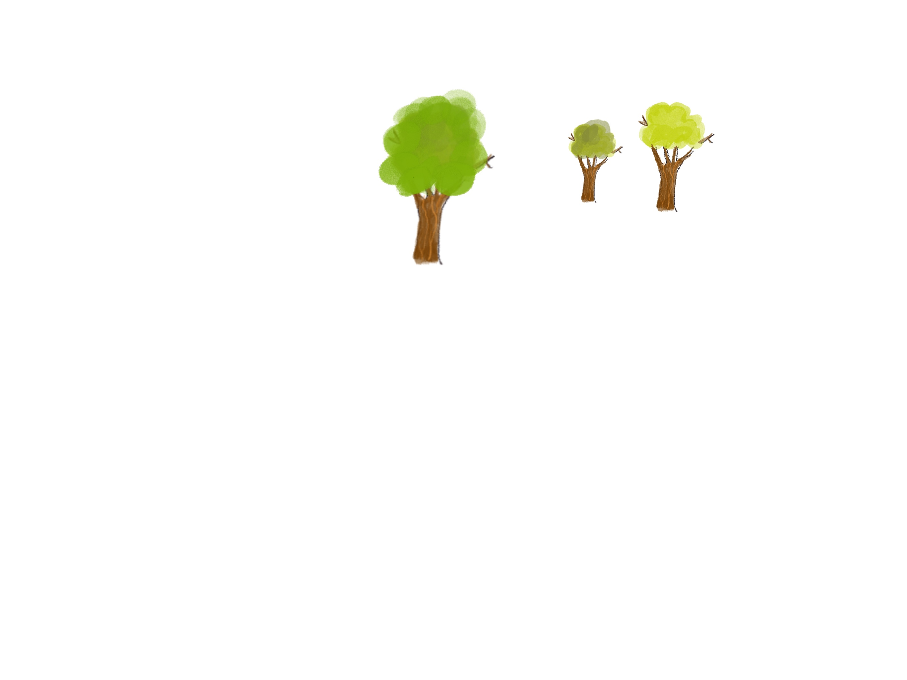
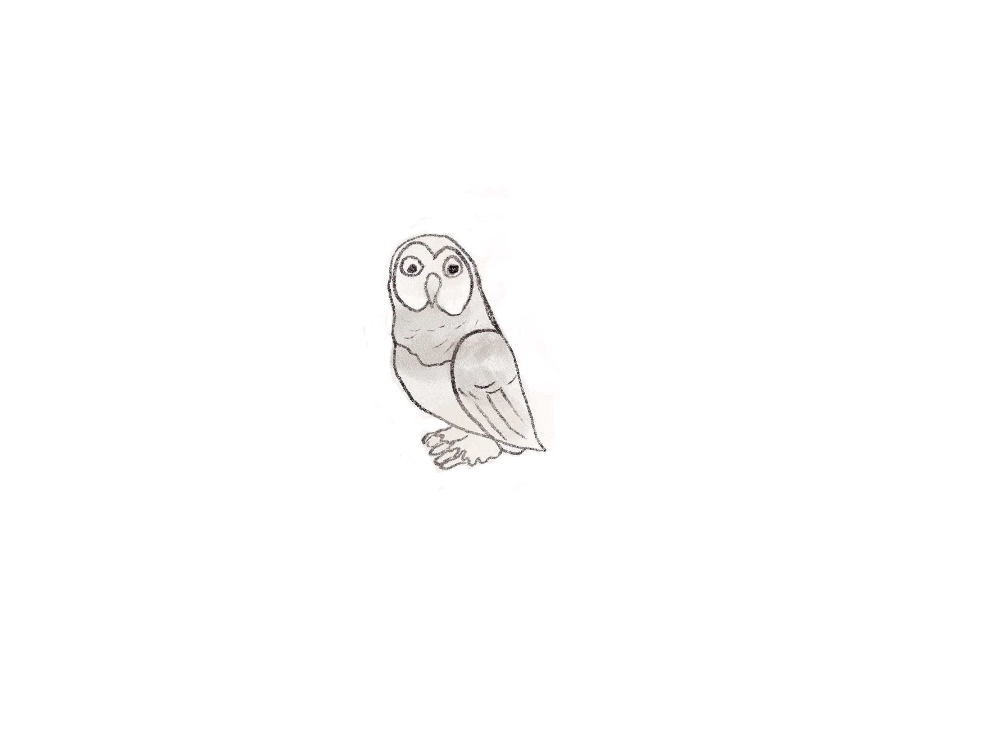
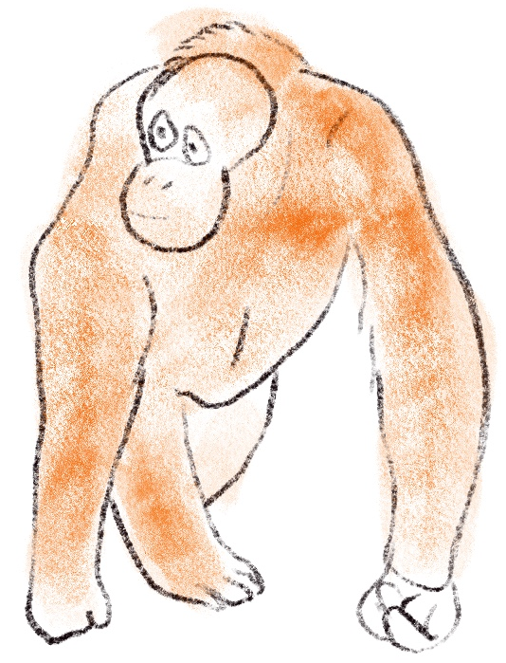
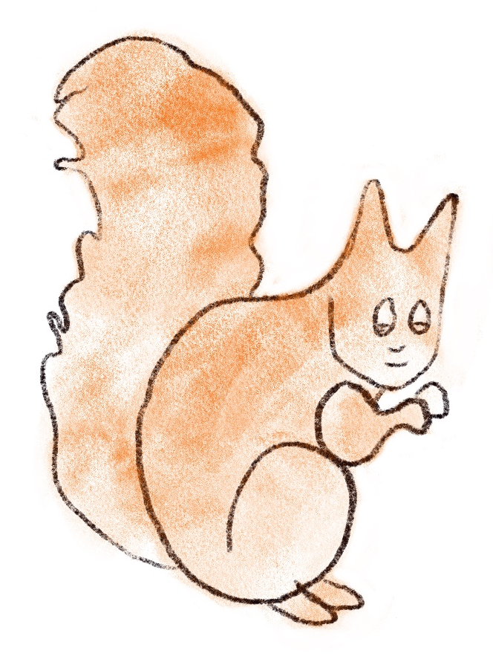
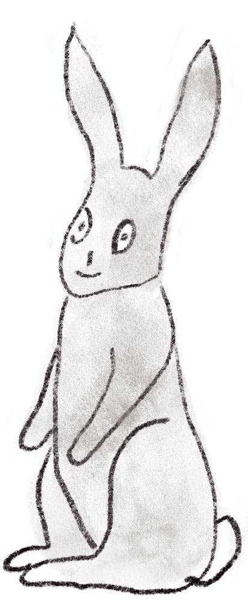
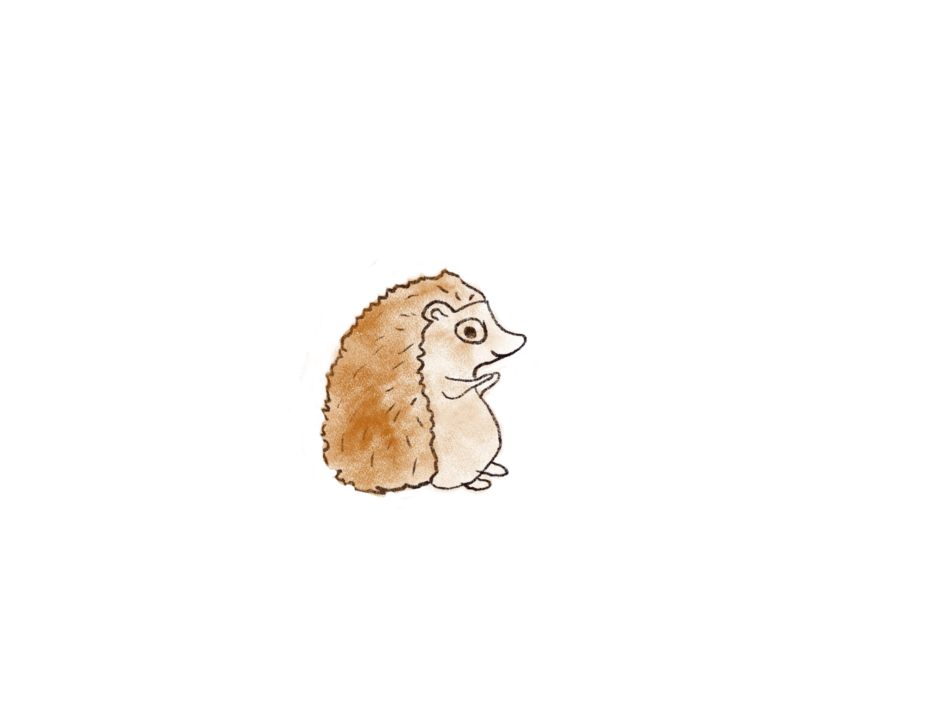
These are some of the characters you might meet along the way

Slide 15

Click for kids folk dancing website
http://resources.hwb.wales.gov.uk/VTC/2017/dawnsio-gwerin-english/index.html

Slide 16
End of the day stretches
Make your body loose and free

