Slide 1

MAKE GOOD THINGS HAPPEN
Day 11 EARTH CARE
Materials free for classroom use

Slide 2



stretch 1
Make your body loose and free
Swing your arms open and hug yourself 5 times

Slide 3


stretch 2
Make your body loose and free
Flap your arms like a bird 5 times

Slide 4





stretch 3
Make your body loose and free
Roll your shoulders in a circle 5 times

Slide 5


cloud meditation
Press
cloud
to
play

Slide 6
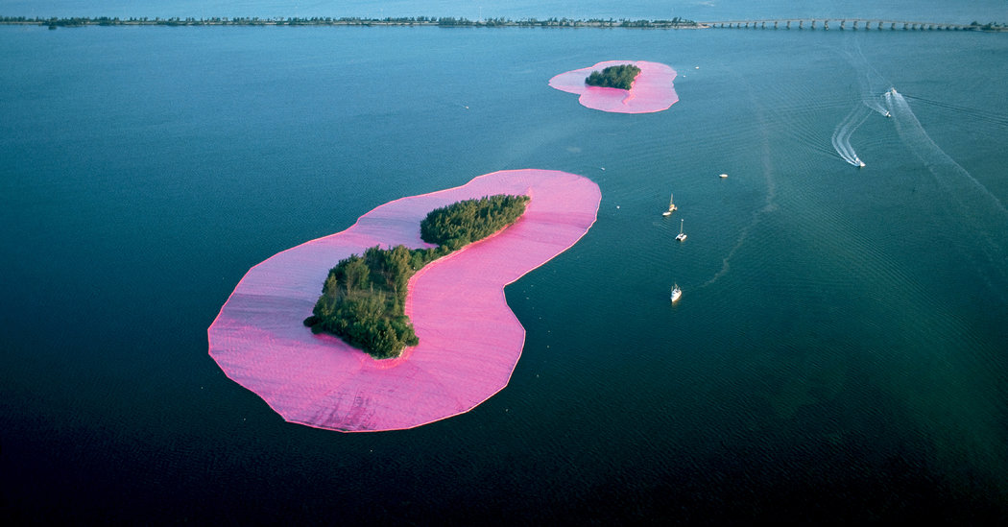
The biggest artwork
in the world?
Wrapped Islands by Christo & Jeanne-Claude

Slide 7
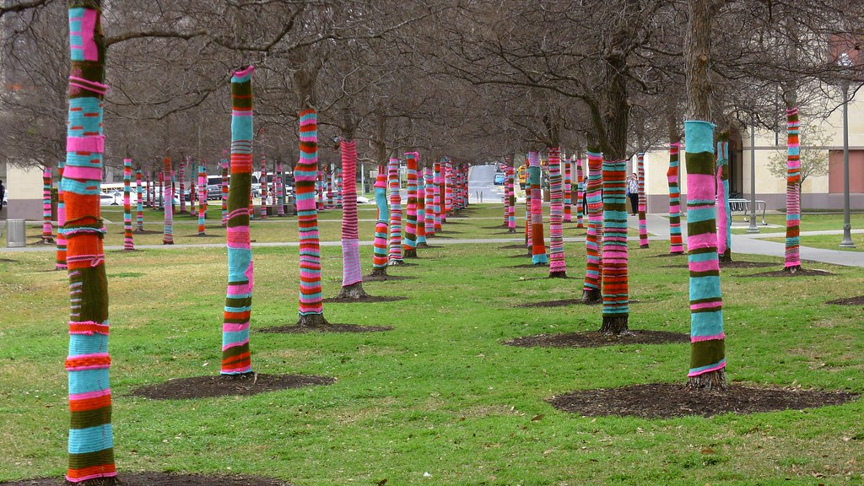
Wrapped Trees

Slide 8
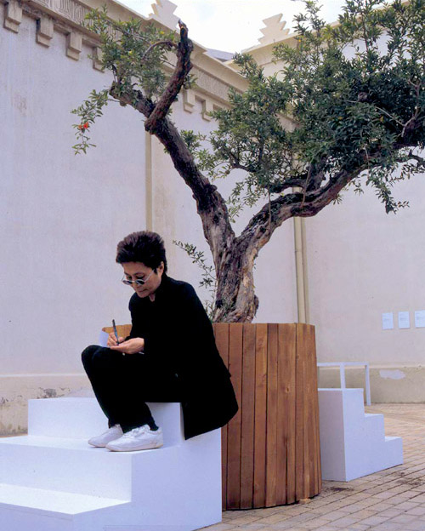
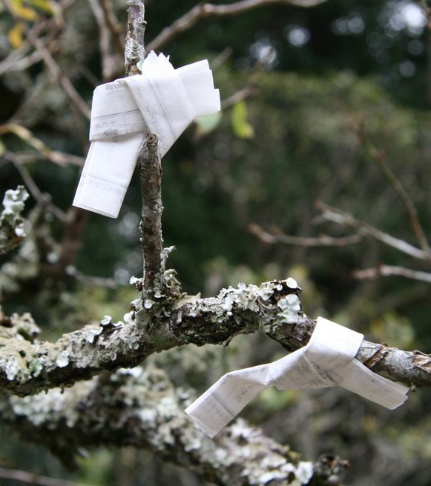
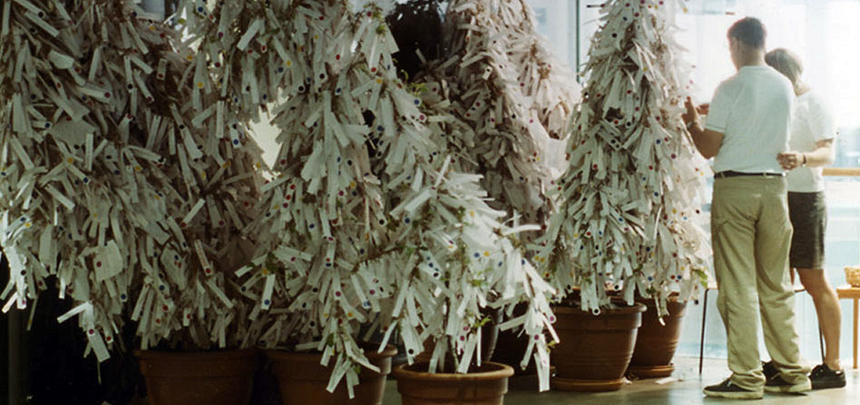
Wish Trees
“As a child in Japan, I used to go to a temple and write out a wish on a piece of thin paper and tie it around the branch of a tree. Trees in temple courtyards were always filled with people’s wish knots, which looked like white flowers blossoming from afar.” Yoko Ono
Wish knots on a temple tree in Japan
Above is Artist Yoko Ono: ‘All My Works Are A Form Of Wishing’
A wish tree inspired by Yoko Ono’s project
Around the world

Slide 9

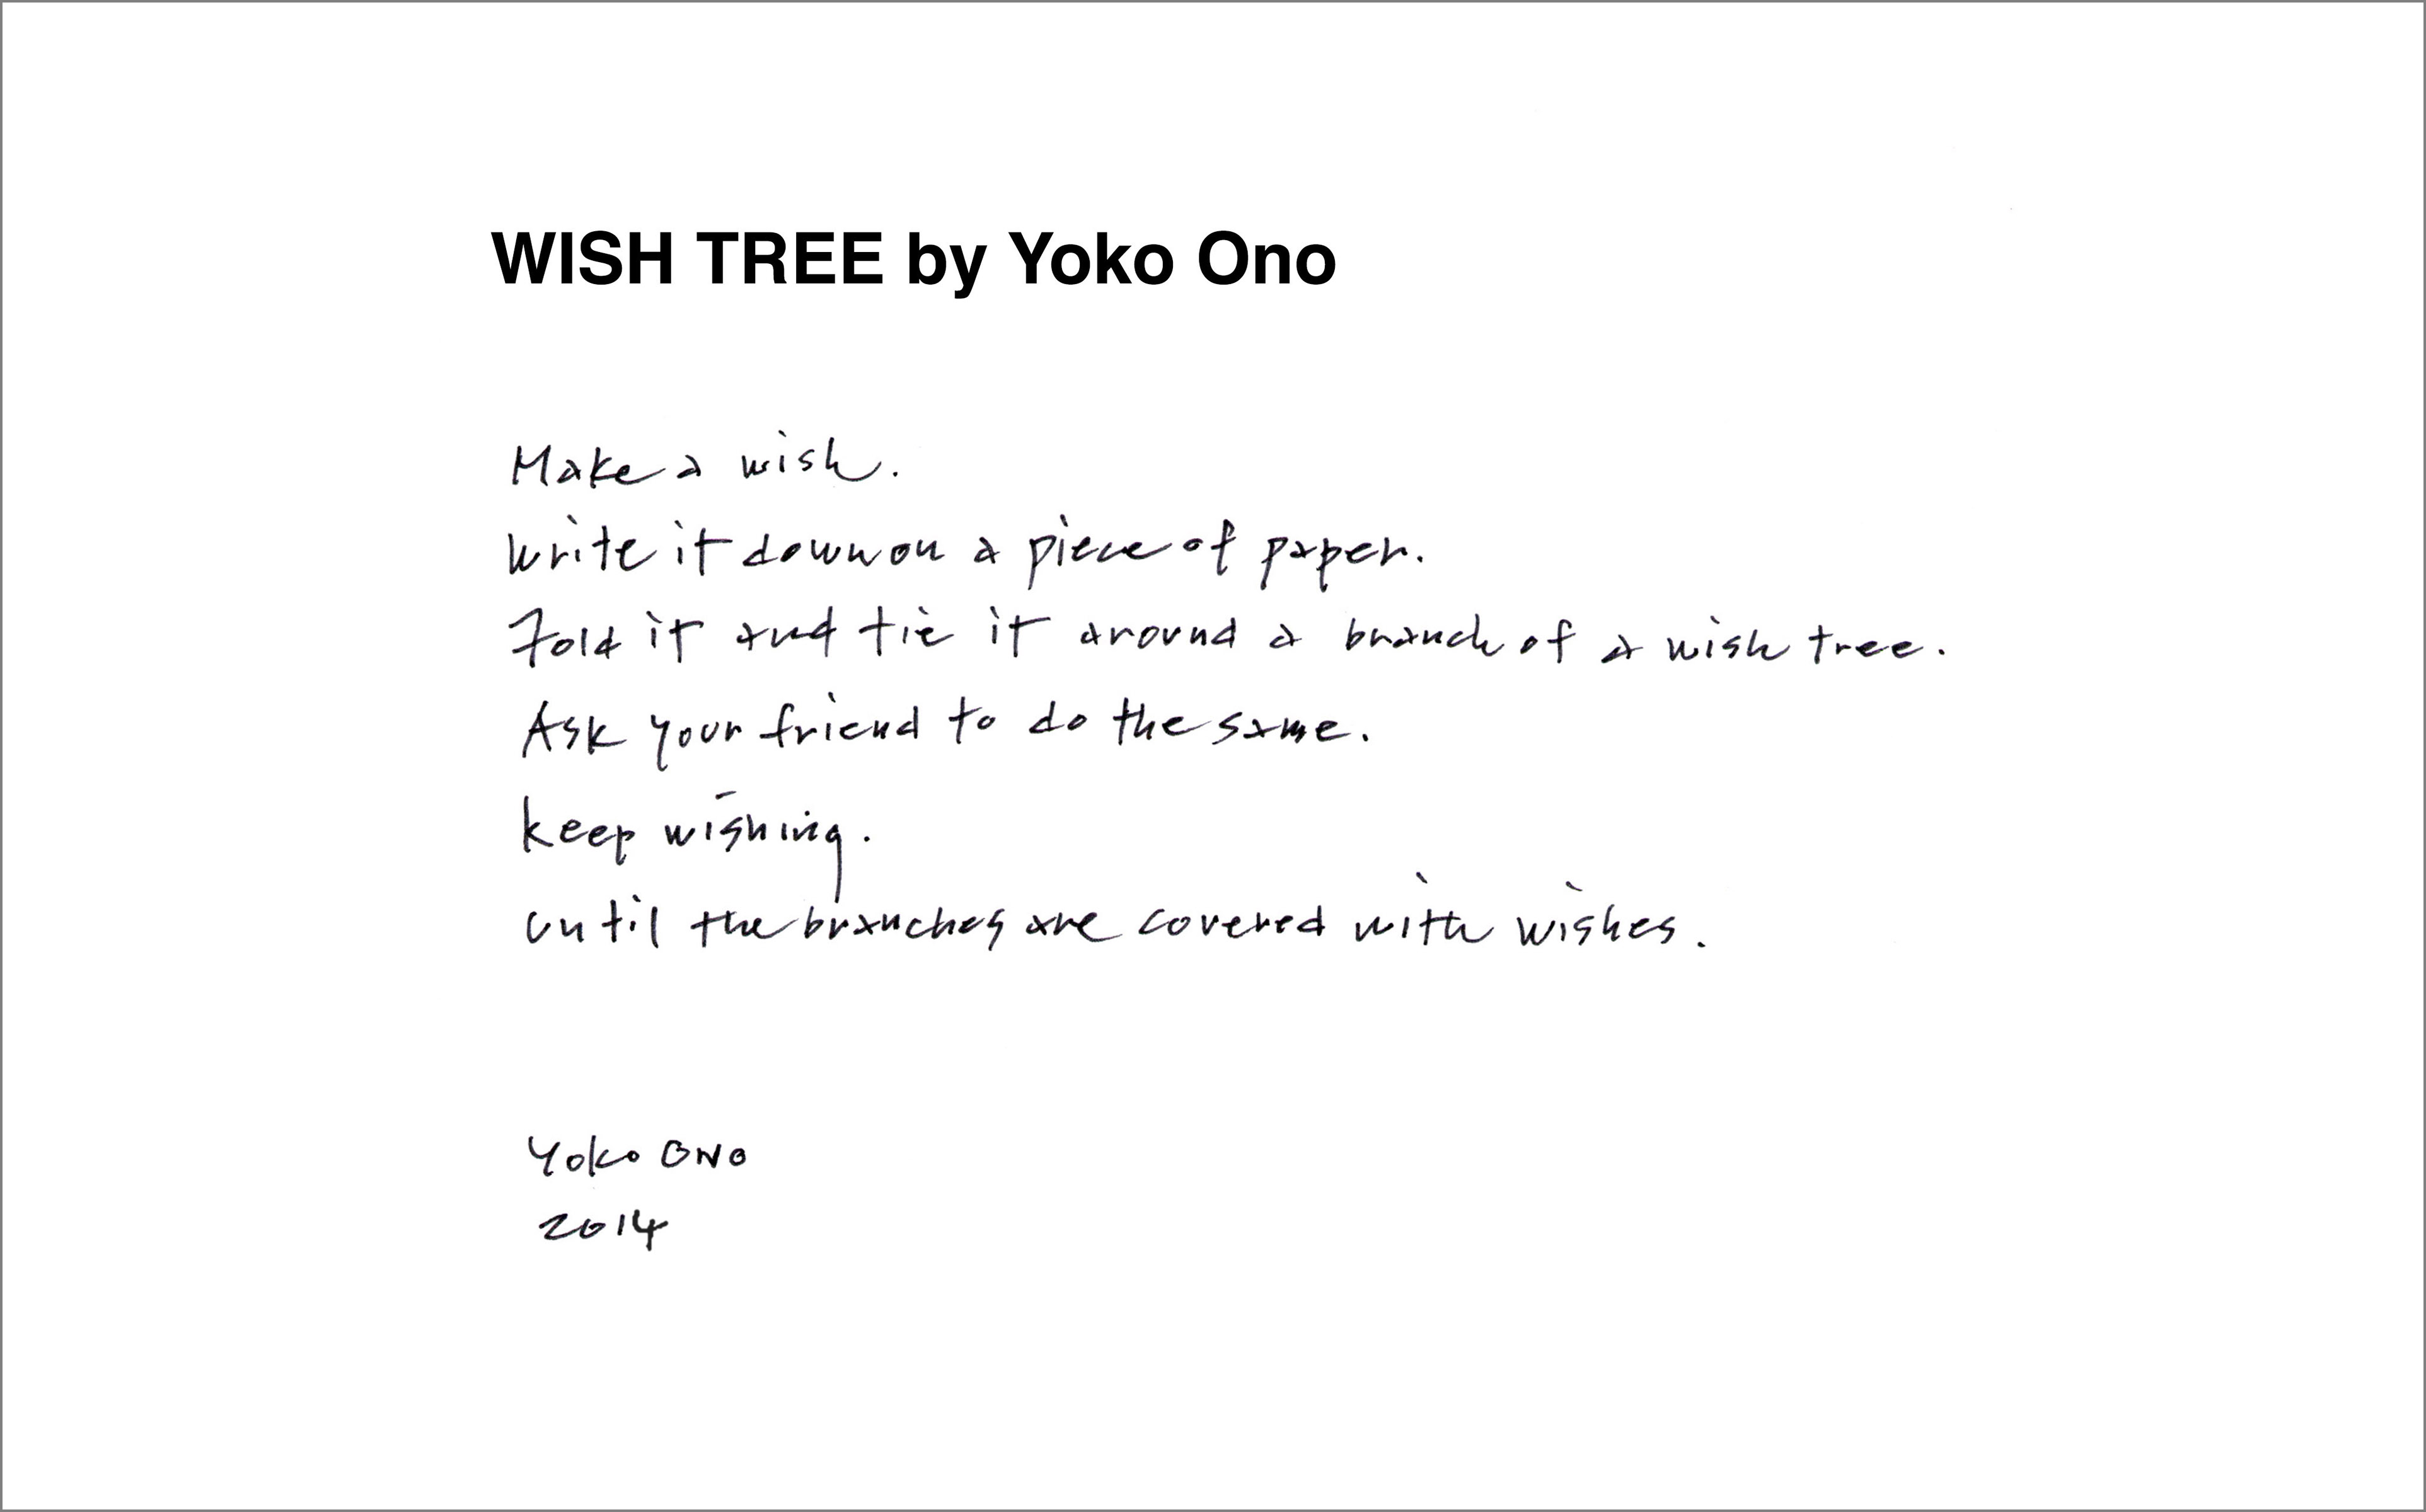
Yoko Ono has now collected 1 million wishes from wish trees
that people have created in schools and communities around the world.
Create a wish tree. Make it as beautiful as you can so that people feel happy when they see it.

Slide 10
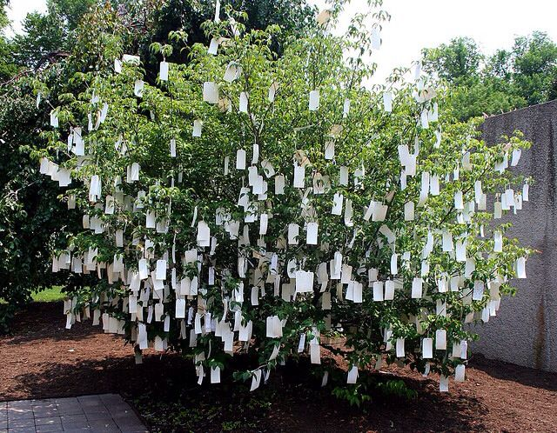
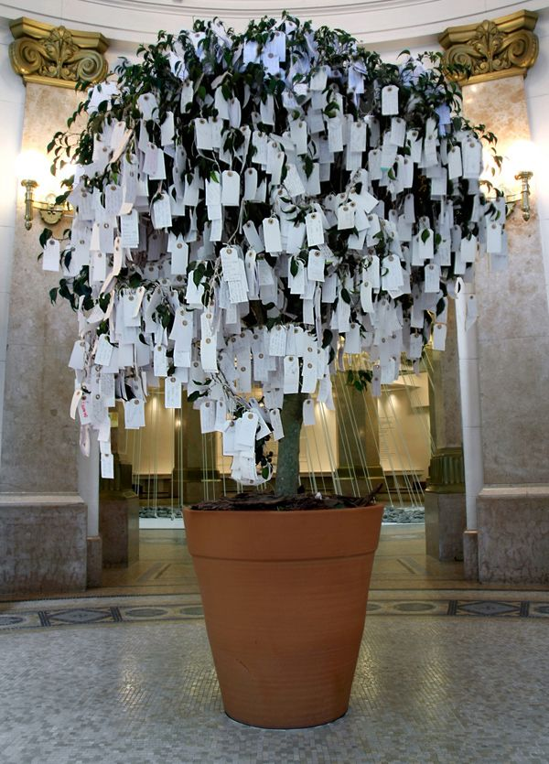
The wish trees can be outside
or inside

Slide 11
Our beautiful Earth

Slide 12
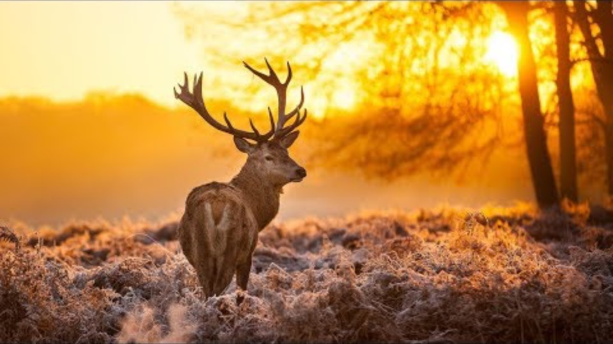
Film clip - click and wait to load.
Make sure you have enabled live content below menu bar.

Slide 13
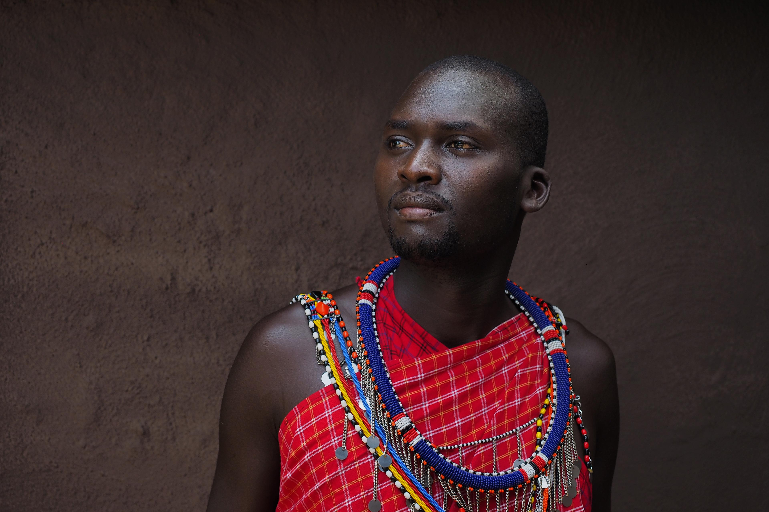
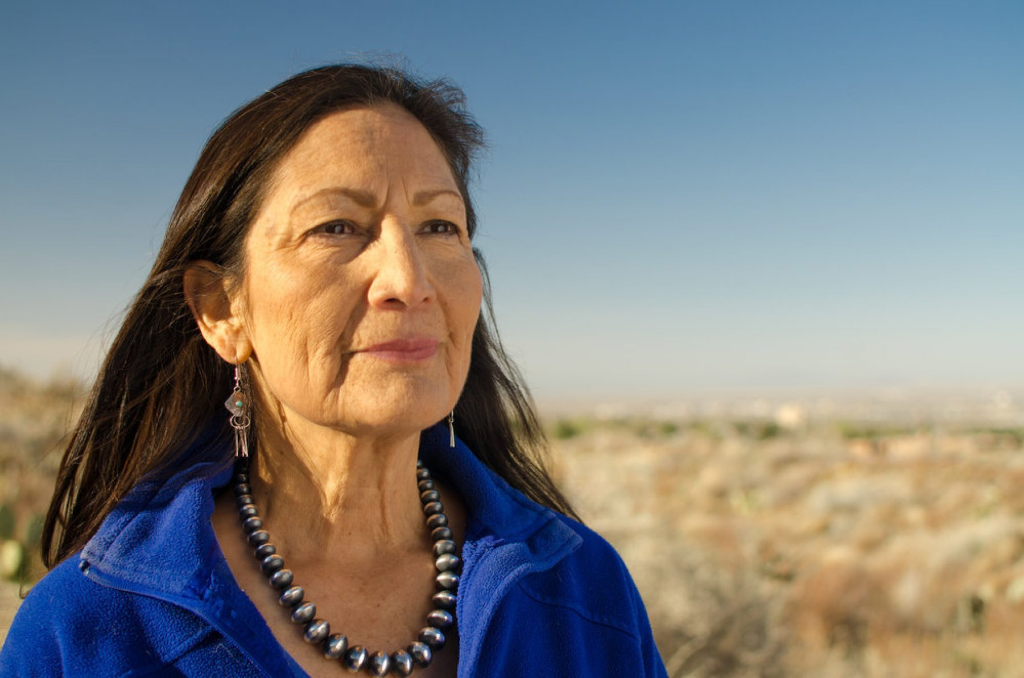
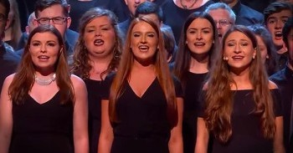
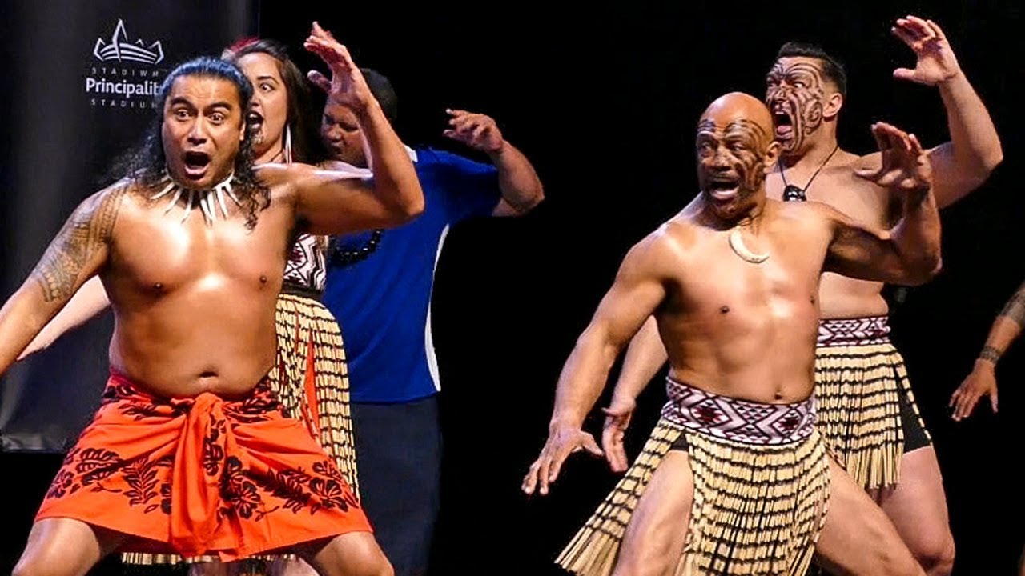
The beautiful people of the earth

Slide 14
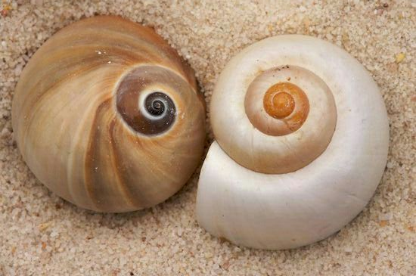
Beauty
in small
things

Slide 15
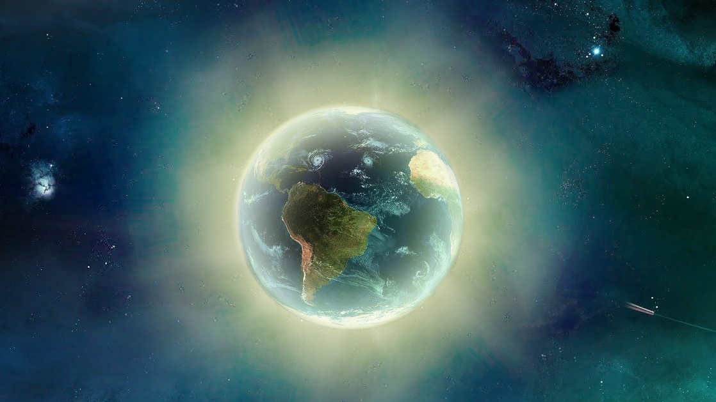
Send Rays
of Heartle
to the world
Press to play

Slide 16
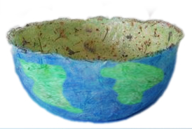
WORLD BOWL
Today we can paint the bowl (if it’s dry)
with oceans and continents on the outside
And decorate the inside with a beautiful pattern from nature

Slide 17
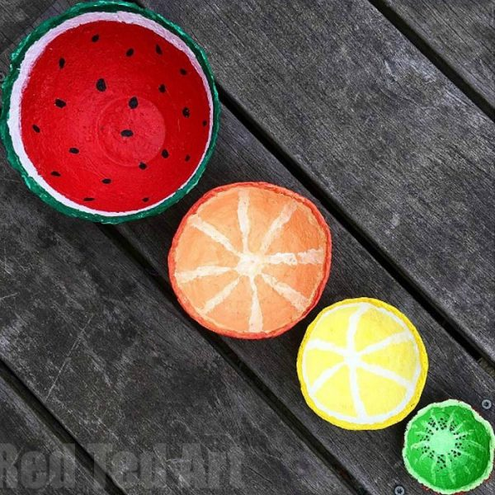
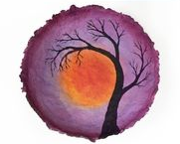
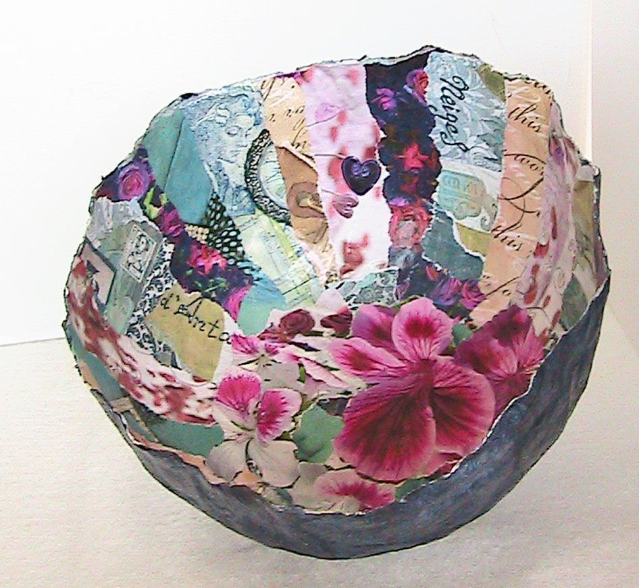
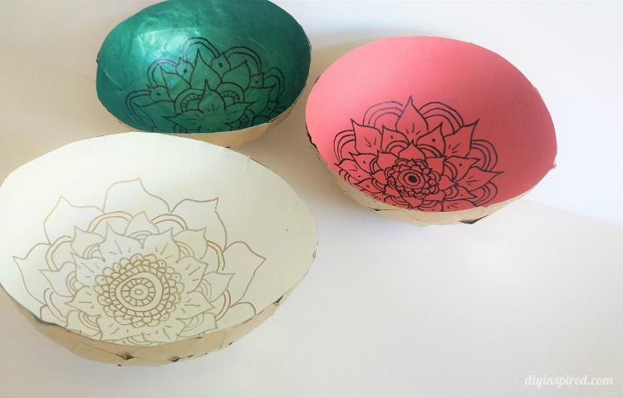
Create something beautiful from the natural world to decorate
the inside of your world bowl

Slide 18

Click for kids folk dancing website
http://resources.hwb.wales.gov.uk/VTC/2017/dawnsio-gwerin-english/index.html

Slide 19
End of the day stretches
Make your body loose and free

