Slide 1

MAKE GOOD THINGS HAPPEN
Day 10 LOOKING AFTER OUR COUNTRY
Materials free for classroom use

Slide 2



stretch 1
Make your body loose and free
Swing your arms open and hug yourself 5 times

Slide 3


stretch 2
Make your body loose and free
Flap your arms like a bird 5 times

Slide 4





stretch 3
Make your body loose and free
Roll your shoulders in a circle 5 times

Slide 5


cloud meditation
Press
cloud
to
play

Slide 6
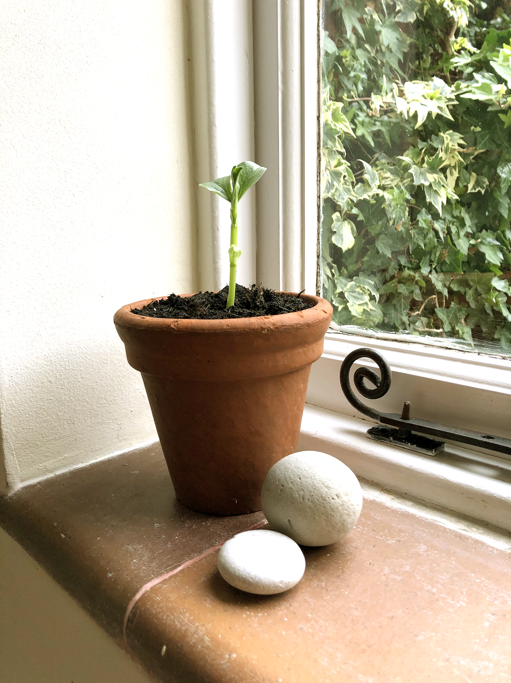
Grow a seed
Grow a seed
Everything wants to grow and be the best it can be. Each plant needs something different to grow well.
.
Choose a seed.
Find out what conditions it needs to grow well.
Look after it and see how strong and healthy it can become. Sometimes we need a few tries to get it right.

Slide 7
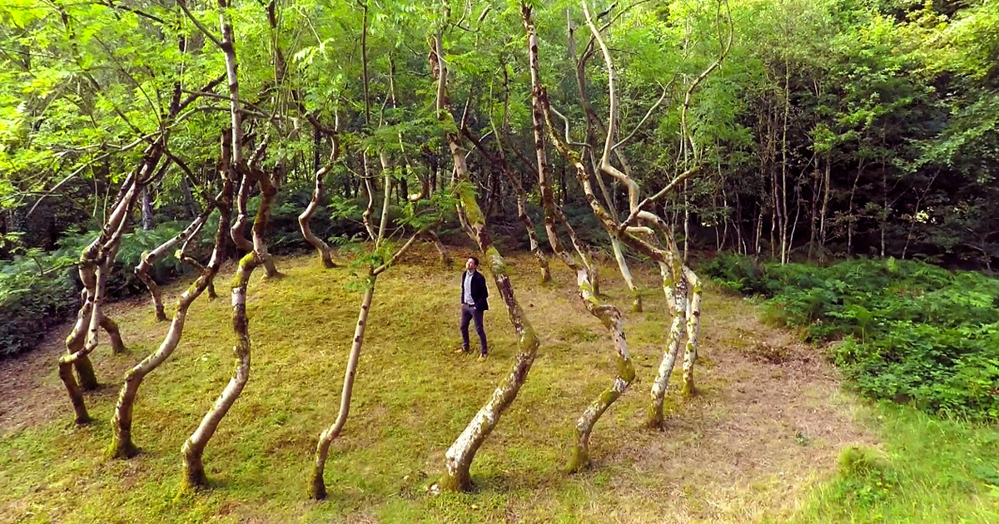
A living work of art
Ash Dome. Planted 40 years ago by sculptor David Nash

Slide 8
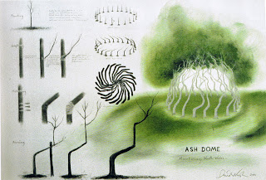
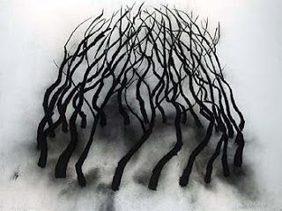
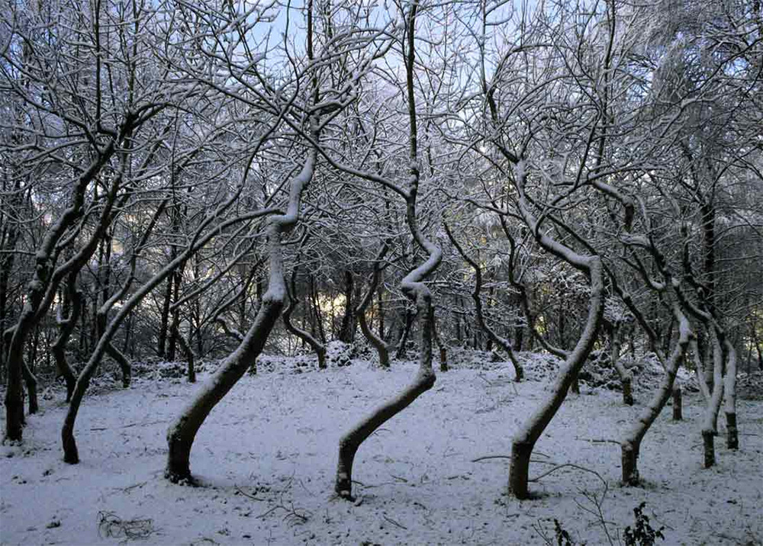
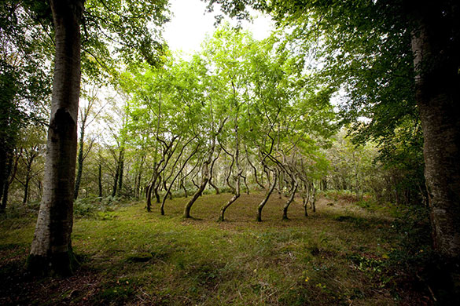
First imagining it.
Then drawing it
Then working out
how to do it
40 years
of pruning
the trees
and watching them slowly grow.

Slide 9
Looking after our country
is like being a really good gardener.
Caring enough
to make the right conditions
for everyone to become amazing
.

Slide 10

Send Rays
of Heartle
to the people
taking care of our country
Press to play

Slide 11
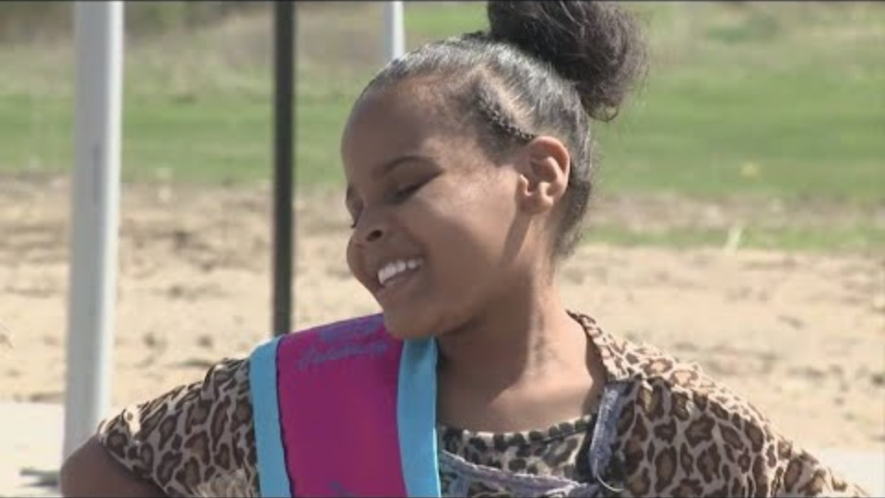
8 year old
American
Writes
to her
President
TO HELP HER CITY
Film clip - click and wait to load.
Make sure you have enabled live content below menu bar.

Slide 12
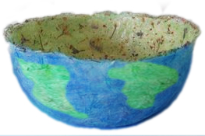
what can we do to help the world?
Make a paper mache world bowl
It will take a day or two to dry….
When its dry we will do the next part of painting it with oceans and countries
While you are making the bowl think of some ideas to make the world a better place.
Ready to put them in the world bowl when its finished

Slide 13

Film clip - click and wait to load.
Make sure you have enabled live content below menu bar.

Slide 14
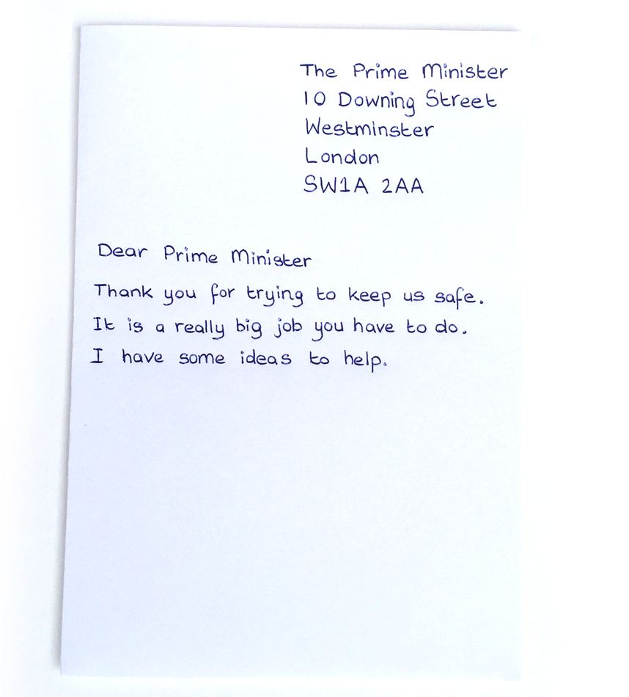
WE LOVE
GOOD IDEAS for our COUNTRY
Prime Ministers always want to make our country a wonderful place. So they need us to give them good ideas.
Send a letter to the Prime Minister or First Minister of your county to thank them for taking care of us.
Tell them what ideas you have
to make our country even better.

Slide 15
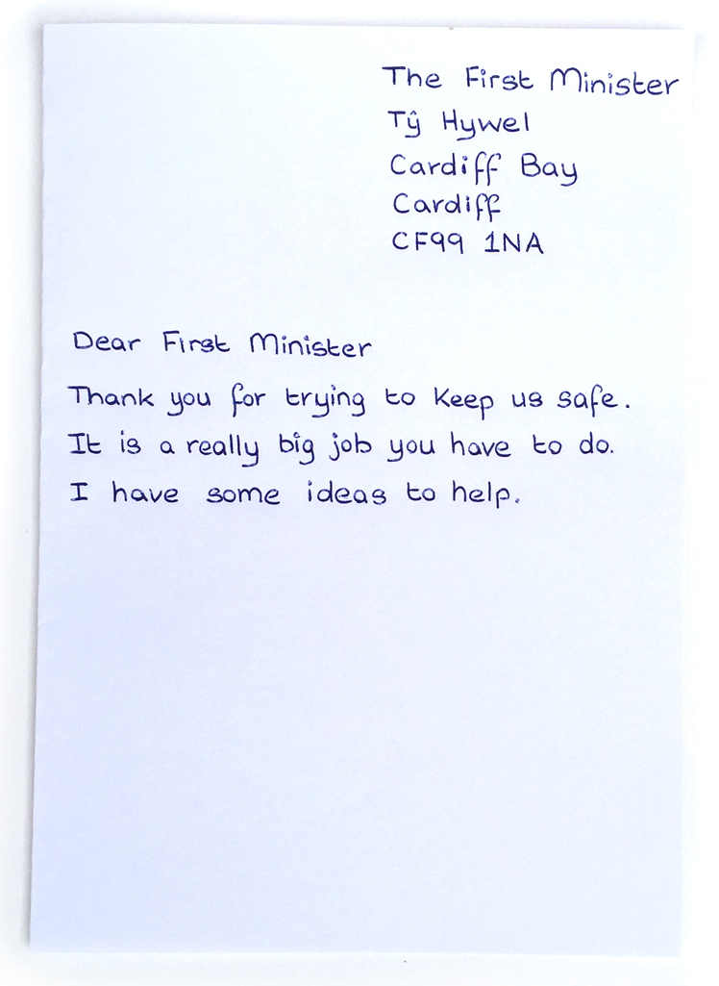
Good ideas for WALES

Slide 16
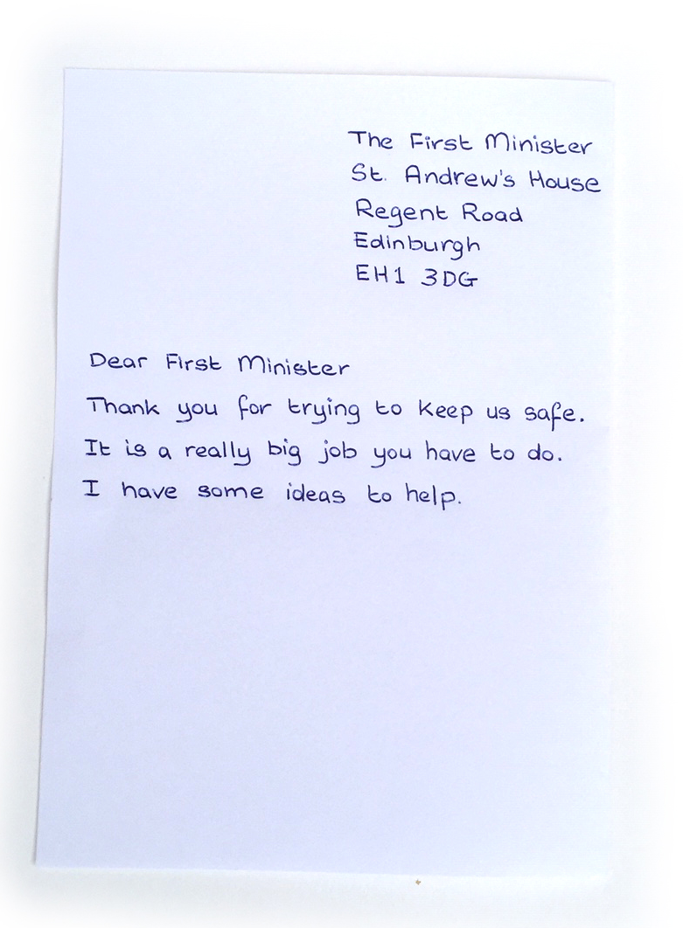
Good ideas for Scotland

Slide 17

Click for kids folk dancing website
http://resources.hwb.wales.gov.uk/VTC/2017/dawnsio-gwerin-english/index.html

Slide 18
End of the day stretches
Make your body loose and free

