Slide 1

MAKE GOOD THINGS HAPPEN
Day 1
Day 1
Materials free for classroom use

Slide 2



stretch 1
Make your body loose and free
Swing your arms open and hug yourself 5 times

Slide 3


stretch 2
Make your body loose and free
Flap your arms like a bird 5 times

Slide 4





stretch 3
Make your body loose and free
Roll your shoulders in a circle 5 times

Slide 5
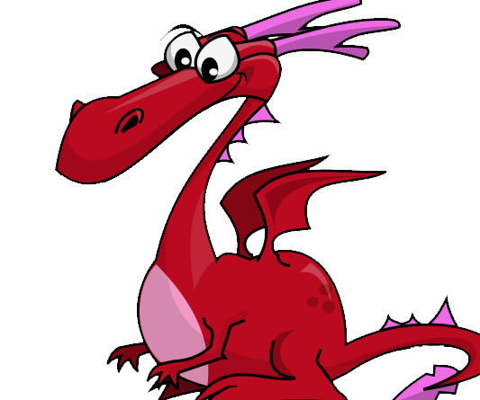
FEED THE DRAGON
Dragons love worry clouds, they find them very tasty, they gobble them down and usually make a very smelly burb afterwards.
No other creature enjoys a good meal of other people’s worries. They get happier and happier the more worries you give them.
Write your worries on the worry paper and post them in the box for the dragon to eat. There won’t be any left by the morning.

Slide 6

NATURE ART
collect natural things
arrange in a spiral
or a circle
or any shape at all

Slide 7


Slide 8
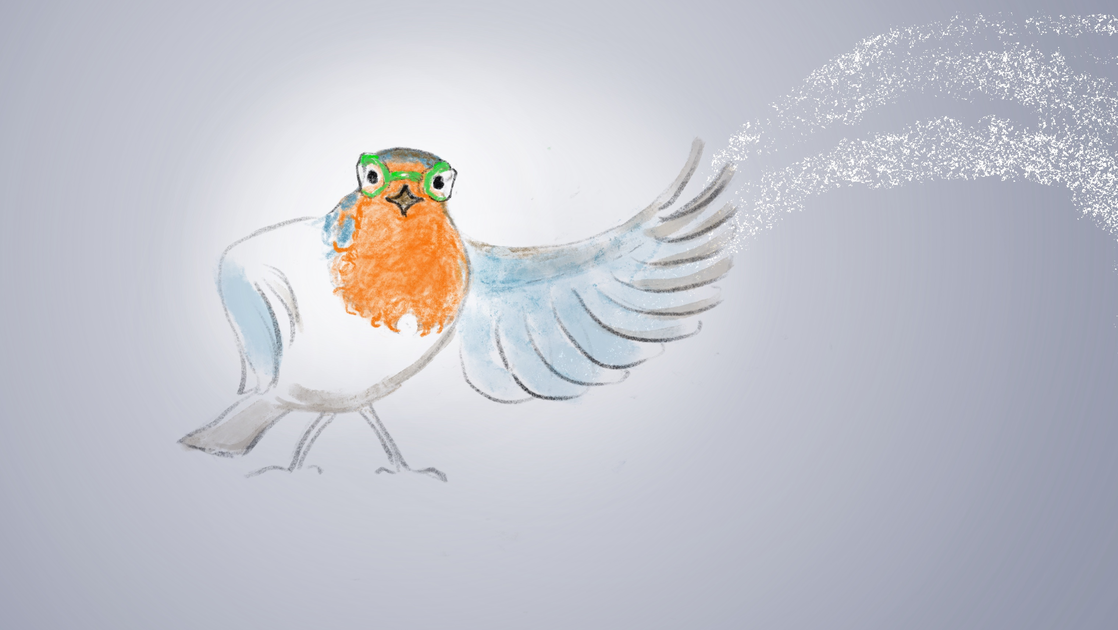
Robyn and the
Three Secrets
Chapter 1

Slide 9
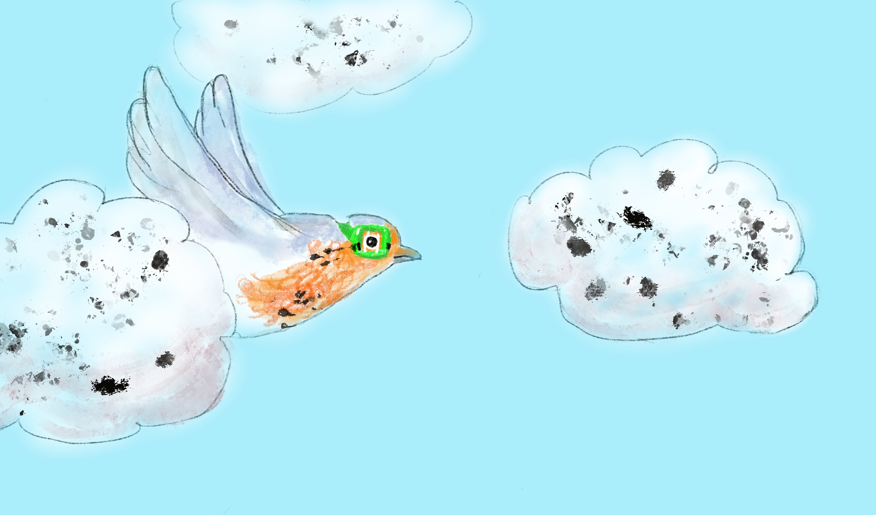
splat

Slide 10
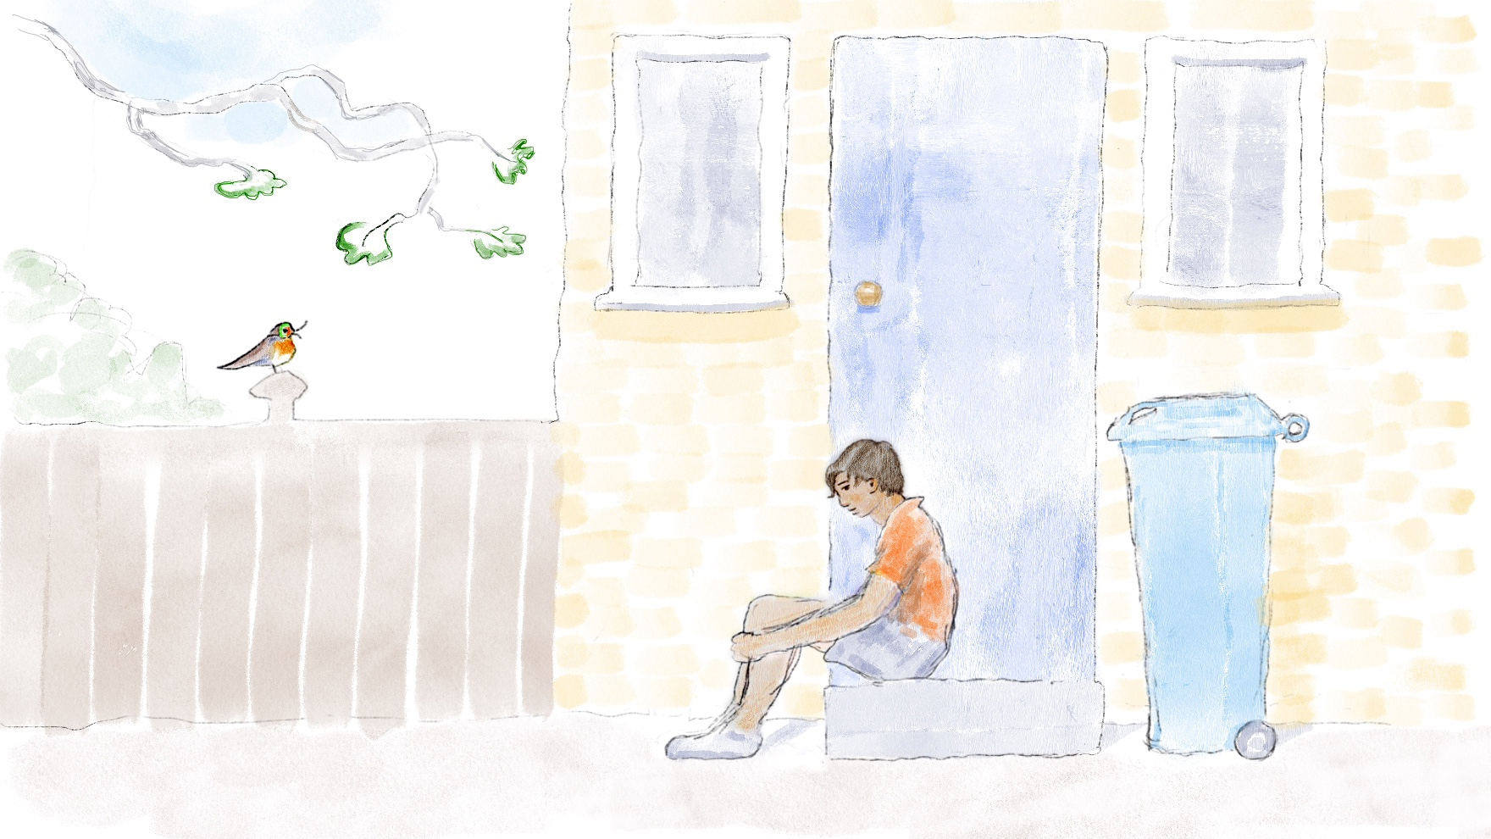

Slide 11
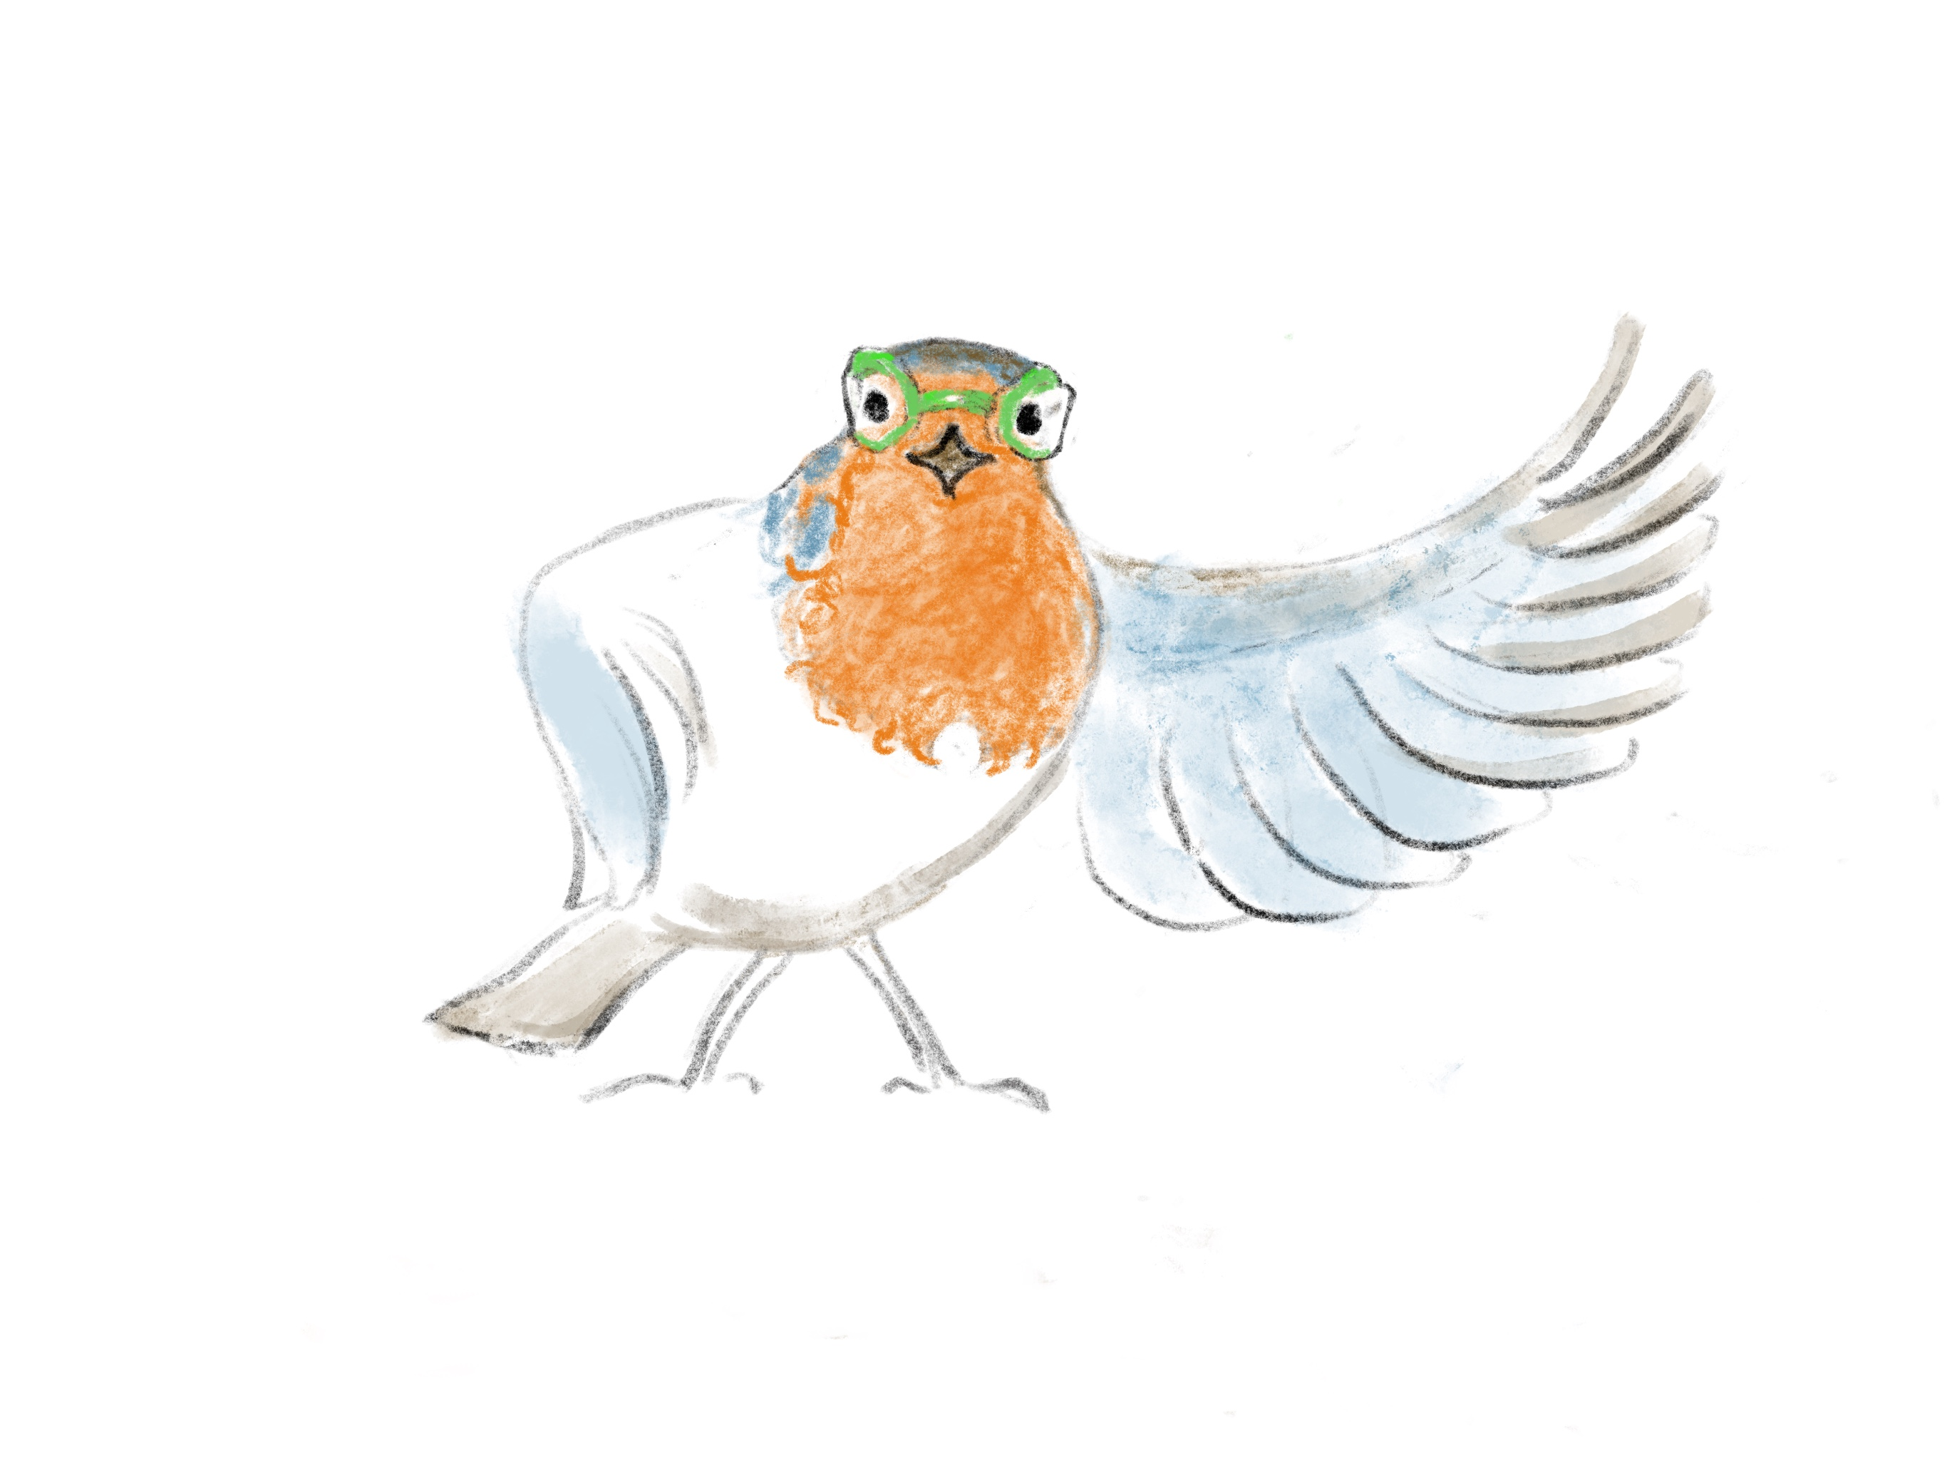

Slide 12
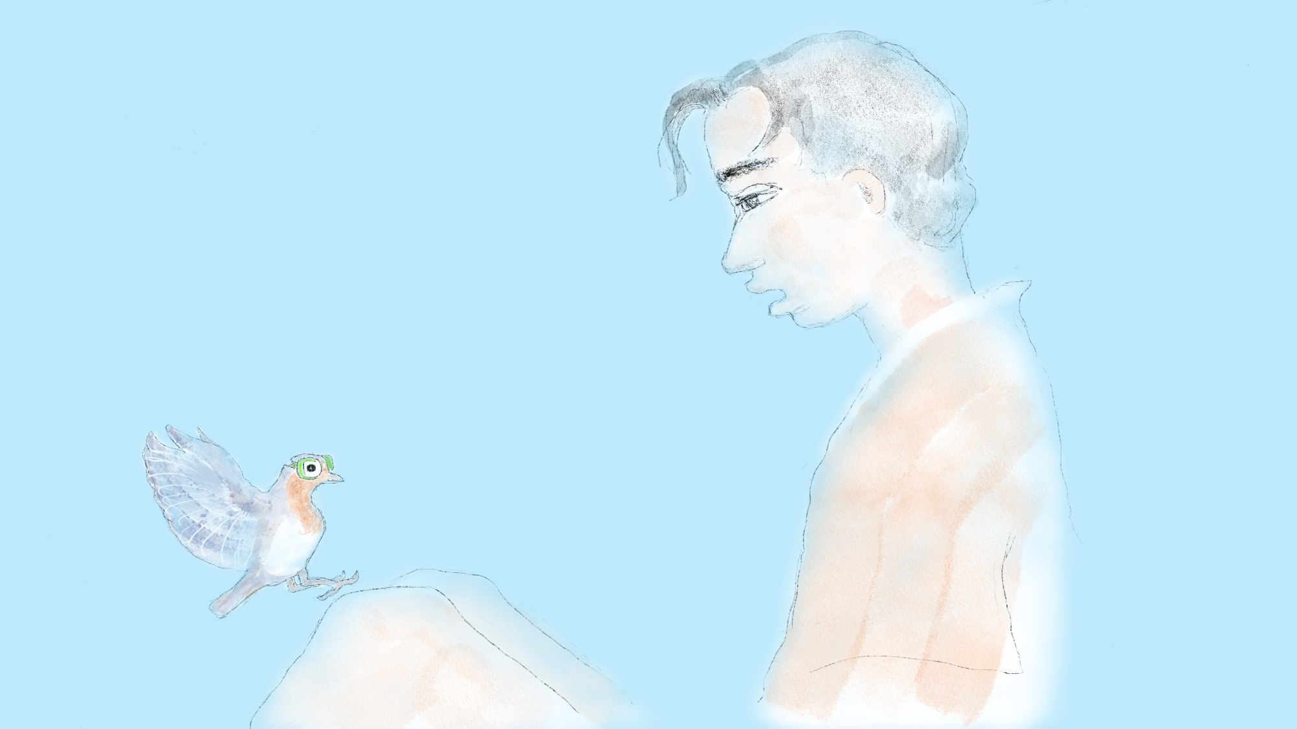

Slide 13


cloud meditation
Press
cloud
to
play

Slide 14
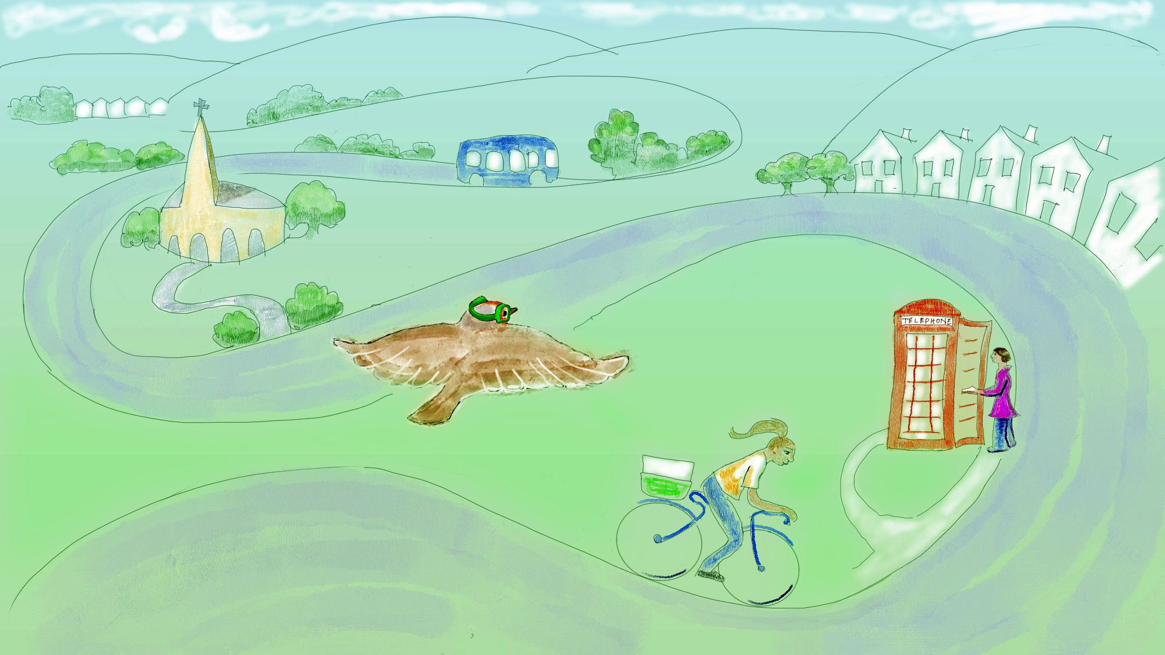

Slide 15
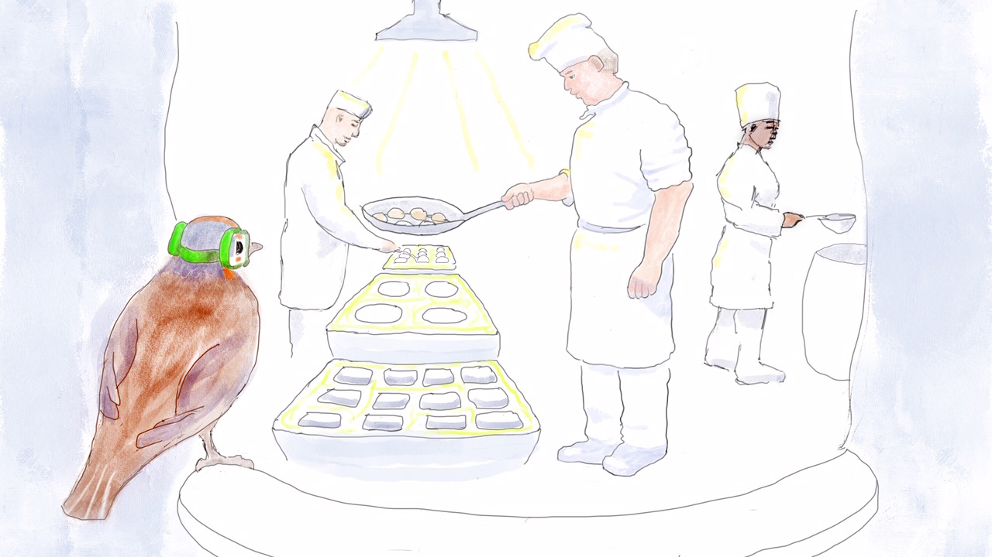

Slide 16
GOOD IDEAS
THAT MAKE THE WORLD
A BETTER PLACE
LITTLE IDEAS
OR VERY BIG IDEAS

Slide 17
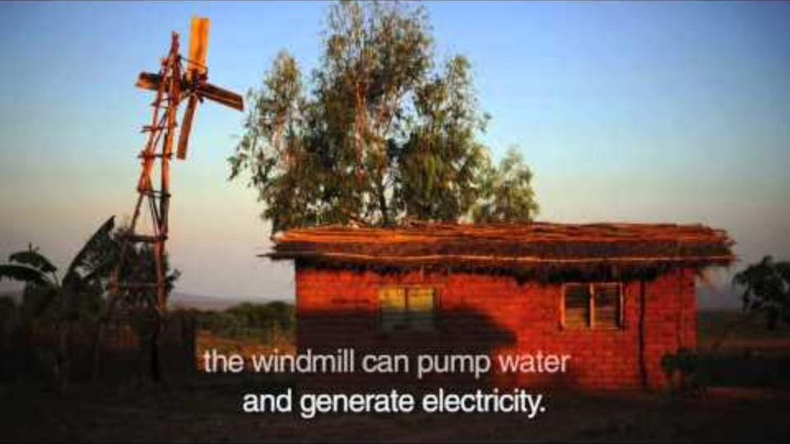
The boy who
made a windmill
from scrap
FOR HIS FAMILY
Film clip - click and wait to load.
Make sure you have enabled live content below menu bar

Slide 18
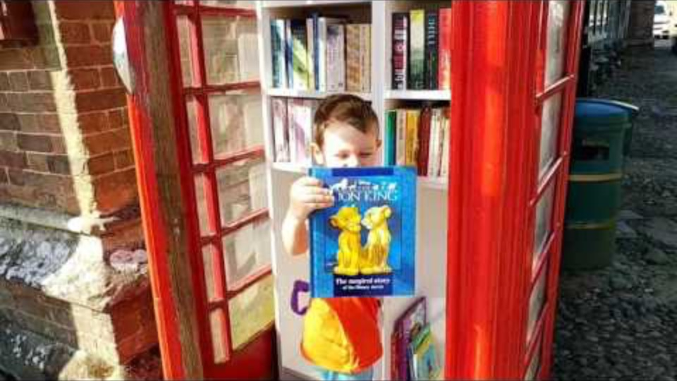
phone box book swap
FOR A VILLAGE
Film clip - click and wait to load.
Make sure you have enabled live content below menu bar

Slide 19

Film clip - click and wait to load.
Make sure you have enabled live content below menu bar
show the view from your window
A little idea that
TRAVELLED ROUND THE WORLD

Slide 20

MAKE GOOD THINGS HAPPEN POSTER
Make a poster
ABOUT HELPING OTHERS
It could be something you do
to help your family or your village.
Or something other people do
to help others.

Slide 21

Click for Folk Dancing Website
http://resources.hwb.wales.gov.uk/VTC/2017/dawnsio-gwerin-english/index.html

Slide 22
End of the day stretches
Make your body loose and free

