Slide 1

MAKE GOOD THINGS HAPPEN
Day 9 BIG HEARTED ONES
Materials free for classroom use

Slide 2



stretch 1
Make your body loose and free
Swing your arms open and hug yourself 5 times

Slide 3


stretch 2
Make your body loose and free
Flap your arms like a bird 5 times

Slide 4





stretch 3
Make your body loose and free
Roll your shoulders in a circle 5 times

Slide 5
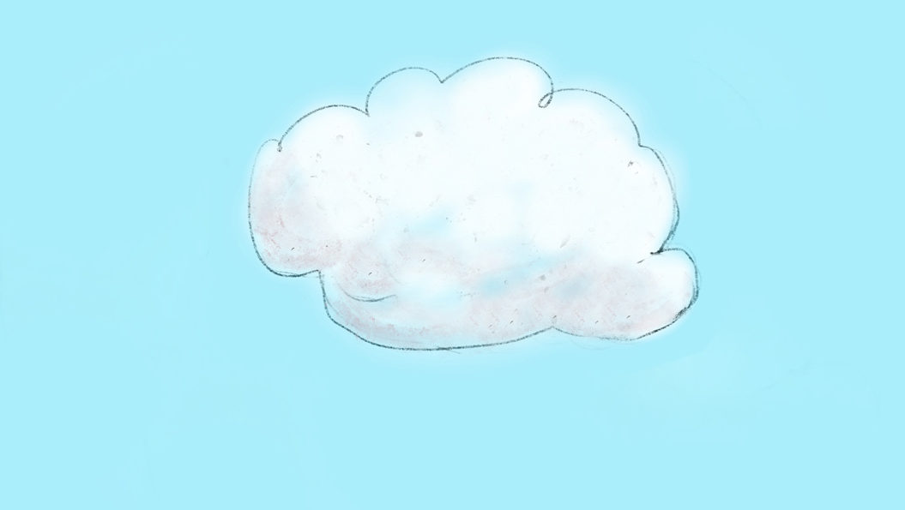

cloud meditation
Press
cloud
to
play

Slide 6
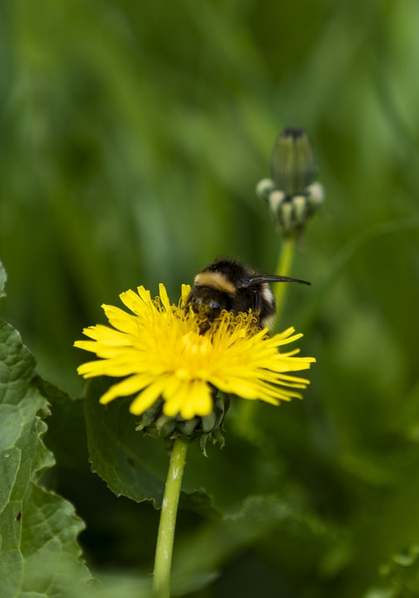
world wide web of
cooperation
Everything in nature helps something else. Have a look outside to see it happening all around you.
A flower that makes us happy and provides nectar for bees.
Trees that give shade and provide nuts for squirrels and other animals.
Ants that carry away dead things. Even flies are important to the web of life
.
Find some small creatures and natural things and work out how they help something else.

Slide 7
In nature
who helps who?
.

Slide 8
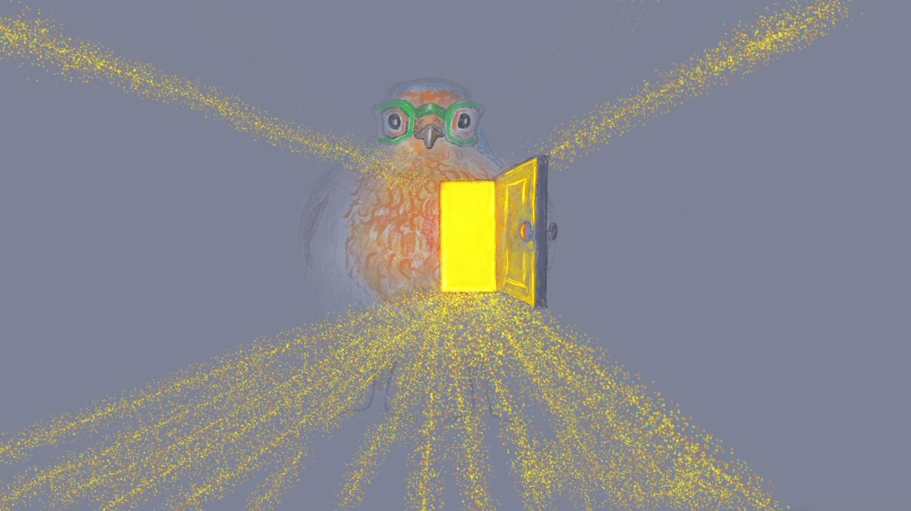
Send Rays
of Heartle
to the
Big Hearted Ones
Press to play

Slide 9
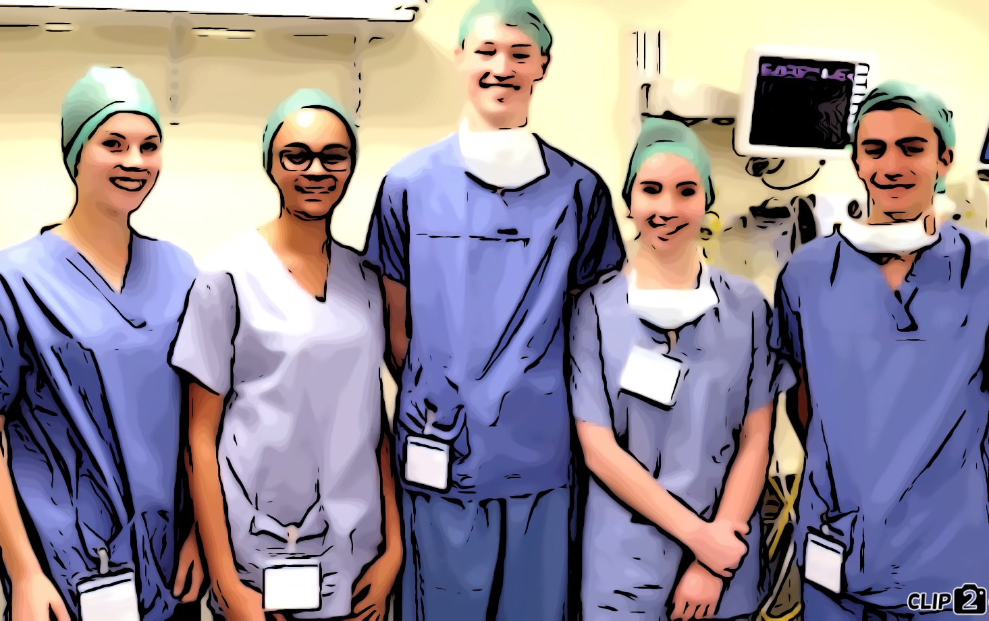
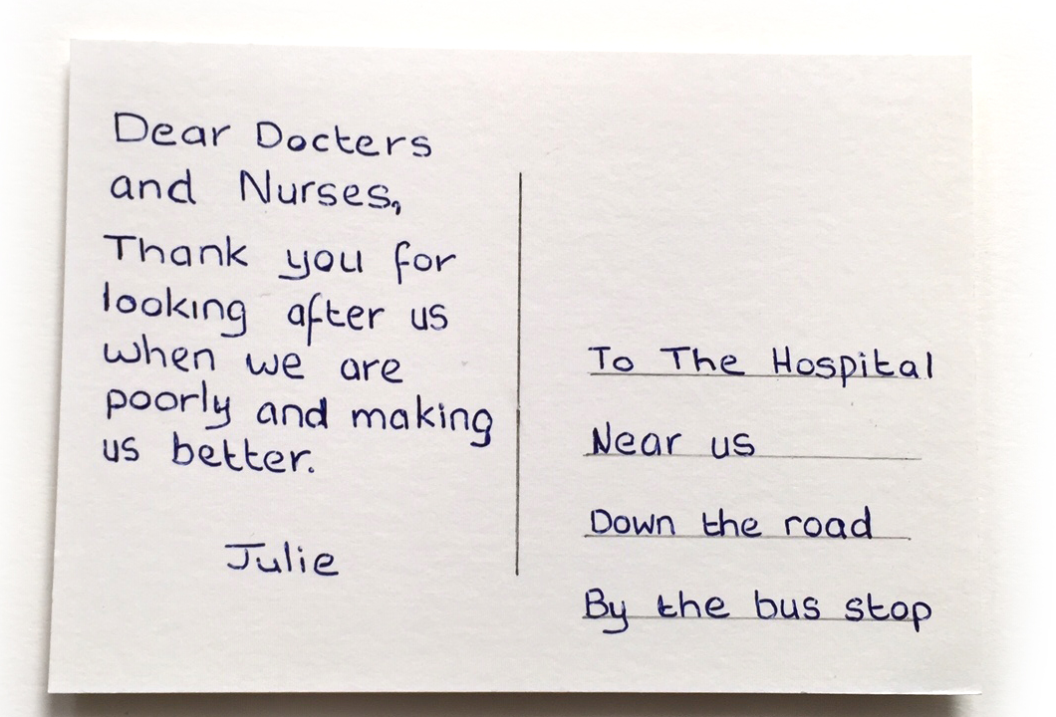
Big thanks postcard
big thanks to the
BIG HEARTED ONES
Big thanks to the
BIG HEARTED ONES
Big thanks postcard
Together, make a list of all the people that take care of us in some way.
Choose who you would like to thank.
Make a postcard with a drawing of them.
Write a thank you message on the back.
Collect them from everyone in the school and deliver them. It will make their hearts even bigger.

Slide 10
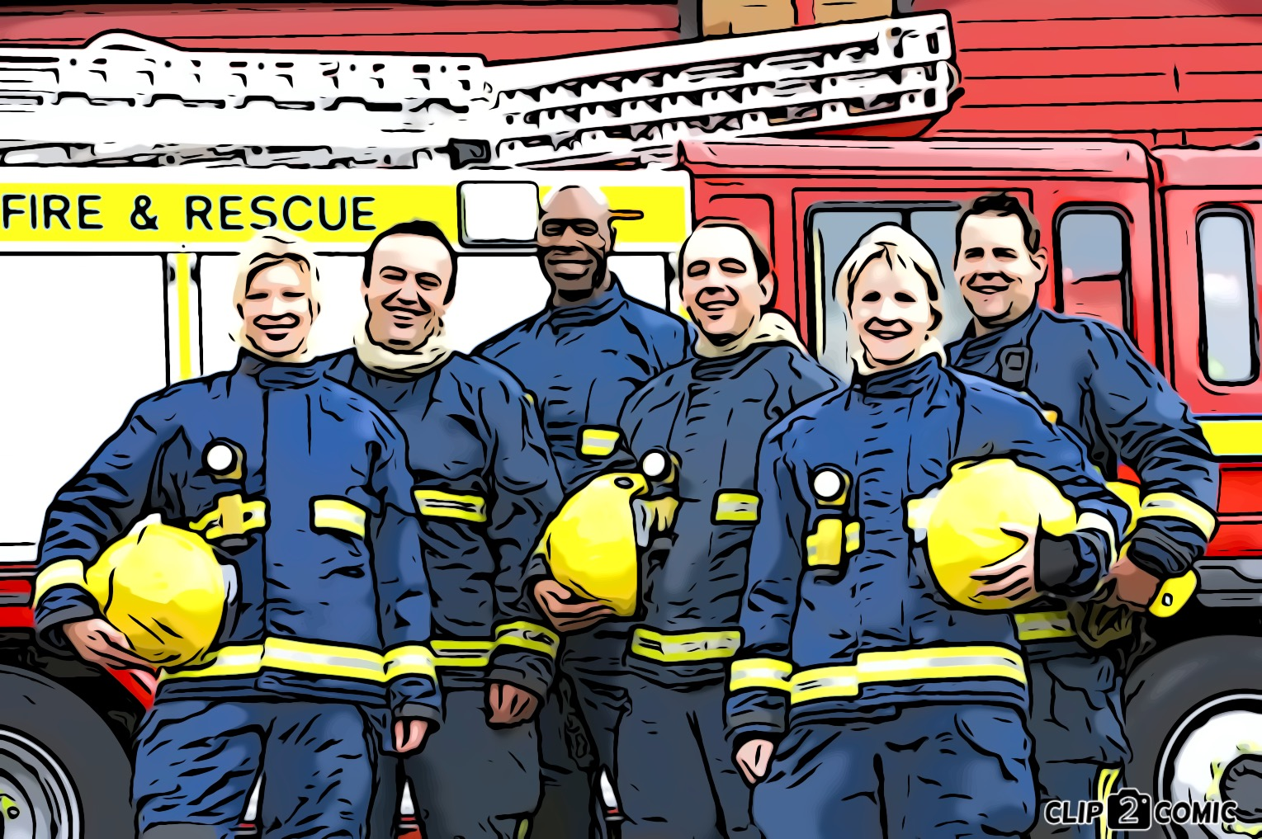
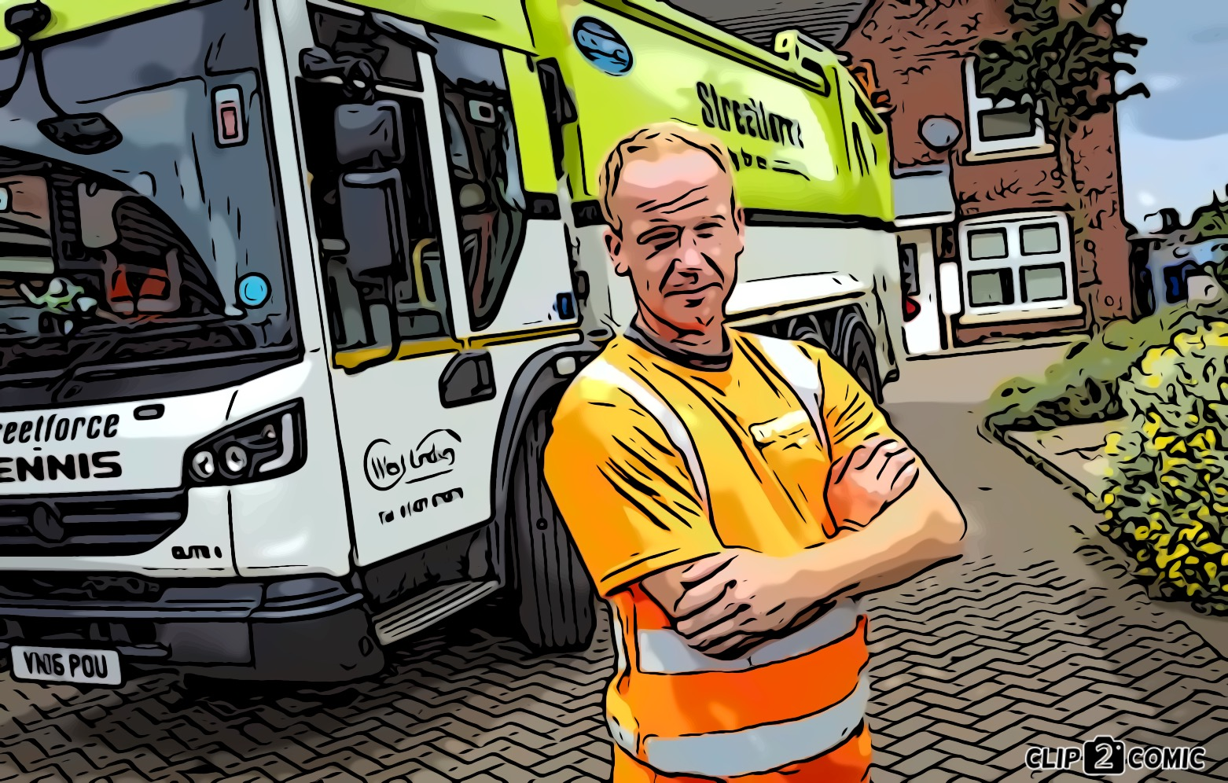
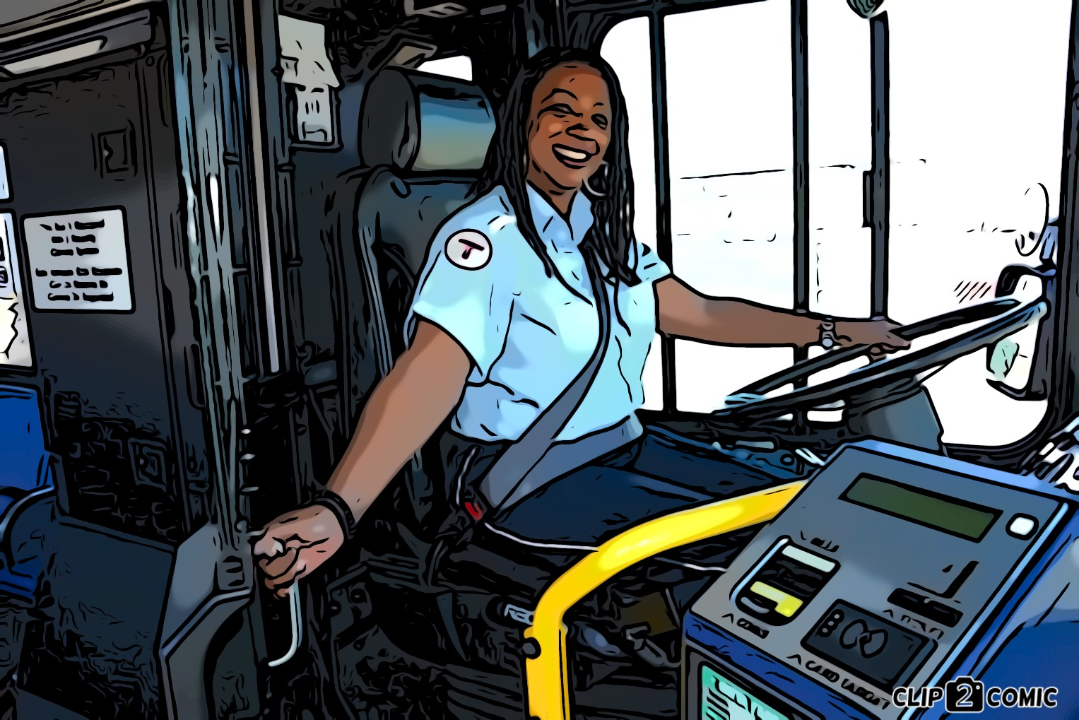
THE
BIG HEARTED ONES

Slide 11

Click for kids folk dancing website
http://resources.hwb.wales.gov.uk/VTC/2017/dawnsio-gwerin-english/index.html

Slide 12
End of the day stretches
Make your body loose and free

